Slide 1
Comedy in Modern British Literature
A mini-lesson on Douglas Adams and Terry Pratchett

Slide 2
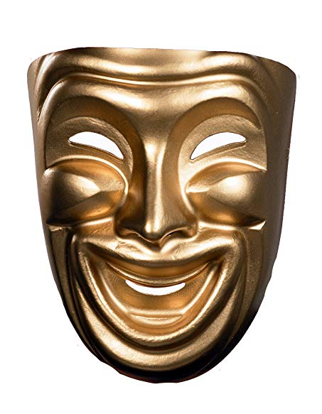
Why so serious?
Humor has been used throughout history in literature, theater, films, songs, video games – all forms of media, really.
Like genre-fiction, if a work is thought humorous, it is often discounted as being “not serious,” not “serious literature,” not worthy of “serious study” or concern. This is not necessarily true.
Humor is often used to highlight
  The absurdities of life, human nature, the world, etc.
  To satirize or parody real-world concepts and issues.
  To create a period of “comic relief” or rest between times of stress and danger in a lengthy work.

Slide 3
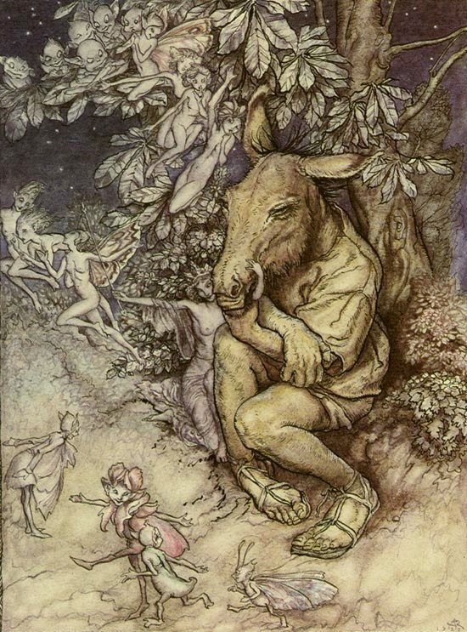
Famous Literary Works to Use Humor
Lysistrata by Aristophanes (411 BC)
  - Wherein wives keep men from going to war by threatening to have no more…”alone time.”
The Comedies (i.e. Midsummer, Merry Wives, etc) by Shakespeare (1590-1613 AD)
  - While the definition of Shakespearean comedy does not mean humor as it does with modern films, they usually contained many humorous lines and situations.
Don Quixote de la Mancha by Miguel de Cervantes Saavedra (1605 AD)
  - Wherein a man reads too many tales of medieval romance, becomes delusional, and believes himself a knight. He then goes on wild adventures with a peasant turned squire, Sancho Panza, in a time when knights have long since gone from the world.
Candide by Voltaire (1759 AD)
  - Wherein a boy is raised to believe that since God created the world, and God is perfect, this must be a perfect world, and everything that happens is good, and should happen. He has many problems in life, usually resulting in dramatic irony and humor throughout.
And many, many others.

Slide 4
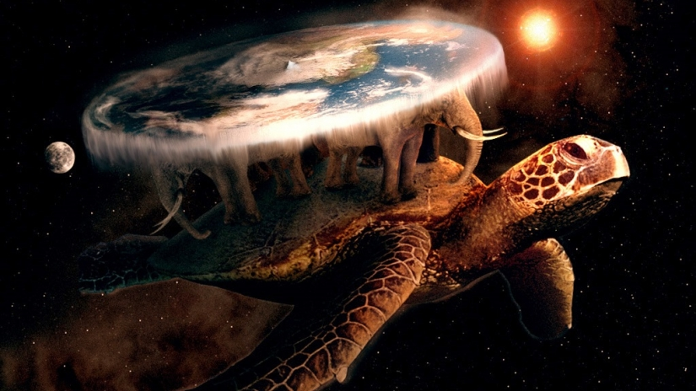
Modern Literary Works to Use Humor
Noteworthy authors of modern British literature to use humor include the following:
  Terry Pratchett – Author of the fantasy series The Colour of Magic (1983-2015, with over 40 books in all). Herein is a world that resides on a flat disc, on the backs of four elephants, on the back of a giant turtle, floating through space. The entire series parodies many typical fantasy-genre concepts and ideas while also poking fun at various aspects of life and human nature in general.

Slide 5

Modern Literary Works to Use Humor
Douglas Adams – Author of a science-fiction series The Hitchhiker’s Guide to the Galaxy (1978-2001, around 6 books in all). Herein, a human, Arthur Dent, discovers that his best friend is an alien and ends up traveling the galaxy for a variety of insane and wacky adventures. Much absurdity follows.

Slide 6
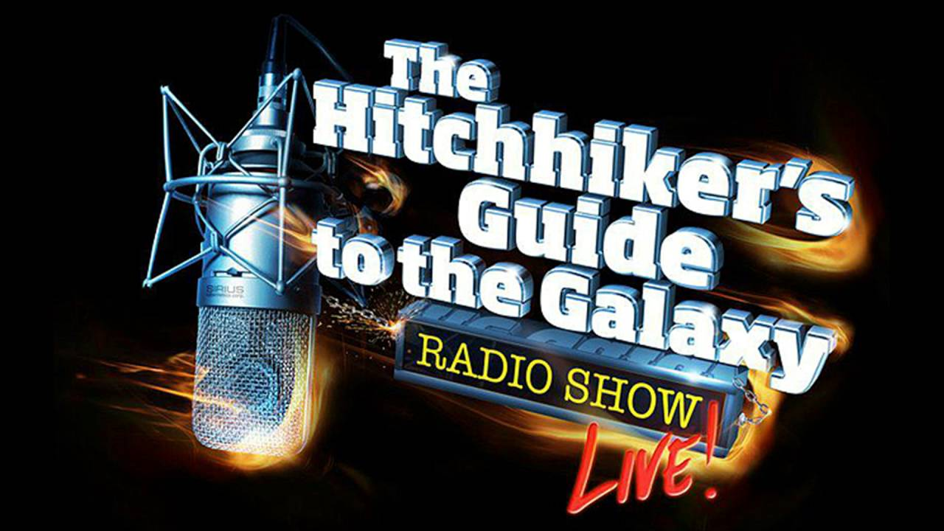
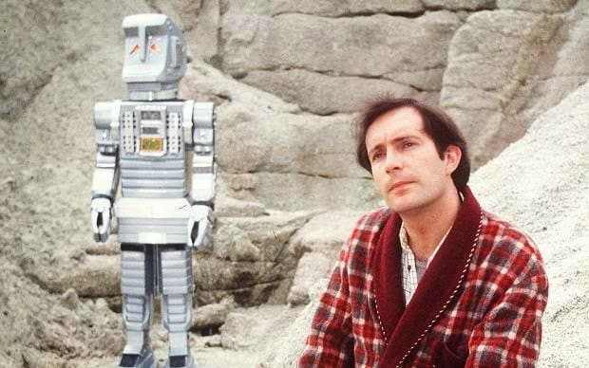
Hitchhiker’s Guide to the Galaxy
BBC Radio Drama (1978)
BBC Television Adaptation (1981)

Slide 7
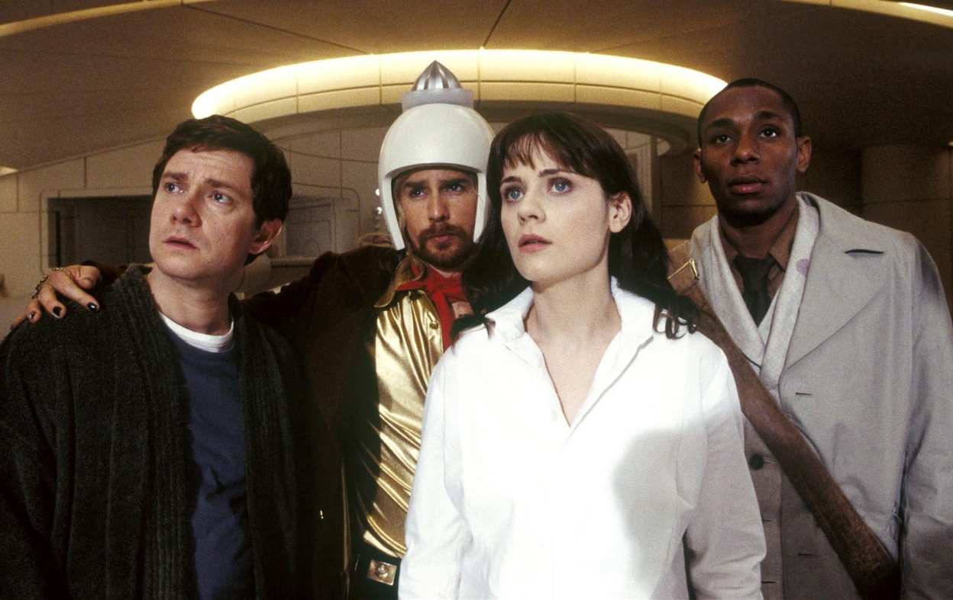
Most Recent Film (2005): Cast, left to right:
Martin Freeman as Arthur Dent, Sam Rockwell as President Zaphod Beeblebrox, Zoey DeSchanel as Trillian, and Mos Def as Ford Prefect

Slide 8
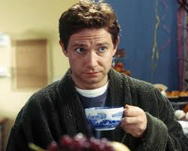
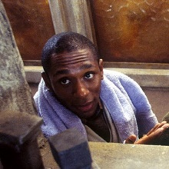
Main Characters
Arthur Dent, human, who until the beginning of this book did not know anything about aliens. Ends up roaming the galaxy in his bath robe.
Ford Prefect, an alien disguised as human, on Earth to write an article for the Hitchhiker’s Guide to the Galaxy, and Arthur’s best friend.

Slide 9
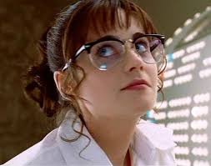
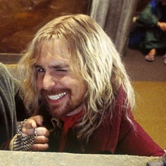
Main Characters
Tricia McMillan (Trillian) – Arthur fails to impress Trillian at a party on Earth. She subsequently goes off with a man that claims “I’m from a different planet. Want to see my space ship?”
Zaphod Beeblebrox – President of the galaxy, has two heads and three arms, friends with Ford, and the same man that picked up Trillian from the Earth party.

Slide 10
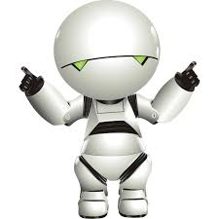
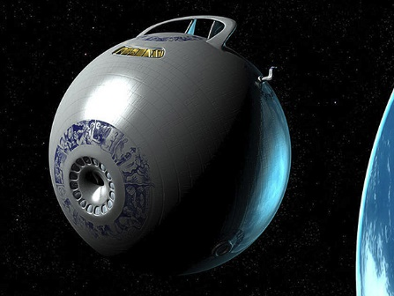
Main Characters
Marvin – A clinically depressed robot.
The Heart of Gold – an experimental talking ship whose drive runs on improbability. Zaphod steals the ship and the cast travel about the galaxy in it for the bulk of the series.

Slide 11
Readings from The Hitchhiker’s Guide
For the next week, we’ll read some select scenes from the beginning of the Hitchhiker’s Guide.
Afterward, we will watch the 2005 film adaptation.

