Slide 1
The Hitchhiker’s Guide to the Galaxy by Douglas Adams
Notes for Chapters 25-30(Pgs 166-194)

Slide 2
Chapter 25 (Pgs 166 – 174)
Previously…
…The Heart of Gold arrived outside the airspace of planet Magrathea, mythical site of a once burgeoning and wildly expensive industry for building custom-made planets.
According to the automated message system, they are all out and not accepting guests at the moment. Zaphod ignores this, and pushes forward. The message system then (politely) fires two thermo-nuclear missiles at the ship.
Ironically, Arthur, he who knows the least about space and space travel of the group, recommends the solution that saves them all – engaging the Infinite Improbability Drive.
Doing so not only saves them, but turns the missiles into a whale (whose brief existence is symbolic of humankind’s and the pointlessness of trying to find meaning in so short a time) and a bowl of petunias (who says, “Oh no, not again.”
Thereafter…
…Zaphod, Ford, and Trillian are gassed and knocked out.
Arthur abandons Marvin, meets Slartibartfast, and learns that the Earth was commissioned to be built by the Magratheans by a race of pan-dimensional alien beings that, in our universe / dimension, appear only as…mice.
Mice made the Earth.
There’s a backup Earth.
Now, we get to learn why they made the Earth, and what happens next.

Slide 3
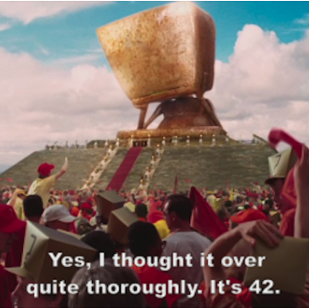
Chapter 25 (Pgs 166 – 174)
Long, long ago, the pan-dimensional beings we know as mice created a super-computer called Deep Thought.
Deep Thought’s purpose was to solve something pretty big. To find an answer.
What answer was it supposed to find?
This program is predicted to take 7.5 million years.

Slide 4
Chapter 26 (Pgs 175)
This chapter is brief and uneventful.
Arthur asks about the rest of the story, and Slartibartfast takes him to his study to hear the rest.

Slide 5
Chapter 27 (Pgs 176 - 181)
They get to his office, and Slartibartfast plays the rest of the story for Arthur.
(Pg 181) What is the answer to life, the universe, and everything?
How is this…less than satisfactory? Less than helpful?
Absurd?

Slide 6
Chapter 28 (Pgs 182 - 184)
Needless to say, the mice folks were not happy. Not satisfied.
Deep Thought reveals that there is an Ultimate Question it can calculate, in order to further reveal what the Ultimate Answer, 42, means. To contextualize it a bit.
However, that will take even longer to compute: 10 million years.
Additionally, Deep Thought is not the computer to do it. It will be building the computer that will then do the 10 million year program to find the Ultimate Question.
What is the name of that computer? (Pg 184).
How is this…bad news?
By the way, if this all seems like a wild goose chase – that’s the point. What is Douglas Adams saying, through all this absurdity, about humankind’s efforts to try to find the meaning of life? The point of it all?

Slide 7
Chapter 29 (Pgs 185 - 191)
We finally return to Zaphod, Ford, and Trillian. Last we saw them, they’d been gassed / knocked out in the chamber down the tunnel, beneath the surface of Magrathea.
Zaphod rambles for a bit, then tells Ford why he decided to become President of the Galaxy, why he steal the Heart of Gold (Pg 189-190).
He still doesn’t know why he did those things. Partly, his surgical mishaps with his own brain were an effort to ensure he didn’t know the whole plan until he needed to – so that no one else could predict it and stop him.

Slide 8
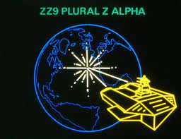
Chapter 30 (Pgs 192 - 194)
As the two groups are slowly drawn back together to meet the mice, Arthur learns the ultimate irony from Slartibartfast.
How close was Earth to computing the Ultimate Question when the Vogons destroyed it? (Pg 192)
“Well, that’s bureaucracy for you.” – A line that’s a theme for the whole book.
“The chances of finding out what is really going on are so absurdly remote that the only thing you can do is say hang the sense of it and just keep yourself occupied.” (Pg 193).
Another theme for the book.
What does that mean, exactly?
How does Douglas Adams’ plot support this?
Granted, Douglas Adams wouldn’t be consistent if he didn’t admit that he doesn’t know the answer, either:
“’I’d far rather be happy than right any day’…’And are you?’…’No. That’s where it all falls down, of course.’” (Pg 193).
Next time…the meeting with the mice, and the book’s conclusion.

