Slide 1
The Hitchhiker’s Guide to the Galaxy by Douglas Adams
Notes for Chapters 5 - 7 (Pgs 45 – 75)

Slide 2
Chapter 5 – Pgs 45 - 56
Who is Prostetnic Vogon Jeltz?
How does the author describe him? (Pg 45)
What planet are they from? (Pg 46)
Do they have much in the way of learning or manners?
An appreciation of beauty?
A love of hitchhikers?

Slide 3
Chapter 5 – Pgs 45 - 56
Who are the Dentrassis? (Pg 47)
How do they feel about food?
What do they love about their bosses, the Vogons? What do they hate?

Slide 4
Chapter 5 – Pgs 45 - 56
(Pg 48) We return to Arthur and Ford, whom we have not seen since the destruction of the Earth. The author has purposefully left us in suspense for a couple chapters.
We also revisit the definition of absurd humor: typically exaggerates things, misleads the audience, tries to take the audience by surprise, and goes in unexpected directions.
How are some of the things Arthur says a little unexpected? (Pg 49)
(Pg 50) Arthur asks when he can go home. What has he forgotten?

Slide 5
Chapter 5 – Pgs 45 - 56
(Pgs 50 – 51) Notice the irony in Jeltz’s sections of these pages.
What impact does the new form of spaceship (aka the Heart of Gold) have on what the Vogons have just done? On what happened to Earth?
How does this further serve to parody bureaucracy and government efficiency?

Slide 6
Chapter 5 – Pgs 45 - 56
(Pg 52) Ford introduces Arthur to the Guide, starting with an entry on Vogons, and going from there.
How much do Vogons love paperwork (i.e. bureaucratic process?)
(Pg 54) What is a Teaser?
(Pg 55-56) What does Ford stick in Arthur’s ear? Why?

Slide 7
Chapter 6 – Pg 57 - 63
(Pg 57) What does Jeltz threaten to do to the hitchhikers…if they’re lucky?
Why does he cancel his employees’ leave / time off?
(Pg 58) What does hyperspace feel like?
“What’s so unpleasant about being drunk?”
(Pgs 58 – 60) The Babel Fish is further explained. Essentially, what does it do?

Slide 8
Chapter 6 – Pg 57 - 63
(Pg 60 – 61) Note Arthur’s continued difficulty with grasping that the Earth is gone.
Contemplate how sometimes, things are too big for us to understand? Not just factually, but emotionally understand or grasp with our imaginations.
What thing finally makes the loss hit home for Arthur? (Pg 61)
(Pgs 62 – 63) – Ford came to Earth to update the entry for Earth in the Guide. What was it originally, and what does the updated entry say, now?

Slide 9
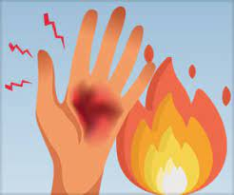
Chapter 7 – Pg 64 - 75
(Pg 64). Whose poetry is the third worst in the galaxy?
Second worst?
First worst?
How does the author’s building up like this deliver a very nasty “burn” to whoever Nancy was?
How do the effects of this poetry illustrate absurd humor?

Slide 10
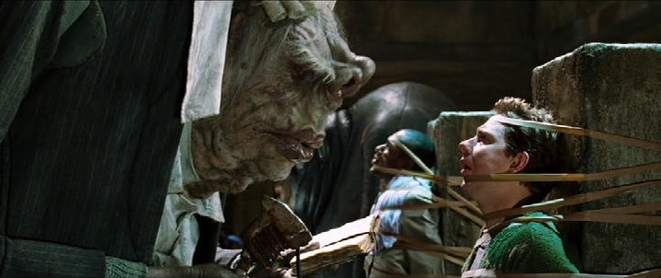
Chapter 7 – Pg 64 - 75
How does Ford take the poetry? (Pg 65)
How does Arthur take an unexpected strategy after the poem? (Pg 66/67).
Does it work? (Pg 68)
(Pg 68 – 69) They are carried off to receive their punishment. What does the guard keep repeating? What is the author saying about the intelligence of the guard, by this?
(Pgs 70 – 73) What does Ford try to use to persuade the guard to let them go?
(Pgs 71-72) What parts of his job does the guard like? And how is this a sign that Ford’s attempts probably won’t work?

Slide 11
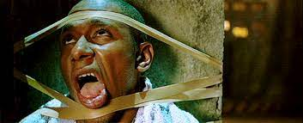
Chapter 7 – Pg 64 - 75
(Pg 73) More absurd humor with Ford’s last attempts to survive.
“Da da da dum! Doesn’t that stir anything in you?”
“No…not really. But I’ll mention it to my aunt.”
(Pg 74) Ford thought of something. What’s the problem?
(Pg 75) Saying the unexpected to create absurd humor.
“It’s at times like this…that I really wish I’d listened to what my mother told me.”
“Why, what did she tell you?”
“I don’t know. I didn’t listen.”

