Slide 1
The Hobbit
Discussion Notes for Chapter 1
Notes:
This book to be checked out to each of you in paperback form. Please take care of these, read them at home (one chapter a night, four nights a week, until completion – chapter 7 is optional), and turn them back in on the last day of assigned reading (during Week 17, before finals). Remember that not turning the book back in during that week will result in fees owed.

Slide 2
J. R. R. Tolkien - Life of the Author
J. R. R. Tolkien was British by ethnicity, but born in South Africa. By religion, he was Roman Catholic.
He participated in World War I, but also lived to see the ravages of World War II.

Slide 3
J. R. R. Tolkien - Life of the Author
He studied literature (especially medieval European literature) and linguistics, became a very prominent scholar and professor in both fields, and began writing both fantasy novels and scholarly defenses of the study of fantasy. His most prominent works are Roverandom (written for his son when he was still a small child), The Hobbit, The Lord of the Rings, The Silmarillion, and many others.

Slide 4
J. R. R. Tolkien - Life of the Author
The latter three take place in one massive and highly detailed fictional world, the most famous part of which is called Middle Earth. Many of the peoples, places, names, stories, traditions, etc, used in Tolkien's mythos are pulled from or inspired by European literature and mythology and blended with his original creations.

Slide 5
Things to Focus On
There’s a lot going on in The Hobbit, and there are many different things to focus on / discuss.
However, let’s focus on a few main things as we go along:
Surface Level – What’s the basic situation? Who are the important characters? What are their traits?
Language – What does the author’s word choice say about a character or situation? How might we find beauty in the songs, poetry, and word choice?
Fantasy Genre – How does a work of fantasy use “the journey,” fantasy races, etc, to talk about aspects of real life?
Intertextuality – How does The Hobbit pull ideas from older works, such as Beowulf and mythology, and puts a new spin on them?

Slide 6
Literary Concepts
Fantasy – literature that is unrealistic and often magical in nature, dealing with fictional places, creatures, etc.
Mythos – The fictional universe in which a work of fantasy takes place, including all races and creatures, rules, histories, maps, etc)
Characterization – The methods a writer uses to develop a character. Characters can be developed directly (the author telling us how the character is,” through dialogue, or through actions.
Exposition – A portion of writing that explains the basic situation of the story, the problem, introduces the main characters, etc.
Infodump – A common term for when a work of scifi/fantasy gives a large block of information that explains how the fictional world works. It feels more like an encyclopedia entry or tour-guide speech than actually flowing with the story naturally.

Slide 7
Literary Concepts
Fantasy Plot-Types
Portal-Quest – Wherein the protagonist leaves a normal / mundane world through a portal or portal-like opening to get to the fantastical world beyond.
Immersive – Wherein the protagonist is a native of the fantasy world.
Intrusion – Wherein the fantasy world “intrudes” into the normal world to reach the protagonist.
Liminal – Wherein the fantasy world stays at the edges of the normal and is only hinted at or suggested.
(Not rigid categories, but helpful concepts)

Slide 8
What are Hobbits?
As this is a fantasy story, we’re dealing with fantasy races.
The first few pages deal primarily with introducing our first fictional race, Hobbits, and our main character /protagonist, Bilbo Baggins.
As we go along, take note of the traits Tolkien uses to characterize each fantasy race – Hobbits, dwarves, goblins, elves, trolls, dragons, humans, etc.

Slide 9
First lines are always important:
Hobbits vs. Rabbits. What do they have in common?
Look for this as we continue.
Notes:
"In a hole in the ground there lived a hobbit" - Pg 1

Slide 10
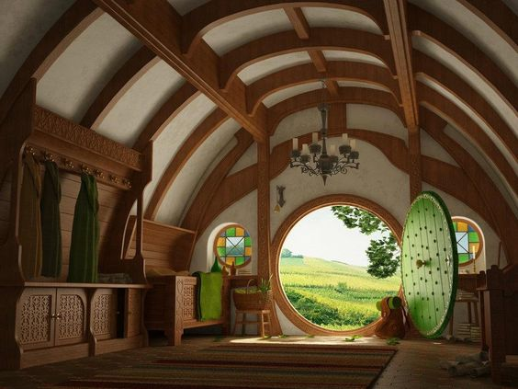
Page 1
What do Hobbits like?
What do they value?
Notes:
"It was a hobbit hole, and that means comfort." - Pg 1

Slide 11
Page 1
Why would the author tell us this?
To show how Bilbo is strange - different - stands out from the rest.
Notes:
"This is the story of how a Baggins had an adventure."

Slide 12
Page 2
Other Hobbits respect Bilbo Baggins's family because
From this statement, what do Hobbits value in their culture? What do they dislike?
Notes:
"Not only because most of them were rich, but also because they never had any adventures or did anything unexpected." - Pg 2

Slide 13
Page 2
Traits of a Hobbit:
Short (half the size of an average human)
Smaller than dwarves
No beards
Handy with tools
Love laughter
Little to no magic
Extraordinary talent (magical ability?) to become unseen /unnoticed by larger creatures. Not literally invisible, just unnoticed.
"Well fed" in the stomach area.
Dress in bright colors.
No shoes
Leathery bottoms to their feet, hair on top.
They eat about six times a day (second breakfasts, etc)
Love giving and receiving presents
Notes:
"What is a Hobbit?" - Pg 2

Slide 14
Page 3
Bilbo's mother, Belladonna Took, and her family, came from "across the water" - a vague wording for farther away than normal.
Bilbo might be tempted into an adventure because, unlike other hobbits, his ancestors liked adventures.
Notes:
"One of the Took ancestors must have taken a fairy wife. That was, of course, absurd" - Pg 2
"Once in a while the Took-clan would go and have adventures" - Pg 3
Notice also the attention to ancestry - think back to how Beowulf paid close attention to ancestry. Tolkien himself was a huge Beowulf scholar.

Slide 15
Page 3
We get the idea here that the different races have different typical lifespans.
Fifty is middle-aged for us, but it would seem younger for Hobbits.
Notes:
"Until Bilbo Baggins was grown up, being about fifty years old or so" - Pg 3

Slide 16
Page 3
Bottom of Page 3 - The story leaves off explaining Hobbits and Bilbo to actually start the events of the story. Here we are also introduced to our second important character, Gandalf the Wizard.
Let's read together starting at "By some curious chance" - Pg 3 and ending at the very top line of page 7. Look at what these pages tell you about Bilbo's personality, Gandalf's personality, etc.
Notes:
"Bilbo Baggins was standing at his door after breakfast smoking an enormous long wooden pipe that reached nearly down to his woolly toes (neatly brushed)--Gandalf came by." - Pg 3
This statement opens the initial, "basic situation." One morning, a normal morning like any other, Gandalf intrudes upon Bilbo's life and intends to change it - to break him from the "normal."
If the magical element is entering into the normal life and setting of Bilbo's home (the Shire), what plot type are we dealing with at the moment?

Slide 17
Page 4
Notice the wordplay in Gandalf's analysis of "Good morning" - pg 4.
Characterization - priorities. What are Bilbo's priorities this morning? What are Gandalf's?
Notes:
"There's no hurry, we have all the day before us!" - Bilbo
"I have no time to blow smoke-rings this morning. I am looking for someone to share in an adventure." - Gandalf
"We are plain quiet folk and have no use for adventures. Nasty disturbing uncomfortable things! Make you late for dinner!" - Bilbo

Slide 18
Page 5
How is Bilbo using it now, in a new way? How is this breaking with his usual courtesy / manners?
"Goodmorninged" - ironic, as good morning is usually wishing someone well.
Notice the change in Bilbo now that he knows who he's talking to.
Notes:
"What a lot of things you do use Good morning for!" - Gandalf, pg 5
"I am Gandalf, and Gandalf means me!" –
Gandalf, chiasmus, a bit overdramatic. Apparently, he's someone important. Someone well known.
Notice how many of the things were marvels from his childhood, how he looks back on them fondly.
Think about Alice getting back into the garden - certain aspects of childhood remain alluring even in adulthood.
Tales.
Fireworks.
Midsummer's Eve - these types of celebrations are common in Europe.

Slide 19
Page 6
What does this foreshadow for Bilbo?
How is Bilbo show ambivalence (mixed feelings) about Gandalf, here?
How does this mean two things? What did he literally ask for? What does Gandalf think he needs?
Notes:
"Not the Gandalf who was responsible for so many quiet lads and lasses going off into the Blue for mad adventures?" - Bilbo, Pg 5-6
"Bless me, life used to be quite inter--I mean, you used to upset things badly in these parts" - Bilbo, Pg 6
"I will give you what you asked for." - Gandalf, Pg 6

Slide 20
Page 7-11
Meanwhile, dwarves show up, unannounced. Many dwarves. Pgs 7-11
Dwalin, Balin, Kili, Fili, Dori, Nori, Ori, Oin, Gloin, Bifur, Bofur, Bombur, and Thorin Oakenshield.
Which one do you think is the most significant? How can you tell?
Notes:
Each practically help themselves to all the food and drink that Bilbo has in his home. What does this scene tell you about dwarven manners / hospitality vs. hobbit hospitality?
Eventually, Gandalf shows up. Pg 11.
A song / poem on page 12 helps characterize dwarven humor (digging at poor Bilbo, making him nervous for the sake of humor, all the while helping him do the dishes).

Slide 21
That’s What Bilbo Baggins Hates
Chip the glasses and crack the plates! Blunt the knives and bend the forks! That's what Bilbo Baggins hates-- Smash the bottles and burn the corks!
Cut the cloth and tread on the fat! Pour the milk on the pantry floor! Leave the bones on the bedroom mat! Splash the wine on every door!
Dump the crocks in a boiling bowl; Pound them up with a thumping pole; And when you've finished, if any are whole, Send them down the hall to roll!
That's what Bilbo Baggins hates! So, carefully! carefully with the plates!
Notes:
Notice that Tolkien uses poems / verse embedded in prose. Think about how Alice did the same. Most authors choose either prose or verse, but others blend them for various effects.

Slide 22
Page 13
They leave off one song and dive into another. Dwarves are apparently very musical people.
Let's read pages 14 - 15 together. We'll listen to various musical versions of this song, later. It serves to lay out the basic situation of the dwarves' quest, the main plotline of the novel, itself.
Notes:
"Now for some music!" said Thorin. Pg 13. (Discuss exposition, infodump, etc.

Slide 23
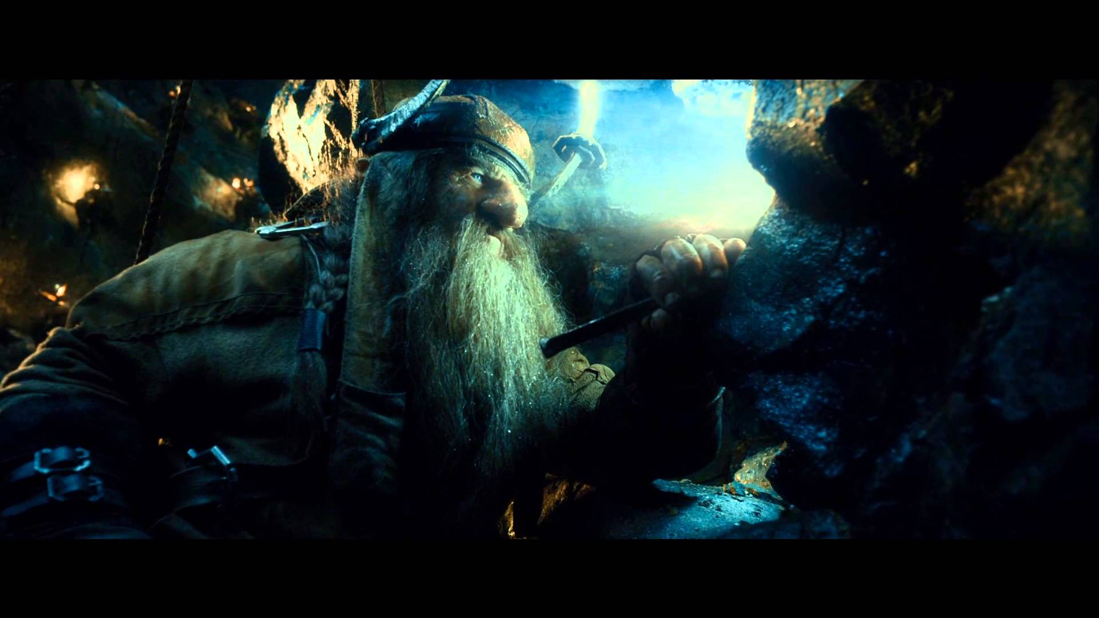
Far Over the Misty Mountains Cold
Far over the misty mountains cold To dungeons deep and caverns old We must away ere break of day To seek the pale enchanted gold.
The dwarves of yore made mighty spells, While hammers fell like ringing bells In places deep, where dark things sleep, In hollow halls beneath the fells.
For ancient king and elvish lord There many a gleaming golden hoard They shaped and wrought, and light they caught To hide in gems on hilt of sword.
On silver necklaces they strung The flowering stars, on crowns they hung The dragon-fire, in twisted wire They meshed the light of moon and sun.
Far over the misty mountains cold To dungeons deep and caverns old We must away, ere break of day, To claim our long-forgotten gold.

Slide 24
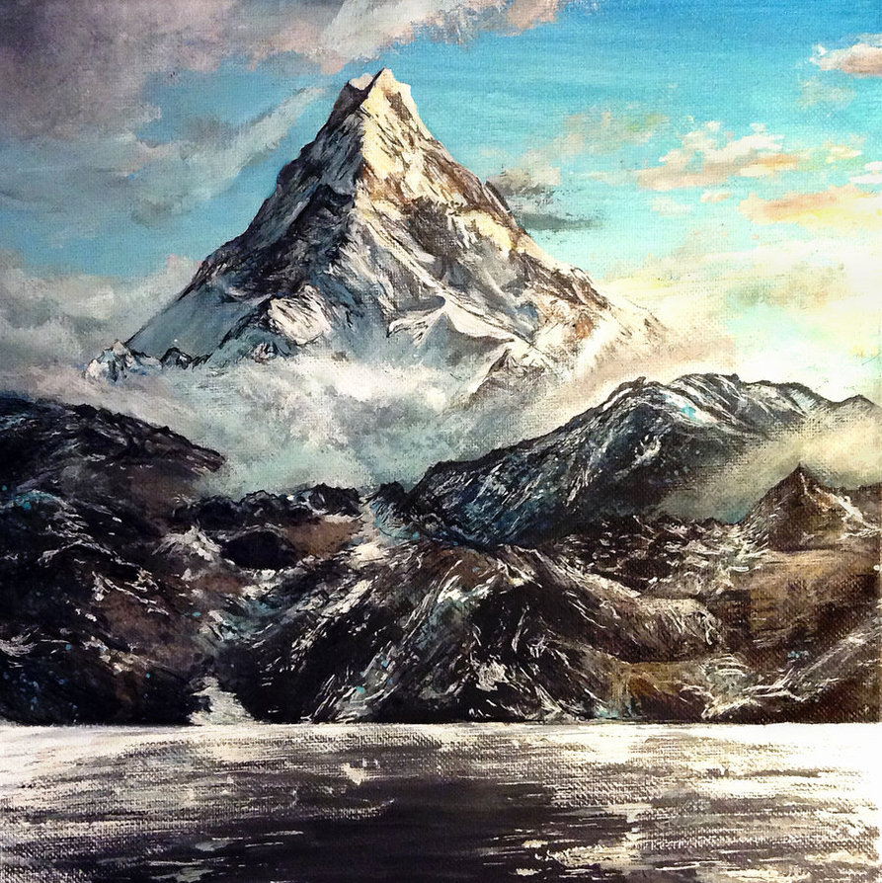
Continued
Goblets they carved there for themselves And harps of gold; where no man delves There lay they long, and many a song Was sung unheard by men or elves.
The pines were roaring on the height, The winds were moaning in the night. The fire was red, it flaming spread; The trees like torches blazed with light.
The bells were ringing in the dale And men they looked up with faces pale; The dragon’s ire more fierce than fire Laid low their towers and houses frail.
The mountain smoked beneath the moon; The dwarves they heard the tramp of doom. They fled their hall to dying fall Beneath his feet, beneath the moon.
Far over the misty mountains grim To dungeons deep and caverns dim We must away, ere break of day, To win our harps and gold from him!

Slide 25
Pages 15-16
What is this desire that the dwarves' song has stirred in Bilbo?
Have you ever felt anything like this?
Note the imagery in this paragraph - how vivid and visual the descriptions are of the things Bilbo imagines.
Notes:
"As they sang the hobbit felt the love of beautiful things made by hands and by cunning and by magic moving through him, a fierce and jealous love, the desire of the hearts of dwarves. Then, something Tookish woke up inside him, and he wished to go see the mountains, and hear the pine-trees and the waterfalls, and explore the caves, and wear a sword instead of a walking stick." - Pg 15-16

Slide 26
Page 16
Notice how immediately after Bilbo is filled with wonder, he starts to worry. He starts to fear the dark.
Why might dwarves like the dark more than hobbits?
How is "dark" used figuratively, here?
What other meaning could there be for "There are many hours before the dawn," especially when stated so near the beginning of the book?
Notes:
"He thought of plundering dragons" Pg 16
"He shuddered."
"The music and the singing had stopped, and they were looking at him with eyes shining in the dark."
"'What about a little light' said Bilbo...'We like the dark,' said all the dwarves, 'Dark for dark business! There are many hours before the dawn."

Slide 27
Pages 16-17
Notice that on pages 16 and 17, the same plans discussed in song are now discussed more plainly.
What are Thorin and company's main objectives?
What do Bilbo's reactions tell us about him?
Notes:
"This was Thorin's style. He was an important dwarf." - What does this mean? What does this tell us about Thorin?
What do they plan to do? Why?
"At may never return he began to feel a shriek coming up inside"
"The poor little hobbit could be seen kneeling on the hearth-rug, shaking like a jelly that was melting."
"Excitable little fellow...Gets funny queer fits, but he is one fo the best, one of the best--as fierce as a dragon in a pinch." - Gandalf, pg 17
How does he have two natures / how does he feel torn inside about this mission?
How is he different from some of our other protagonists? Beowulf? Gawain?
How does this make him more relatable to a modern audience?
How convincing is this?

Slide 28
Page 18
What does this tell us about hobbits?
How is Bullroarer Took an exception to this rule?
What's important about him being a Took, to our current situation?
Did they have many grocery stores in medieval times (or medieval themed fantasy worlds)?
Why the use of modern language?
Notes:
"This was only poetical exaggeration when applied to any hobbit." - Pg 18
"He looks more like a grocer than a burglar!" - Pg 18.
Again, relatable. How many of you have worked at grocery stores or fast food restaurants or any other "normal" job from the "modern" world? How many of us would be afraid to face dragons, to face the things that people like Beowulf and Gawain seemed all too happy to face?

Slide 29
Pages 18-19
Bottom of 18 / Top of 19 - Notice the change in Bilbo when he hears their doubts.
How many times in movies have people been called coward, yellow, chicken, etc, only to turn right around?
Think about Marty McFly in Back to the Future, if you're familiar. This was a running theme in the films.
Notes:
"Pardon me...if I have overheard your words that you were saying. I don't pretend to understand what you are talking about, or your references to burglars, but I think I am right in believing...that you think I am no good. I will show you...Tell me what you want done, and I will try it, if I have to walk from here to the East of East and fight the wild Were-worms in the Last Desert." - Bilbo - Pg 18-19

Slide 30
Page 19
Why did they want a fourteenth man?
What have the dwarves been doing all this time, since leaving the Lonely Mountain?
What title(s) are they using to refer to Bilbo's role in the upcoming adventure?
Who else "burgled" or stole from a dragon's treasure mound?
Notes:
"You asked me for the fourteenth man for your expedition, and I chose Mr. Baggins. Just let any one say I chose the wrong man or the wrong house, and you can stop at thirteen and have all the bad luck you like, or go back to digging coal." - Gandalf - Pg 19

Slide 31
Page 20
As we reach page 20, Gandalf produces a map he's been holding onto for quite some time.
What does the map show?
What's hidden?
Why do they believe Smaug, the dragon, has not seen it yet?
This relates to Bilbo in some ways, and to hobbits in general. What are they known for?
Notes:
"He loved maps." - Pg 20
Note that Bilbo loves maps. Yet what has he never done? Ironic.

Slide 32
Pg 21
Here, Gandalf gives Thorin a silver key.
Where else have we seen a shiny key, in fantasy?
This is a motif in fantasy works - special keys, hidden doors, etc.

Slide 33
Pg 21-22
Who would we usually expect to take on a quest like this?
How many of your neighbors or friends could you imagine going off to slay dragons? Normal people?
Notes:
“‘That would be no good,’ said the wizard, ‘not without a Warrior, even a Hero. I tried to find one; but warriors are busy fighting one another in distant lands, and in this neighborhood heroes are scarce, or simply not to be found.’” - Pg 21-22

Slide 34
Pg 22
Herein, Gandalf shows Bilbo and the dwarves a map.
What do maps imply in a story?
Notes:
Think about how can journeys be both literal and figurative. External and internal.

Slide 35
Pg 22
Bilbo wants it down to earth and down to business.
A very business-like approach to heroic and fantastical deeds.
Notes:
“First I would like to know a bit more about things.” – Bilbo
“’Bless me!...Haven’t you got the map? And didn’t you hear our song? And haven’t we been talking about this for hours?” – Thorin
“All the same, I should like it all plan and clear.” – Bilbo
“Risks, out-of-pocket expenses, time required, renumeration”

Slide 36
Pgs 22-25 – The InfoDump
Herein, Thorin plops the entire tale, in one lengthy block of prose, into the book.
What did the dwarves do when they lived “under the mountain?”
How successful were they?
What was their relationship with elves and humans?
What changed all that?
Notes:
“Undoubtedly, that was what brought the dragon.”
Notice how this is worded, as if it were common sense, something we ought to know.
Think about how the old tales (i.e. Beowulf) have already taught us this.

Slide 37
Smaug, Greatest and Most Terrible of Calamities
What does Smaug the dragon “do” with all that gold?
Notes:
Gives new meaning to having more money than you can possibly use. He doesn’t quite use it at all. He just loves having it. Greed to the ultimate degree.

Slide 38
Pg 25
Who is Thorin to the late King Under the Mountain?
.
What does Thorin think of hard work, tradework?
What does he believe he should be doing?
Notes:
“We have had to earn our living as best we could…often enough sinking as low as blacksmith-work or even coal mining.” – Thorin

Slide 39
Pg 25-26
What happened to Thror, King Under the Mountain?
What happened to Thorin’s father, Thrain?
Notes:
“I found him a prisoner in the dungeons of a Necromancer.”
What is a necromancer?
What does “the” imply?

Slide 40
Pg 26-27
Bilbo interrupts their discussions of goblins and necromancers and other such things.
Notice that Bilbo is now pressing the matter forward, where before he was shrieking.
Also, notice how Thorin treats Bilbo.
Notes:
“Well, I should say that you ought to go east and have a look around. After all there is the Side-door, and dragons must sleep sometimes, I suppose.”

