Slide 1
The Hobbit – Notes for Chapter 2

Slide 2
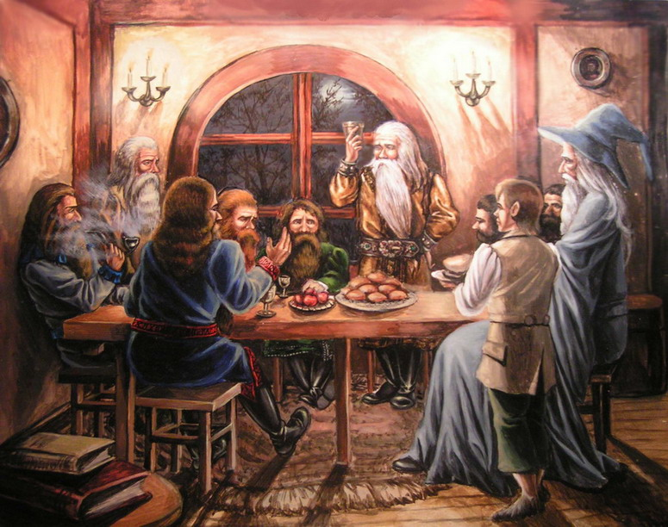
Previously…
Previously in The Hobbit, Bilbo had met Gandalf the wizard and a crew of dwarves who practically invited themselves to dinner.
As it turns out, Gandalf has chosen Bilbo to join himself and the dwarves on an adventure.
Bilbo is at once intrigued and terrified, though in the end, he agrees.

Slide 3
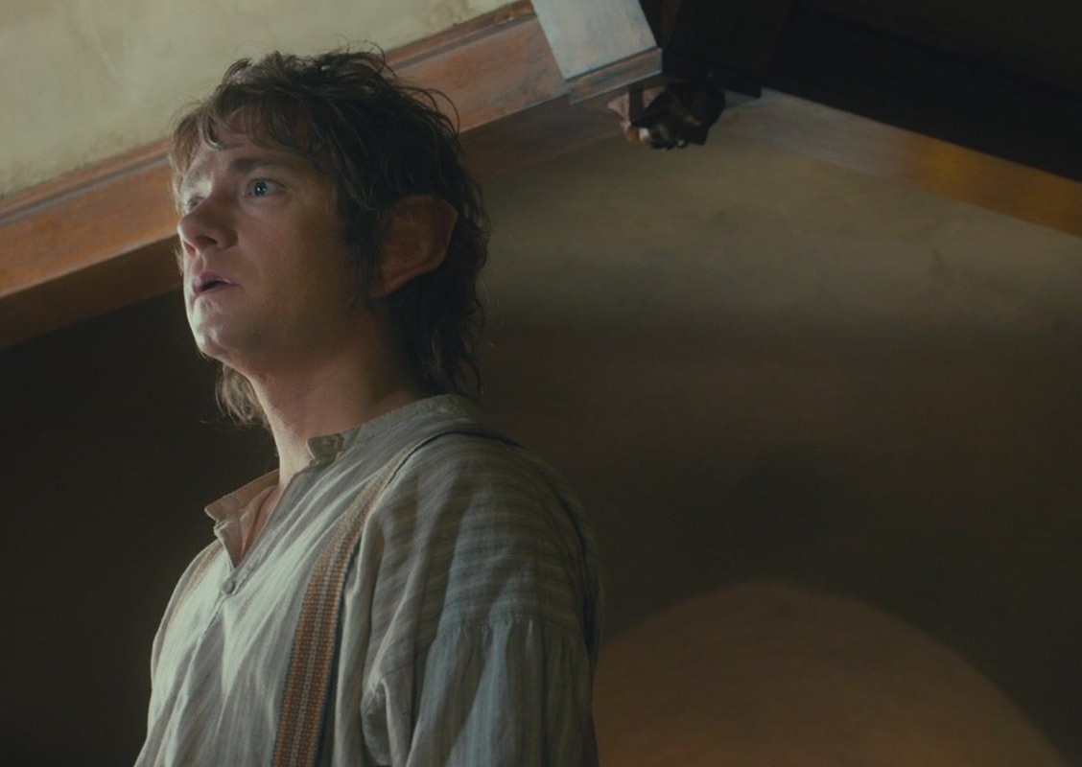
Pg 28 (Chapter 2 Starts)
What does Bilbo discover when he awakes the next morning?
What does he believe happened?

Slide 4
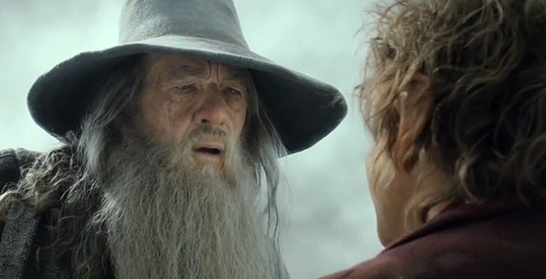
Pg 29
Gandalf arrives to jolt Bilbo out of his relaxation and remind him that no, it was real, and yes, he must hurry.
Read how business-like, formal, contractual the letter is on 29.

Slide 5
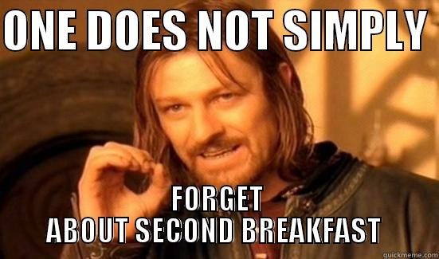
Pg 30
Think about how many luxuries Bilbo, and hobbits in general, are accustomed to.
Think about how few one might have on the road, on foot or horse, without the constant “exits” we have on modern highways.
Notes:
“Bilbo could never remember how he found himself outside, without a hat, a walking-stick or any money…leaving his second breakfast half-finished.”
“You will have to manage without…a good many things, before you get to they journey’s end.”

Slide 6
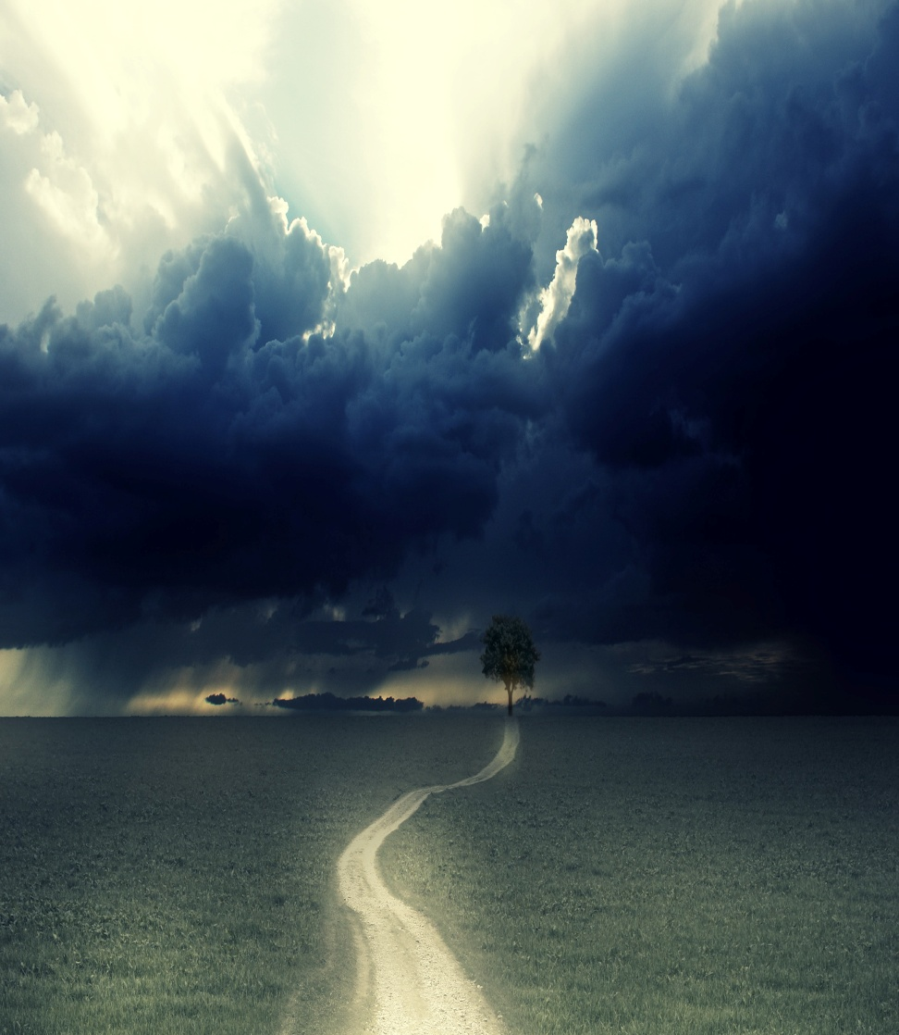
Pg 31
How far into the adventure is he?
Is he in any position to assume this yet?
What might such a claim foreshadow?
Notes:
“He began to feel that adventures were not so bad after all.”
Think “calm before the storm” clichés and what not.
Practically begging for something to happen.

Slide 7
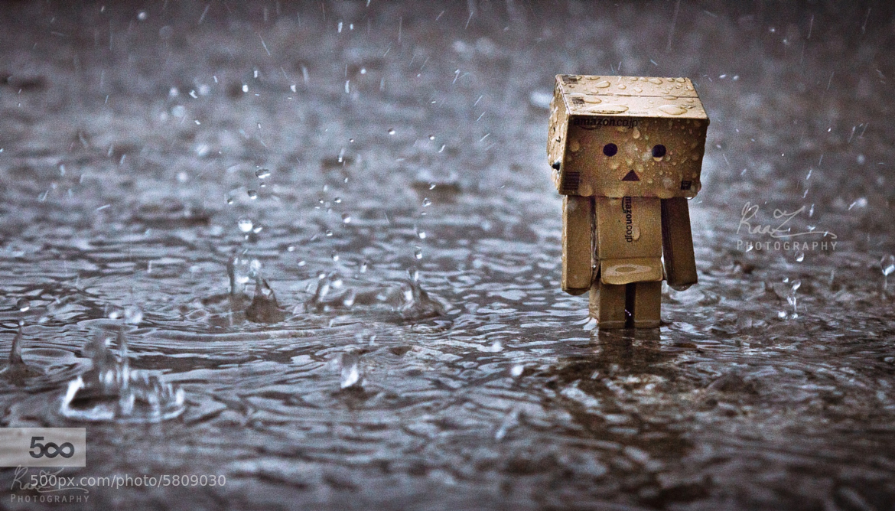
Pg 31-32
And notice how quickly his opinion changes, just with a little rain.
Leaving home for the first time does come with mixed feelings, in fantasy and real life.
Notes:
“Bother burgling and everything to do with it! I wish I was back at home in my nice hole by the fire”
Think about going off to college, for just a moment. Leaving little old Pikeville or Goldsboro.

Slide 8
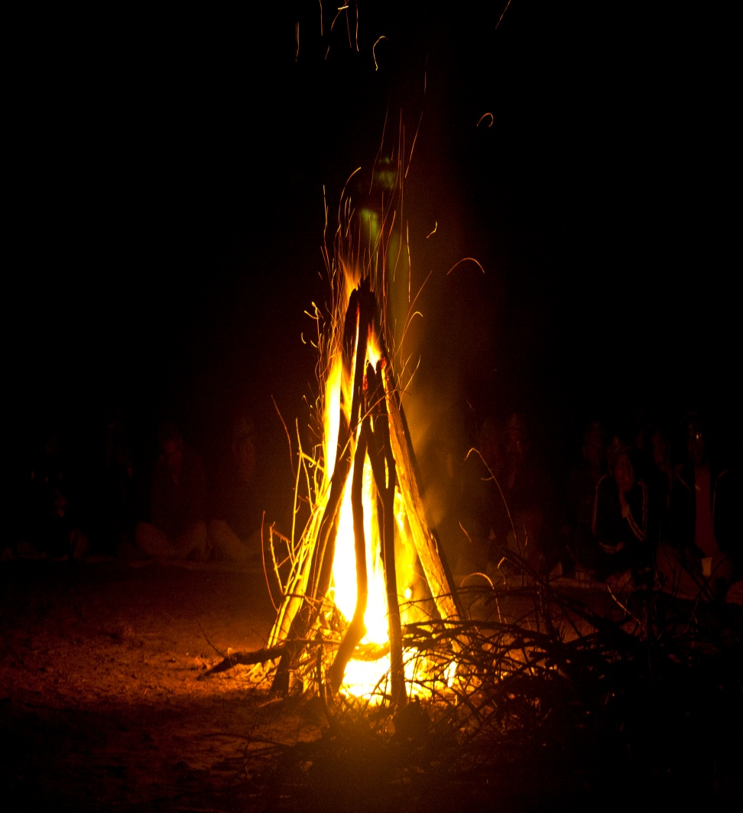
Pg 33
What do the dwarves ask Bilbo to do when they get near the fire?
Notice how the dwarves are such proud people, yet they so readily depend on others.
Notes:
“Where has Gandalf got to?”
“After all we have got a burglar with us.”

Slide 9
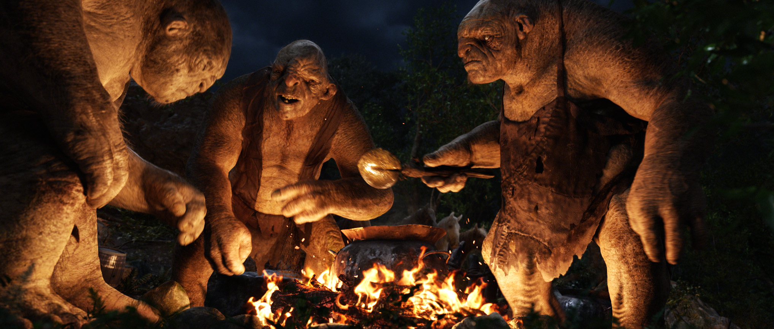
Pg 35
Who or what does Bilbo find at the fire?
Notes:
Notice how their speech patterns are different – English, but more broken, more slang, as if to tell us that these creatures are less educated or less intelligent in some way.
This is a characterization technique.

Slide 10
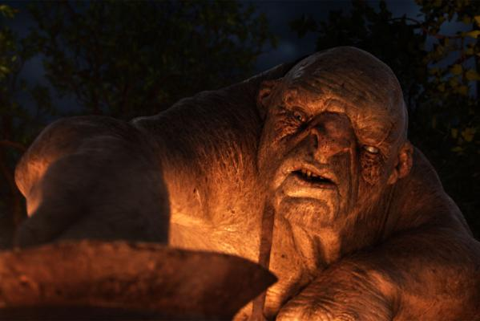
Pg 36
What happens when Bilbo tries to steal from the Trolls?
Let’s read 36-40 together.
Notes:
“A burrahobbit?”
How intelligent are these folks, again?
“Yer nasty little rabbit” – Notice Bilbo is compared to a rabbit, again.

Slide 11
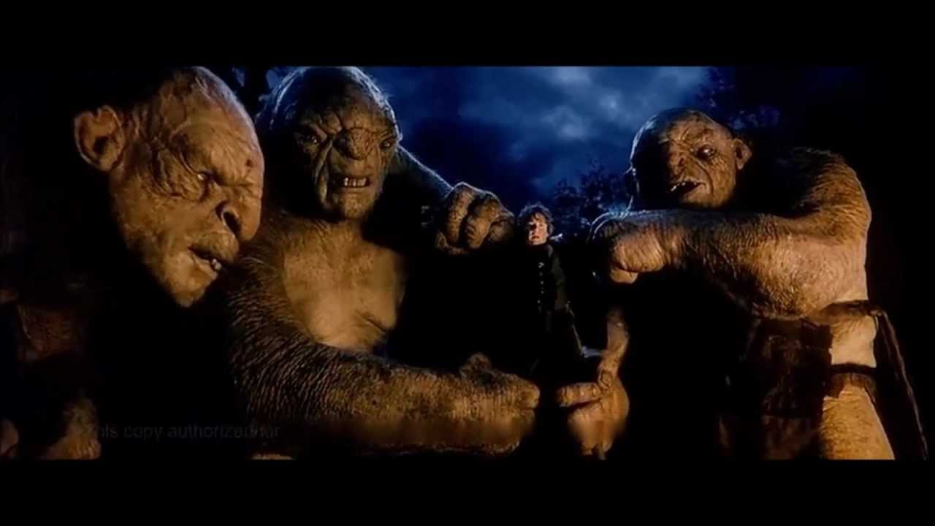
Pg 37 – Continue reading aloud
Bilbo, master of deception…
Notes:
“Yes, lots…No none at all, not one.”

Slide 12
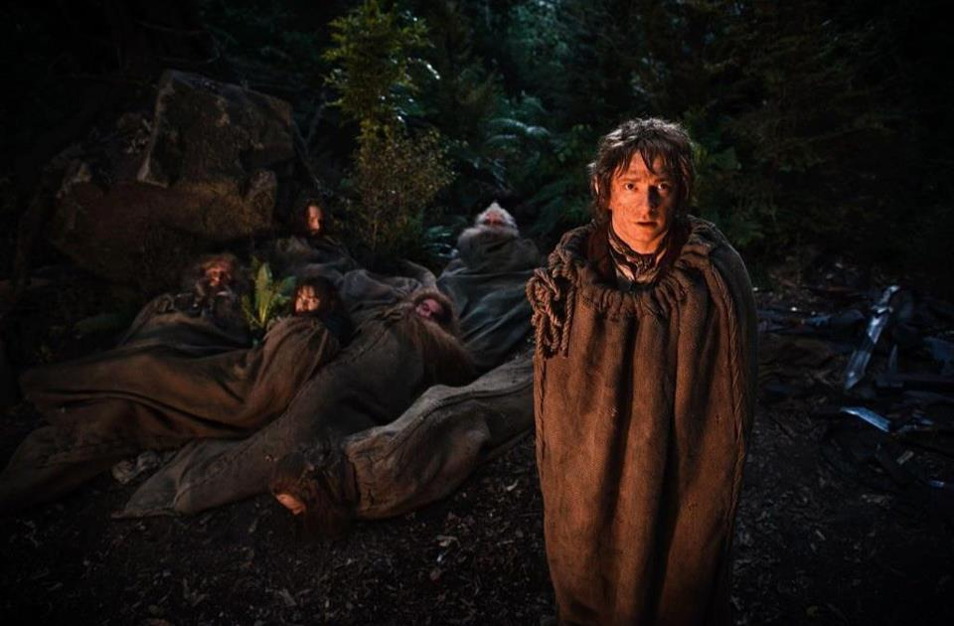
Pg 38 – Continue reading aloud
What happens when some of the dwarves come to see what’s taking Bilbo so long?

Slide 13
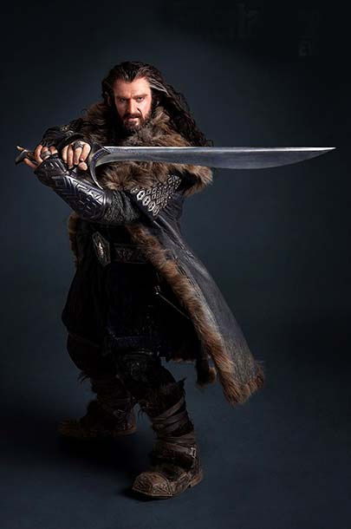
Pg 39 – Continue reading aloud.
Who comes last?
How do Bilbo and Thorin have different types of bravery?
Notes:
Notice that, though they were willling to send Bilbo in first, which seems cowardly, Thorin is willing to fight trolls to the death to save his people.

Slide 14
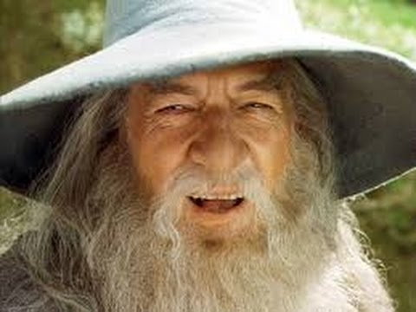
Pgs 39-40
What is going on here?
Who or what is speaking?
Why? To what end?
We’ll find out how this situation ends…tomorrow.
Notes:
“It was just then that Gandalf came back.”
“Said a voice”

Slide 15
Page 41
This isn’t the first time the trolls have mentioned the dawn.
How do they seem to feel about it? Make a prediction.
Notes:
“The night’s getting’ on, and dawn comes early.”
“Dawn take you all, and be stone to you!” – Gandalf

Slide 16
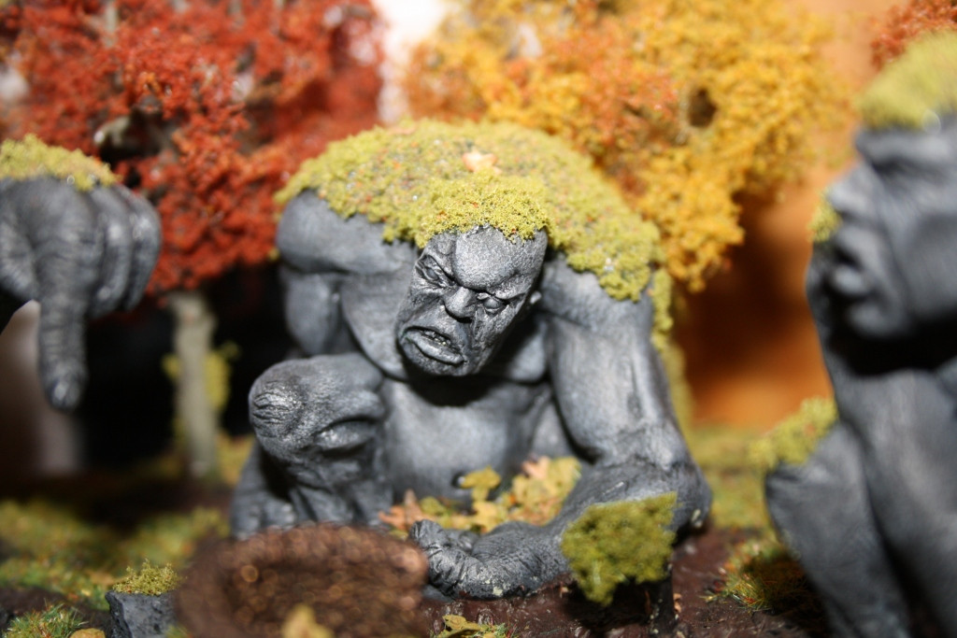
Page 41
Notice the narrator continues to adopt an attitude of certain things – certain facts about the fantasy universe – being common knowledge, even though many of us may not know it at all.
Notes:
“William never spoke for he stood turned to stone as he stooped; and Bert and Tom were stuck like rocks as they looked at him. And there they stand to this day…for trolls, as you probably know, must be underground before dawn”

Slide 17
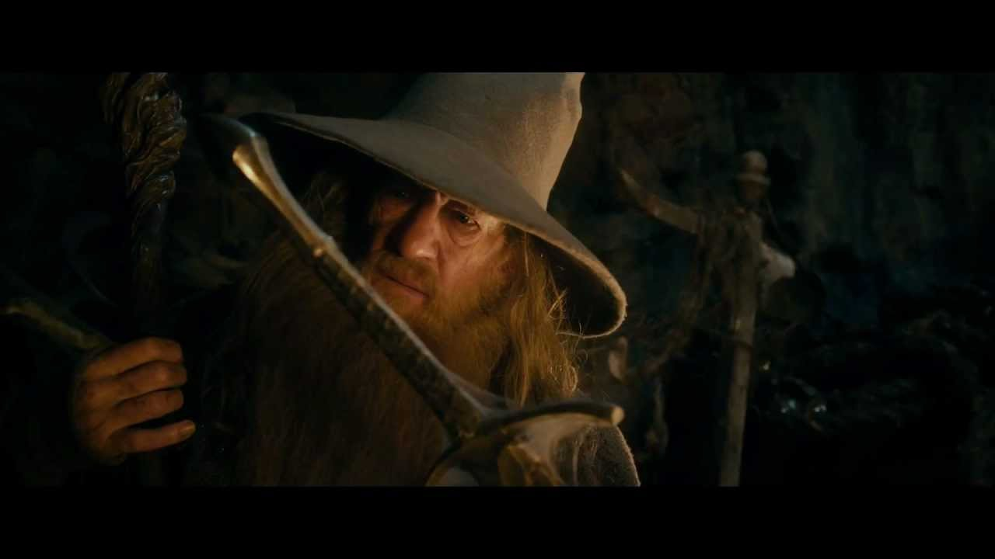
Page 42
After being freed, they all attempt to gain access to the troll’s lair.
How do Gandalf and the dwarves try to enter?
How is Bilbo’s solution somewhat more practical?
Notes:
(Notice this scene is mirrored in the Lord of the Rings, for those who are familiar with it).

Slide 18
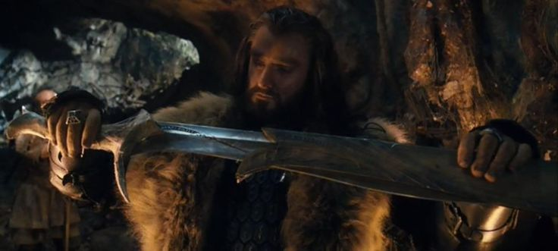
Page 42-43
What do they find in the trolls’ lair?
Why can’t they read the writing on the blades?
Ancient weapons with ancient writing on them. Where else have we seen this?
Think also of how the story is set “long ago,” yet the characters find things from longer ago, still.
Notes:
Beowulf, and many fantasy novels, play with this motif – set in ancient times, yet still digging through ruins of times more ancient still. It adds history / depth to the fictional universe.

Slide 19
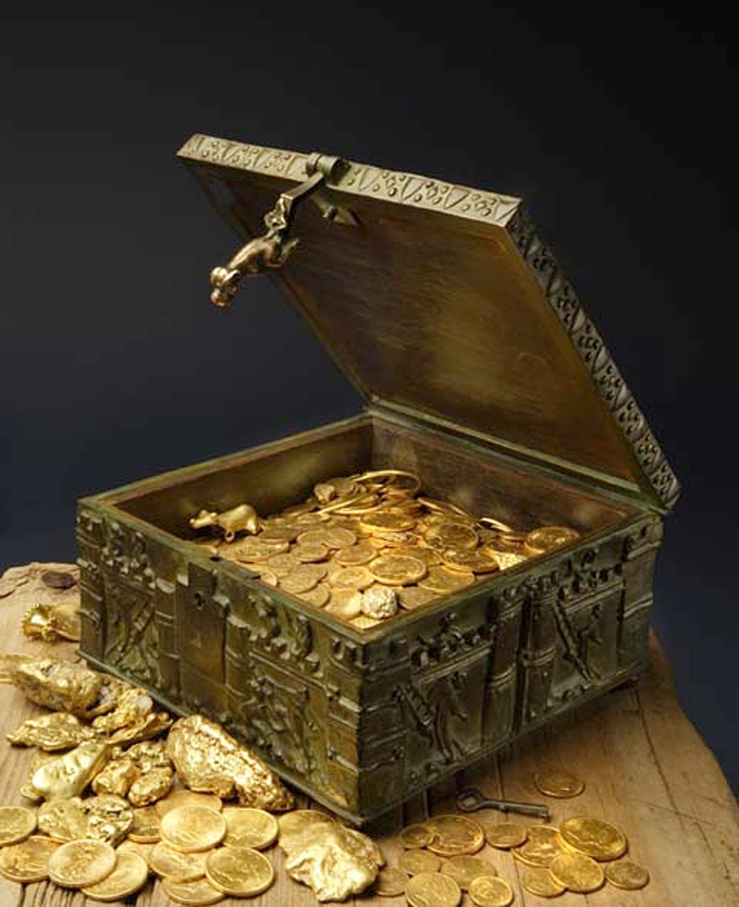
Page 43
Aside from food, drink, and swords, what else do they take from the troll hoard?
Why?
Notes:
Don’t they have enough waiting for them at the Lonely Mountain?
What might this say about dwarves?

Slide 20
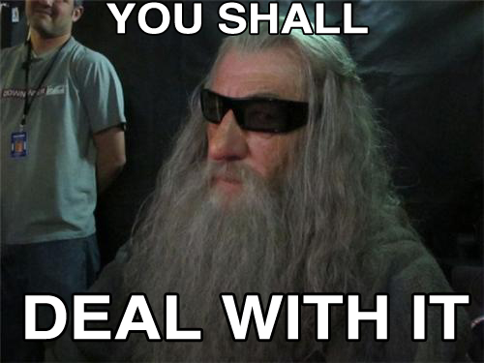
Page 43
Note Gandalf’s mysterious ways.
Seems like the overly literal nature of the Wonderland creatures, but not quite. Gandalf knows he’s doing it. He’s being evasive / vague / mysterious on purpose.
Is that how Gandalf is? How wizards are?
Notes:
“Where did you go, if I may ask?” – Thorin
“To look ahead.” – Gandalf
“And what brought you back?” – Thorin
“Looking behind.” – Gandalf

