Slide 1
The Hobbit – Notes for Chapter 3
With additional visuals and flair, for funsies.

Slide 2
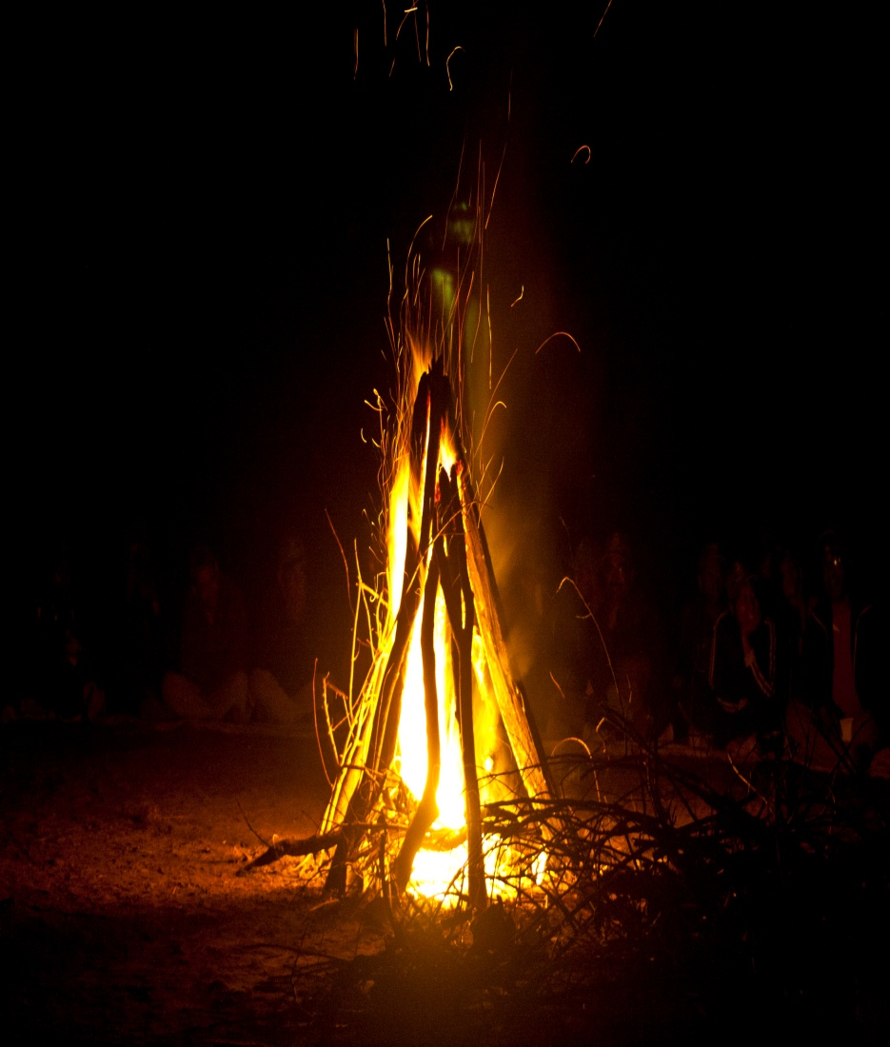
Previously on Days of Our Hobbit
Bilbo, Gandalf, and the dwarves set off on their journey.
Bilbo struggles still between hating and loving adventures.
All of a sudden, Gandalf disappears. The dwarves – cold, wet, and hungry – ask Bilbo to go investigate a nearby campfire for food.
This errand results in Bilbo and all the dwarves being captured by three massive trolls, who intend to eat them.
Meanwhile, Gandalf slips into the camp unseen and begins to distract the dwarves with voices and tricks.

Slide 3
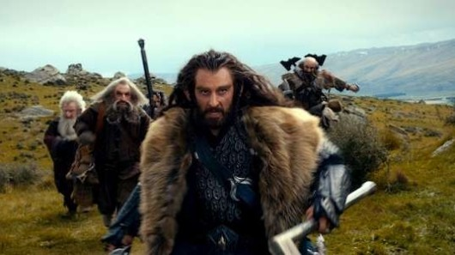
Page 45 (Beginning of Chapter 3)
How has the mood of the group altered after meeting their first danger?
At this point, they’re all getting a feel for how difficult this is going to be.
Those were only trolls, not a dragon, and this was only the beginning of the journey.
Notes:
“They did not sing or tell stories that day, even though the weather improved.”

Slide 4
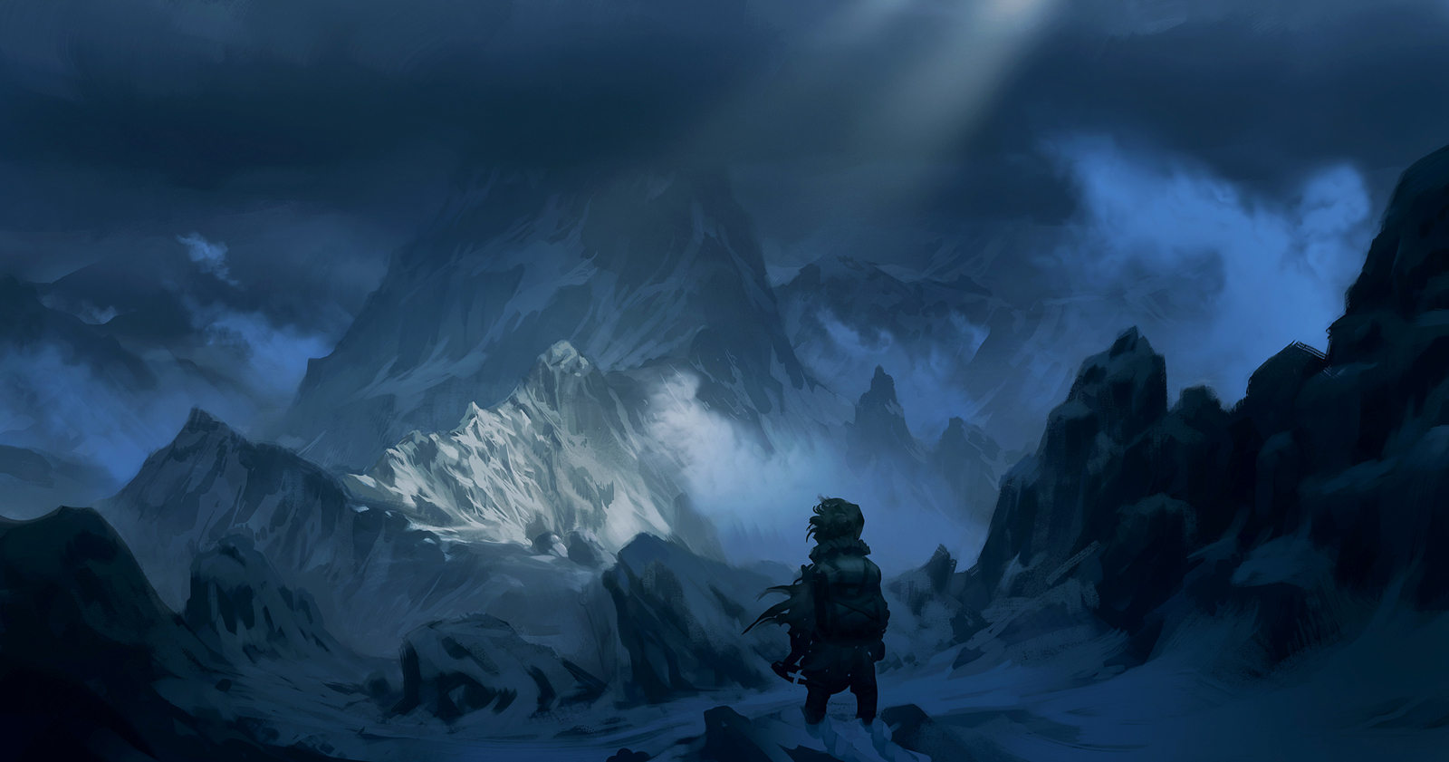
Page 45
Look at where we are in the paperback. Make a prediction on the answer to Bilbo’s question.
Notes:
“Is that The Mountain?” – Bilbo.
“Of course not!...That’s only the beginning of the Misty Mountains…it is a deal of a way even from the other side.” - Balin

Slide 5
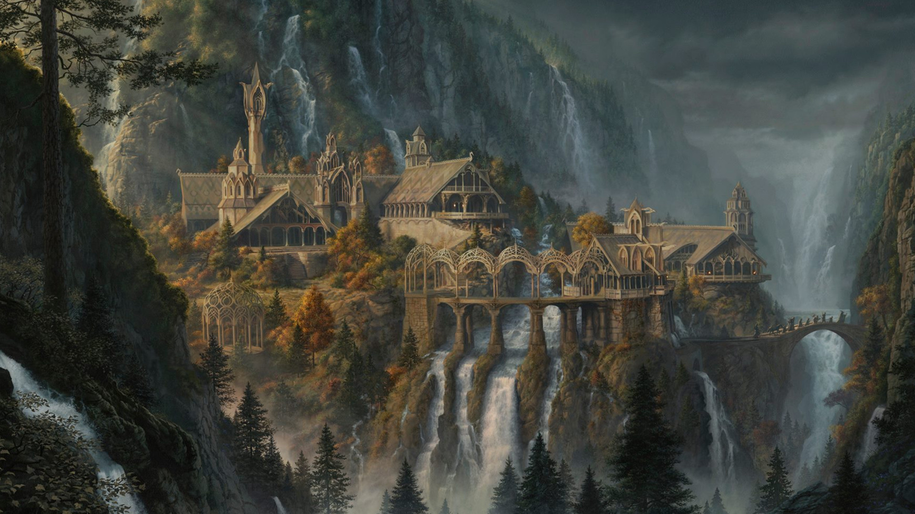
Page 46
How is he feeling about adventures now? What would he rather be doing?
Where are they going, now?
Notes:
“He felt more tired than he ever remembered feeling before.”
“The Last Homely House”
What meaning does “homely” take here?
And what does this say about the lands beyond?

Slide 6
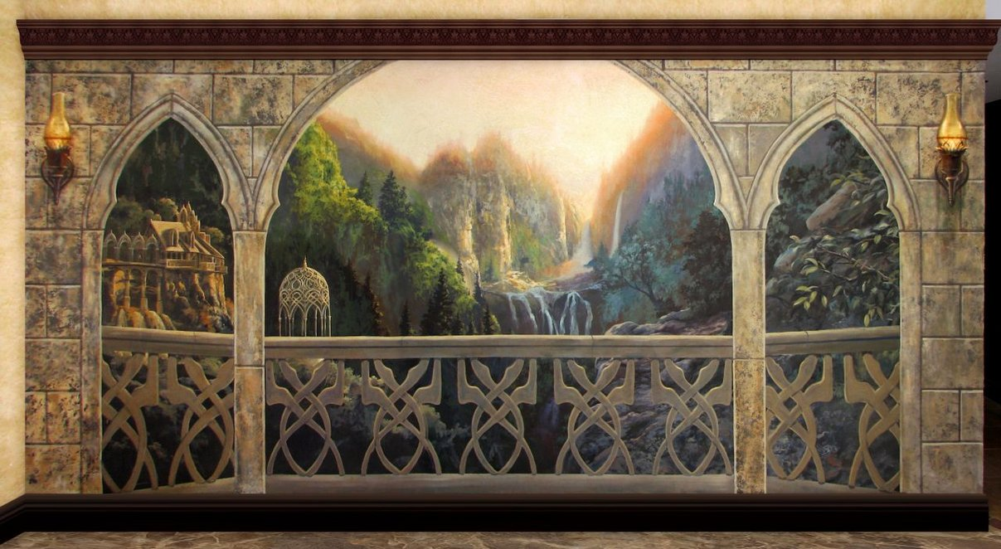
Page 47
The length of the journey and how tired they all are is emphasized.
Bilbo’s having to get used to doing without a great many things.
Notes:
“Tea-time had long gone by, and it seemed supper-time would soon do the same.”

Slide 7
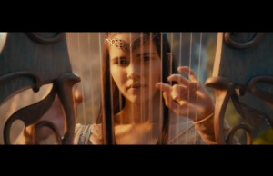
Page 48 - Rivendell
A new land, a new people, a new song.
Let’s read the song on 48-49.
https://www.youtube.com/watch?v=O5vu8vU9yCw
Notes:
Like dwarves, what do elves also enjoy?
Unlike dwarves, where to elves prefer to live?

Slide 8
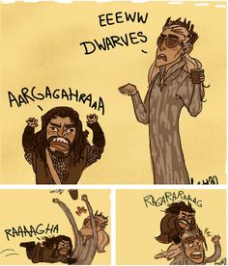
Page 49
What does Bilbo think of the elves?
What do the dwarves think of the elves?
Notes:
“Dwarves don’t get on well with them. Even decent enough dwarves like Thorin and his friends think them foolish (which is a very foolish thing to think), or get annoyed with them. For some elves tease them and laugh at them, and most of all at their beards.”
If you’re at all familiar with Lord of the Rings, the elves in The Hobbit tend to be far more whimsical and fun-loving; the latter, more serious. Bear in mind the audiences – Hobbit was written first and for a younger audience; LOTR afterward and for a more general audience.

Slide 9
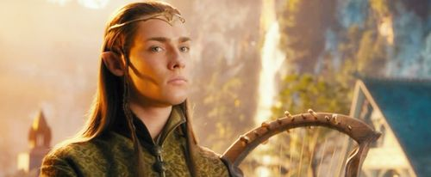
Page 50
Elves are apparently well known for their singing.
Notice the comments they make with their guests.
Light hearted, somewhat immature banter / jokes seem popular here, as well.
Notes:
“Elvish singing is not a thing to miss, in June, under the stars.”
“Don’t dip your beard in the foam, father!” (Father, because he has a beard and thus, looks old).
“Mind Bilbo doesn’t eat all the cakes.”

Slide 10
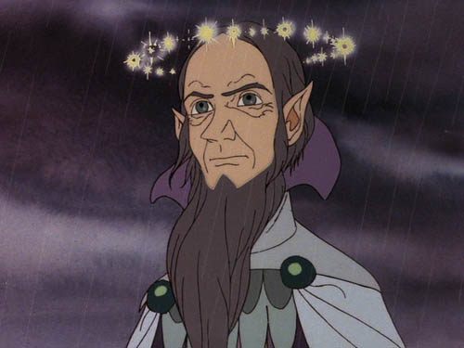
Page 51 – The Last Homely House
Who is the lord of the last homely house?
What race does he belong to, according to the text?
Is he young? Old? How do you know?
Notes:
(Technically speaking, he’s part elf, part human, part maia, but you don’t need to know this)

Slide 11
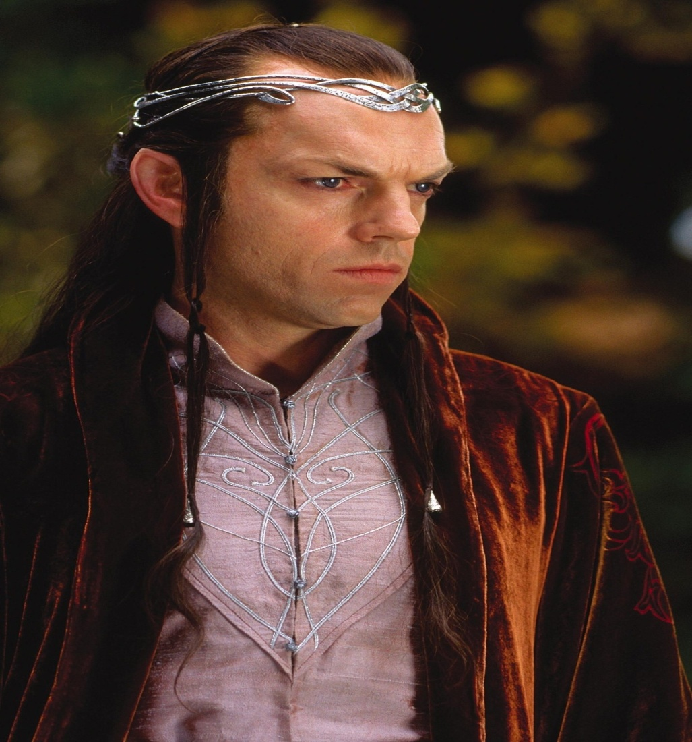
Page 52
How does Elrond help them with the swords and map?
Where did the swords originally come from, and what were their names?
Orcrist, Goblin Cleaver
Glamdring, Foe Hammer
Notes:
“Elrond knew all about runes of every kind.”
Where else have we seen famous, ancient, named weapons?

Slide 12
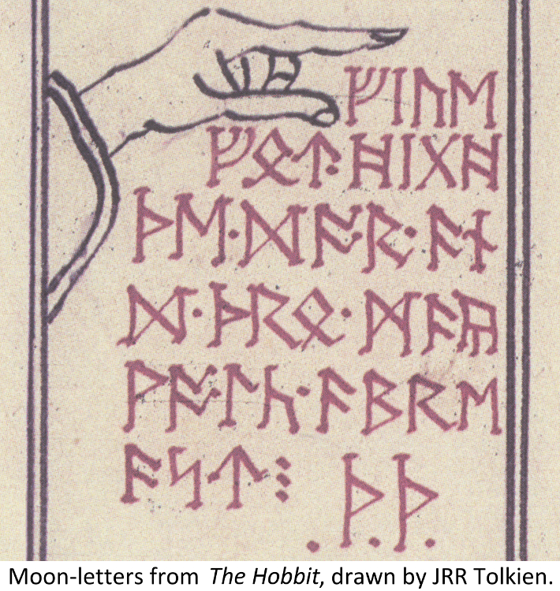
Page 53
What are moon letters?
What do they say?
Notes:
“Moon-letters are rune-letters, but you cannot see them…not when you look straight at them. They can only be seen when the moon shines behind them, and what is more, with the more cunning sort is must be a moon of the same shape and season as the day when they were written.” – Elrond
“Stand by the grey stone when the thrush knocks…and the setting sun with the last light of Durin’s Day will shine upon the key-hole.” - Elrond

Slide 13
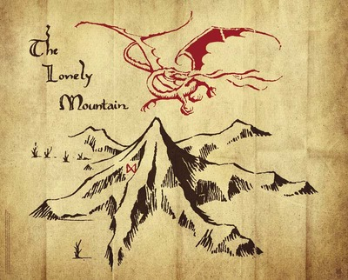
Page 53-54 (End of Chapter)
Now they have a deadline, a time table.
Where before they could mosey along to the Lonely Mountain, now they must make it there by a certain time to find the hidden door, or else risk the main gates.
Why is the secret door supposedly less dangerous than the main gate?

