Slide 1
The Hobbit – Notes for Chapter 4

Slide 2
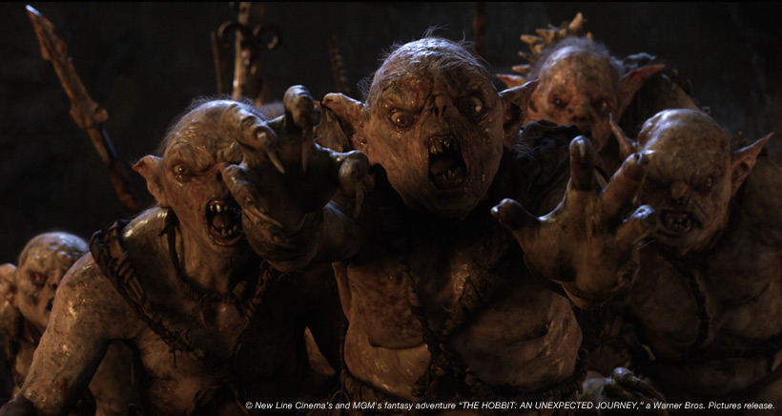
Previously on As the Hobbit Turns
Gandalf saved Bilbo and the dwarves from the trolls through clever deception.
They proceeded onward to Rivendell, where they learned the names of their swords and, more importantly, the location of the Lonely Mountain’s secret entrance.
Afterward, they continued the next leg of their journey – a crossing of the Misty Mountains.

Slide 3
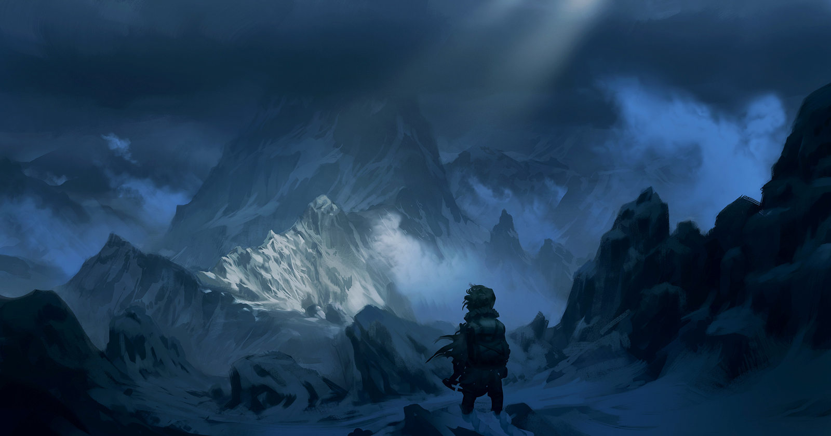
Page 55 (Start of Chapter)
“Over Hill and Under Hill”
Gandalf, Bilbo, and the dwarves leave Rivendell. What mountain range are they heading toward?
What dangers do they face on that road?
Narrow mountain paths, cliffs, boulders.

Slide 4
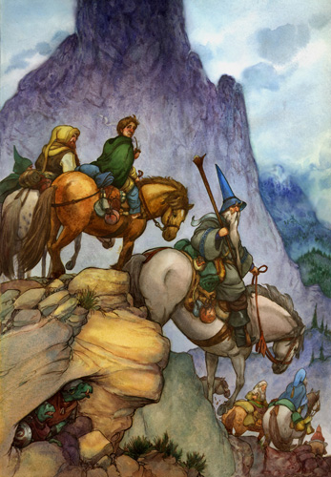
Page 56
Notice how their thoughts drift over the journey.
Bilbo thinks of the harvests going on down below.
The dwarves think of the destination only, as if there weren’t a huge and difficult journey inbetween – as if they were practically there and the obstacles between, a trifle.
Gandalf shakes his head, seeming to know better.
Notes:
“He knew that something unexpected might happen.”

Slide 5
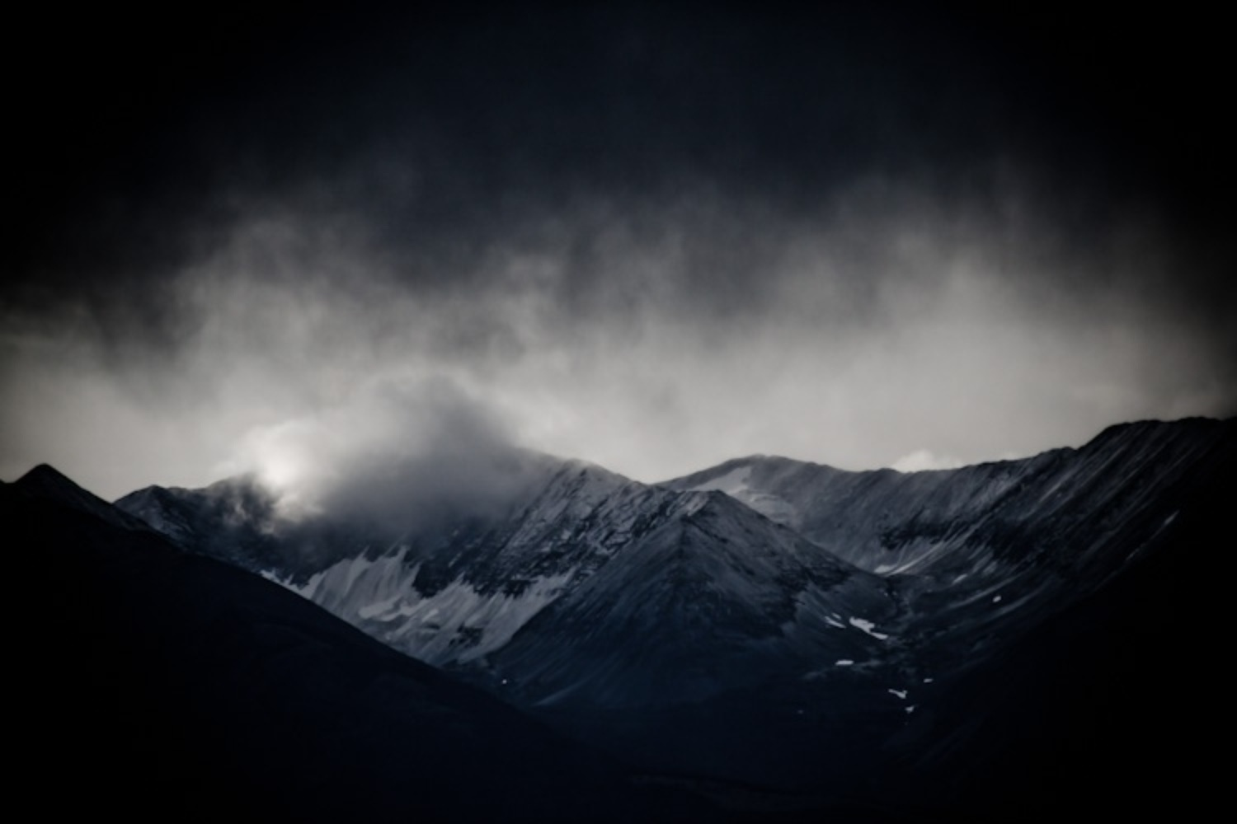
Page 56-57
Notice the sensory details used to describe the terror of the storm.
How do these details, this word choice, add to the experience for readers?
Notes:
“One day they met a thunderstorm—more than a thunderstorm, a thunder battle.”
“Lightning splinters on the peaks, and rocks shiver, and great crashes split the air and go rolling and tumbling into every cave and hollow; and the darkness is filled with overwhelming noise and sudden light.”

Slide 6
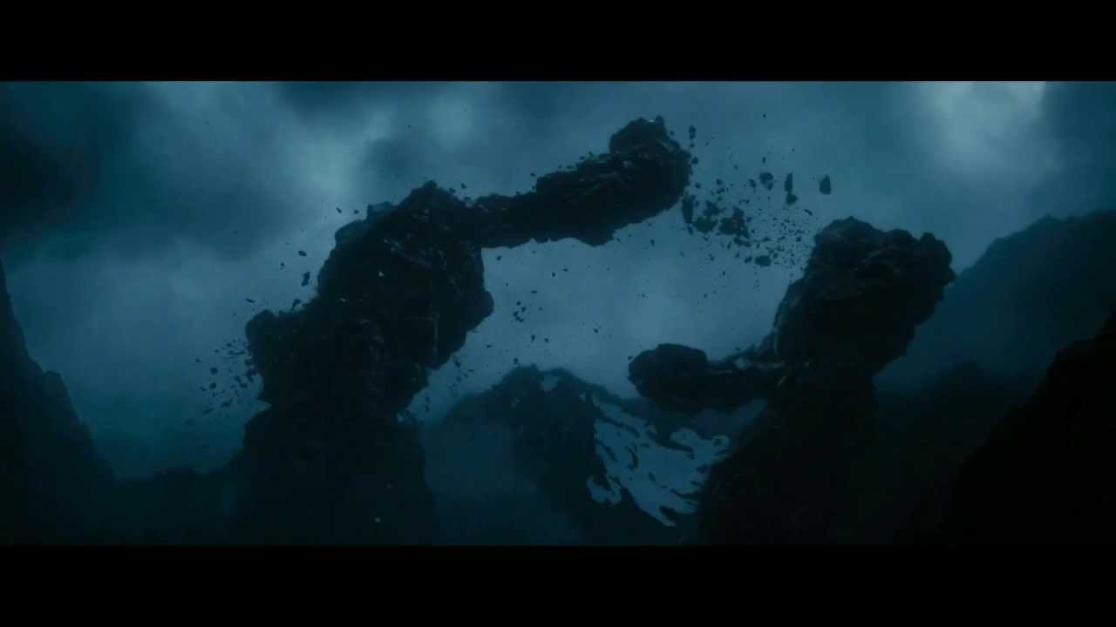
Pages 57
Who or what is really causing the boulders to fall?
Notice how even in the midst of this chaos, Tolkien cracks jokes.
Notice Thorin demanding and ordering yet again.
Notes:
“There is nothing like looking, if you want to find something.”

Slide 7
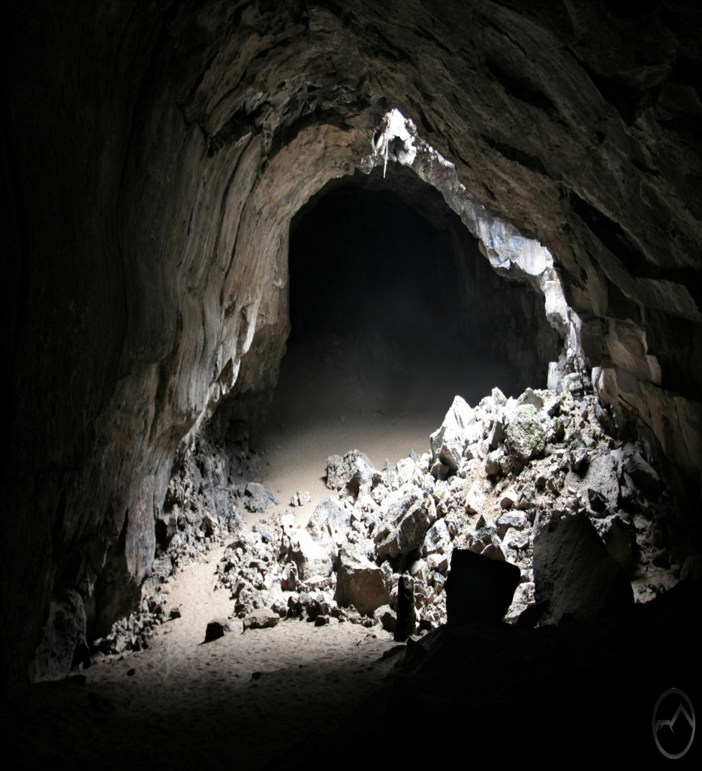
Page 58
What is foreshadowing / foreboding / ominous about this wording, here?
What do you predict will happen?
Is the cave safe?
Notes:
“We have found a dry cave!” – Fili and Kili
“Have you thoroughly explored it?” Gandalf.

Slide 8
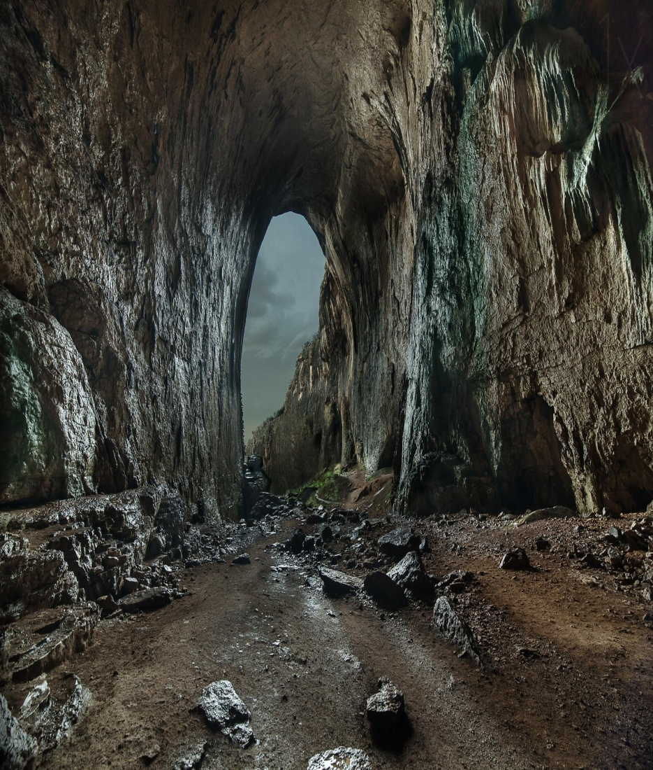
Page 59
Gandalf and the rest explore the cave, find nothing, and decide to camp there for the night.
Why does the book say, on page 59, that it was good they’d brought Bilbo?
What advantage could this possibly have?
Notes:
Goblins.

Slide 9
Page 60
Lots and lots of goblins.
Everyone is captured by the goblins.
And apparently, goblins also sing.
(See song on 60-61, then conclude today’s lecture.
https://www.youtube.com/watch?v=ogTDa-vG2MQ&list=PL545948224B999E8A&index=8

Slide 10
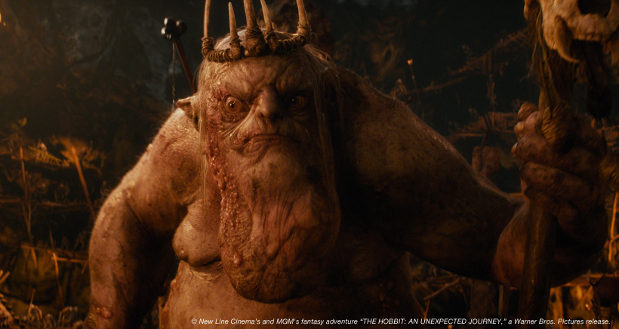
Down Down to Goblin Town
Clap! Snap! The black crack!
Grip, grab! Pinch, nab!
And down down to Goblin-town
You go, my lad!
Crash, crash! Crush, smash!
Hammer and tongs! Knocker and gongs!
Pound, pound, far underground!
Ho, ho! My lad!
Swish smack! Whip crack!
Batter and beat! Yammer and bleat!
Work, work! Nor dare to shirk!
While Goblins quaff, and Goblins laugh,
Round and round far underground
Below, my lad!
Notes:
What does this song focus on?
Noises, described, Many harsh noises.
One word for a chaos of noise – pandemonium.
Pandemonium is also the name of the capital of Hell in John Milton’s Paradise Lost.
What connotations could this have for the goblin city? Will it be a pleasant place?

Slide 11
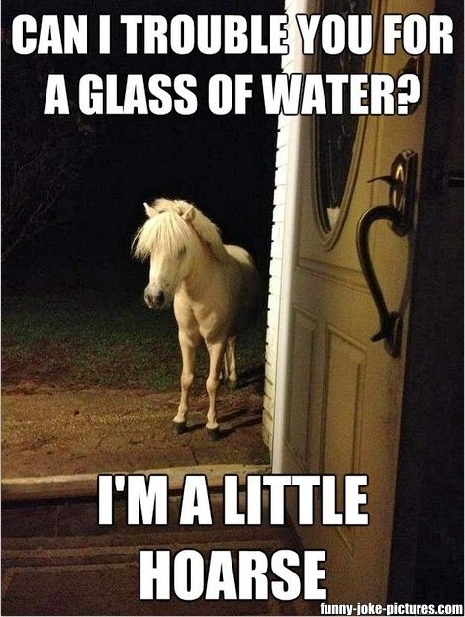
Page 61
So, the goblins continue taking Bilbo and company deep into their city.
What is the ultimate fate of the ponies?
Notes:
“For goblins eat horses and ponies and donkeys (and other much more dreadful things), and they are always hungry.”

Slide 12
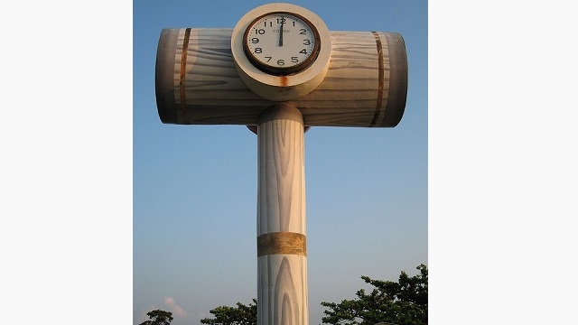
Page 62
How does the narrator characterize goblins?
Notes:
“Now goblins are cruel, wicked, and bad-hearted. They make no beautiful things, but they make many clever ones.
“They can tunnel and mine as well as any but the most skilled dwarves…
“Hammers, axes, swords, pickaxes, tongs, and also instruments of torture, they make very well…
“It is not unlikely that they invented some of the machines that have since troubled the world, especially the ingenious devices for killing large numbers of people at once, for wheels and engines and explosions always delighted them.”

Slide 13
Bottom of 62 – Bottom of 64
Let’s read the conversation between the Great Goblin and the dwarves together.
Thorin tells some truths, but lies about their ultimate goal. Why?
What angers the Great Goblin the most?

Slide 14
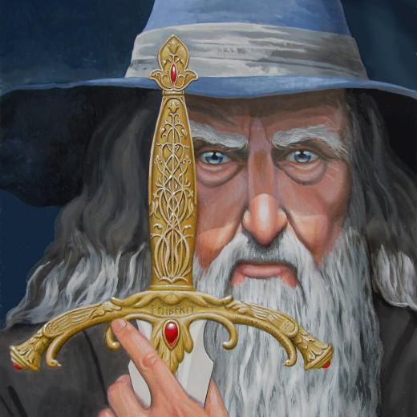
Page 65
Who or what gets them out of this mess?
What does a quick tally reveal about their losses?

Slide 15
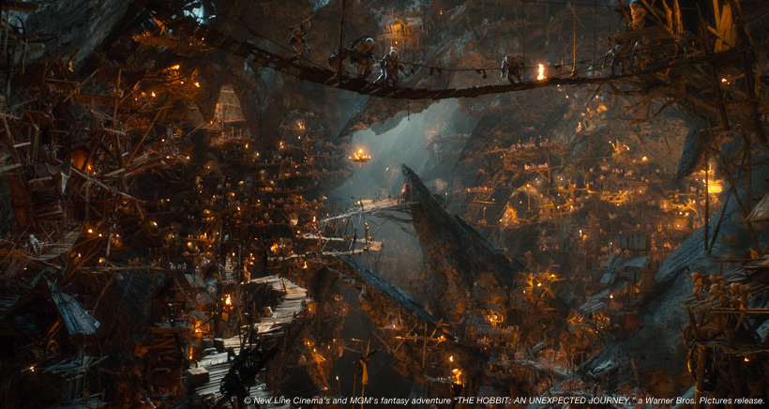
Page 66
Bilbo, Gandalf, Thorin and company all run – one of the dwarves carrying Bilbo at all times as he is not a fast enough runner on his own.
Notes:
Eventually, the goblins’ superior speed in the caves gets them into a battle.
In the midst of it all, Bilbo echoes his former desires to be home, and Bombur the dwarf meets it with the wish that they’d left the burglar at home. At this point, panic and doubts are quite mutual.

Slide 16
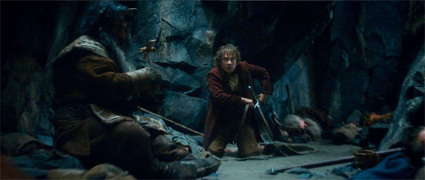
Page 67 (End of Chapter)
What happens to Bilbo in the midst of the battle?

