Slide 1
The Hobbit – Notes on Chapter 5

Slide 2
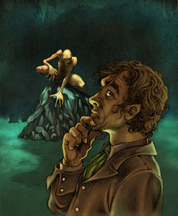
Previously on the Young and the Hobbitless
Bilbo and the dwarves, on their way across the Misty Mountains, took shelter from a violent storm in a small cave, only to be captured by goblins.
Gandalf comes to the rescue, as he did with the trolls, and leads them through the tunnels.
While the dwarves are busy fleeing and fending off goblins, Bilbo is lost – fallen into the deepest reaches of the caves.

Slide 3
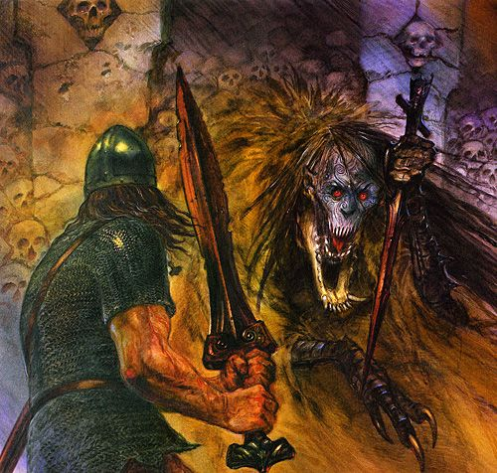
Page 68 (Beginning of Chapter)
“Riddles in the Dark”
Bilbo has found himself in the darkest of dark, the depths of the mountain caves.
What have we previously learned about mountain caves, and the things that live there?
Notes:
Think Beowulf for a moment.
As darkness is sometimes symbolic of sin, evil, ignorance, or all at once, Grendel was the descendent of Cain and his sins.
Furthermore, descents into the earth in old epics often symbolized descents into the underworld.
In a way, we are about to meet a creature turned and transformed by sin and evil into a very accursed state.

Slide 4
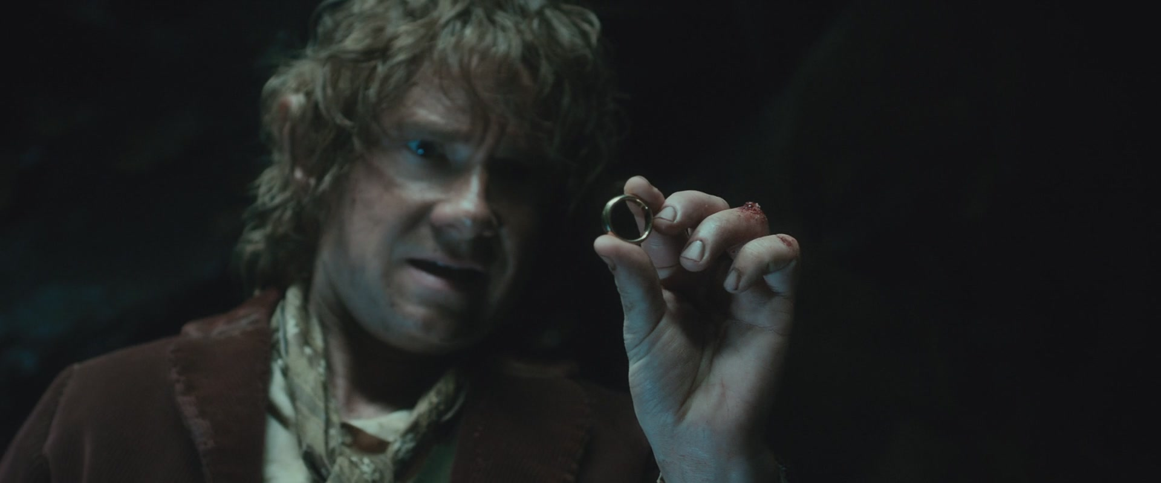
Page 68
What does Bilbo find in the dark?
Notes:
“It was a turning point in his career, but he did not know it.”
Bilbo seems to have found a small, metal ring of some kind.
As the narrator blatantly foreshadows, this will be an important point throughout the series.

Slide 5
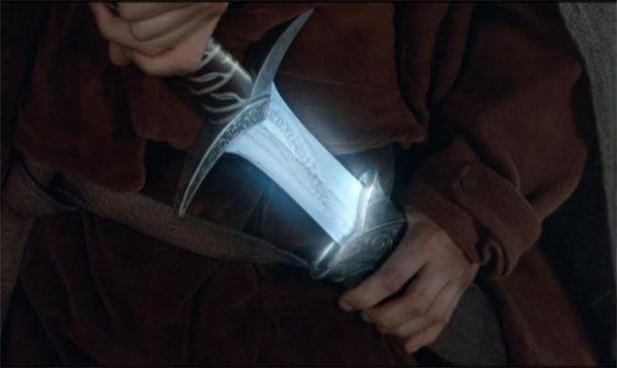
Page 69
Bilbo wishes for food, wishes to smoke his pipe, but can do none of these things.
Finally, he discovers something about his sword.
What unique property does it have?

Slide 6
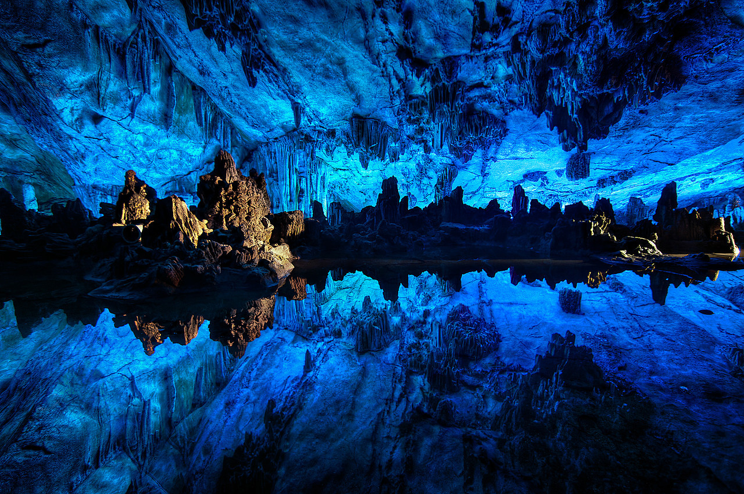
Page 70
Why is Bilbo not entirely uncomfortable in the caverns?
In what does he normally live?
After much wandering through the darkness with the dim light of his sword, Bilbo finds his way to the edge of an underground lake in a large and open cavern.

Slide 7
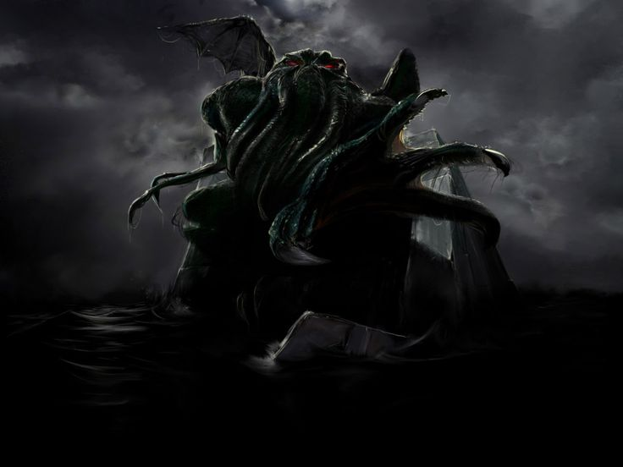
Page 71
Things in the depths of darkness too strange and terrible for words. The unknown is often described as a terrible thing in fantasy, though more often by horror writers like H. P. Lovecraft.
Notes:
“He thought, too, of nasty slimy things, with big bulging blind eyes, wriggling in the water. There are strange things living in the pools and lakes in the hearts of mountains.”
Most often, these horrible unknowns lie in the depths of the earth/ocean, the depths of space, or just on the other side of the wall between this reality and another.

Slide 8
Page 71
It was at this point, in fulfillment of the previous description, that one such creature came forth from the darkness.
How is Gollum described?
How did he find his meals there, in the dark?
Nice guy, right?
Notes:
“Deep down here by the dark water lived old Gollum.”
Old, slimy, creature, his origins “unknown,” dark as darkness, two big round pale eyes, long fingers, etc.
“Goblin he thought good, when he could get it; but he took care they never found him out. He just throttled them from behind.”

Slide 9
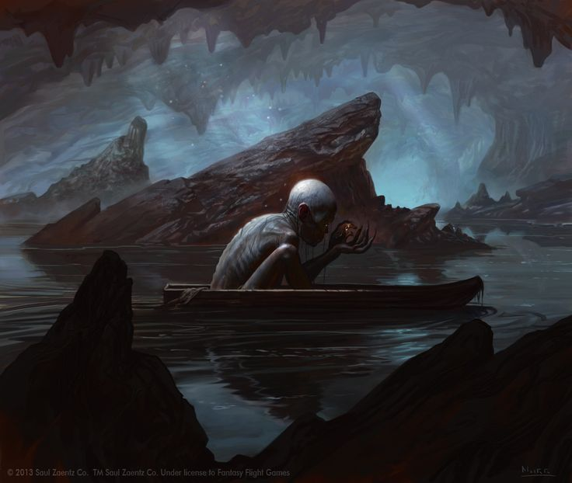
Page 72-73
And so, Gollum rowed out to meet his guest / intruder.
Instead of greeting Bilbo, Gollum goes on talking to himself out loud.
What odd features characterize Gollum’s speech?
Notes:
“I guess it’s a choice feast; at least a tasty morsel it’d make us, gollum!”
The noise gollum, referring to itself in the third person, my precious.

Slide 10
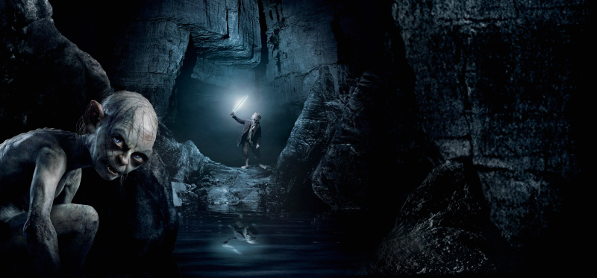
Bottom of 73 - 79
Bilbo is understandably startled at the appearance of this strange creature, talking about him with clear intent to make him dinner.
To gamble for his life, and the way out, Bilbo and Gollum face off in a game of wits – a game of riddles.
Let’s read this game of riddles together, starting at the bottom of 73 and extending to about the end of 79.
Try to notice a pattern in Gollum’s riddles, and a different pattern, or theme, in Bilbo’s riddles.

Slide 11
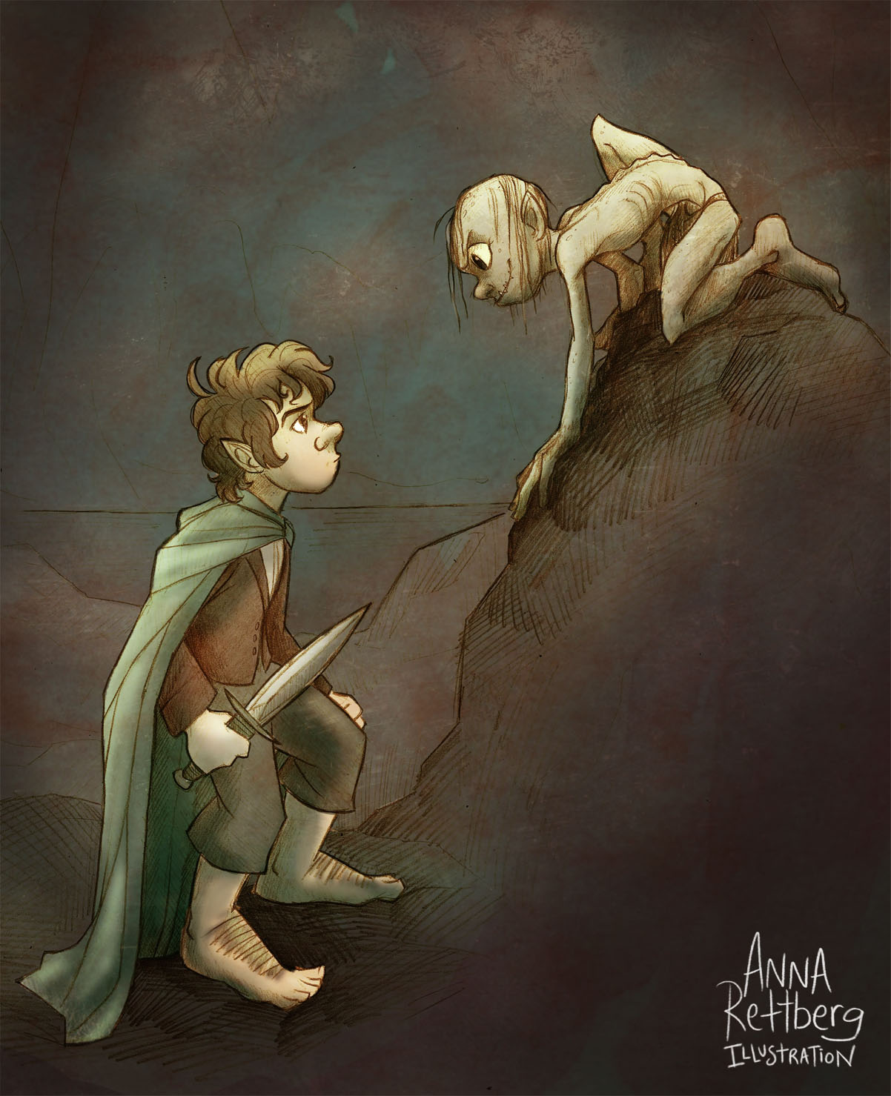
73 – 79 – Riddles in the Dark
“What has roots as nobody sees,
Is taller than trees,
Up, up it goes,
And yet never grows?”
– Gollum, Pg73
“Thirty white horses on a red hill,
First they champ,
Then they stamp,
Then they stand still.”
– Bilbo, Pg 74

Slide 12
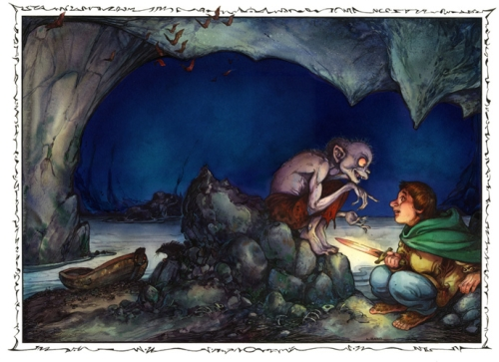
73 – 79 – Riddles in the Dark
“Voiceless it cries,
Wingless flutters,
Toothless bites,
Mouthless, mutters.”
– Gollum, Pg 74
“An eye in a blue face
Saw an eye in a green face.
‘That eye is like to this eye’
Said the first eye,
‘But in low place
Not in high place.’”
– Bilbo, Pgs 74-75

Slide 13
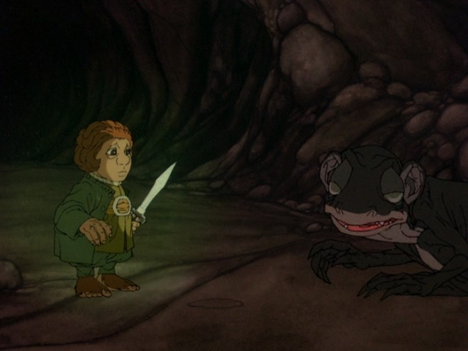
73 – 79 – Riddles in the Dark
“It cannot be seen, cannot be felt,
Cannot be heard, cannot be smelt.
It lies behind stars and under hills,
And empty holes it fills.
It comes first and follows after,
Ends life, kills laughter.”
– Gollum, Pg 75
“A box without hinges, key, or a lid,
Yet golden treasure inside is hid.”
– Bilbo, Pg 75

Slide 14
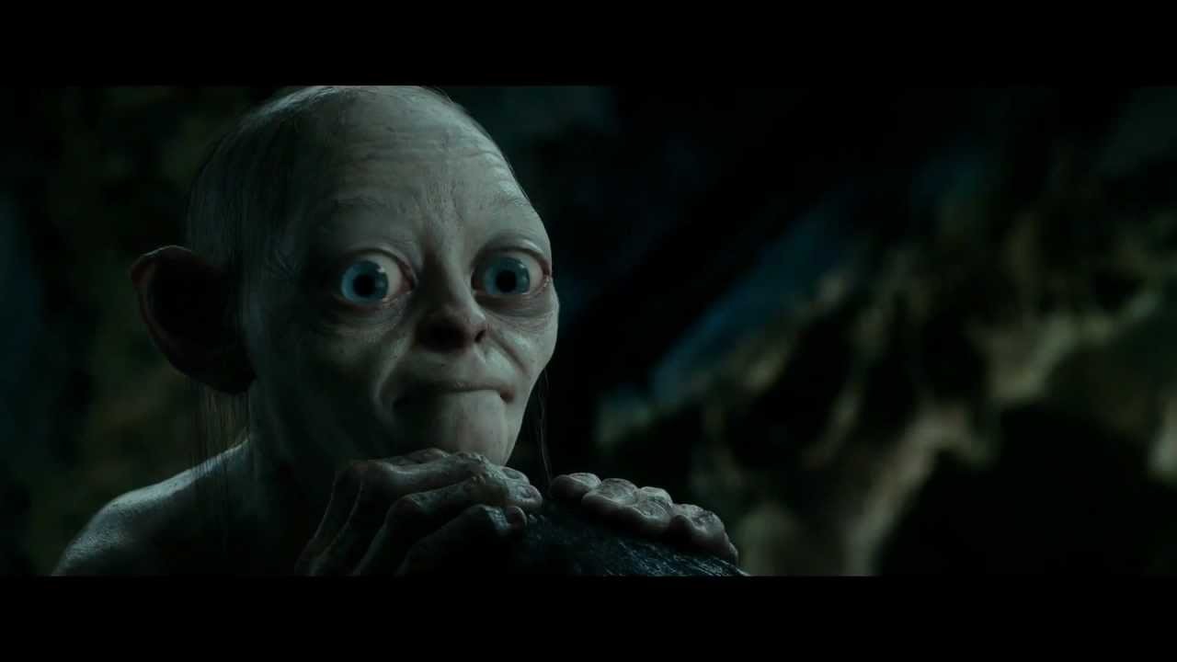
73 – 79 – Riddles in the Dark
“Alive without breath,
As cold as death;
Never thirsty, ever drinking,
All in mail never clinking.”
– Gollum, Pg 76
“No-legs lay on one-leg, two-legs sat near on three-legs, four-legs got some.”
– Bilbo, Pg 77

Slide 15
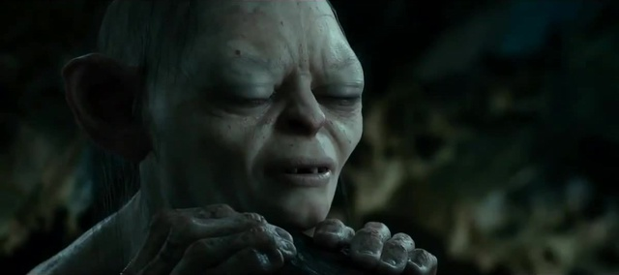
73 – 79 – Riddles in the Dark
“This thing all things devours:
Birds, beasts, trees, flowers;
Gnaws iron, bites steel;
Grinds hard bones to meal;
Slays king, ruins town,
And beats high mountain down.”
– Gollum, Pg 77
“What have I got in my pocket?”
– Bilbo, Pg 78.
Gollum claims this is not fair.
Your thoughts?
What does he have in his pocket?

Slide 16
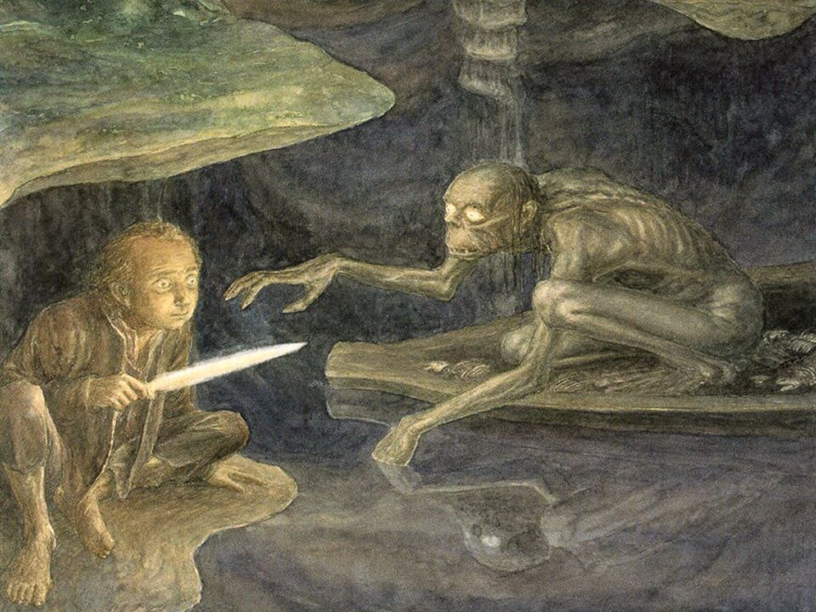
Page 80
Evidently Bilbo, out of sensing the unfairness or out of intimidation, allows three guesses.
What does Gollum guess?
Notes:
“Handses!”
“Knife!”
“String, or nothing!”
Technically four guesses, but all wrong. Bilbo has technically “won.”

Slide 17
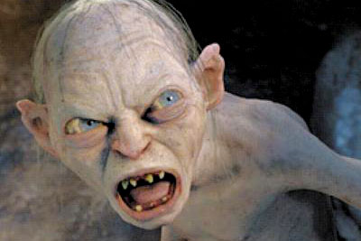
Page 80
However, what is the problem with making deals with beings stronger or more powerful than yourself?

Slide 18
Bottom of Page 80
Soon after coming to terms with his loss, Gollum claims that before he shows Bilbo the way out, he must…show him something.
Notes:
“We must go and get some things first, yes, things to help us.” – Gollum
“Not far away was his island…there…he kept…a ring, a golden ring, a precious ring.”
Notice that Gollum calls himself and his ring “precious,” as if he has trouble distinguishing between himself and it – where one ends and the other begins.

Slide 19
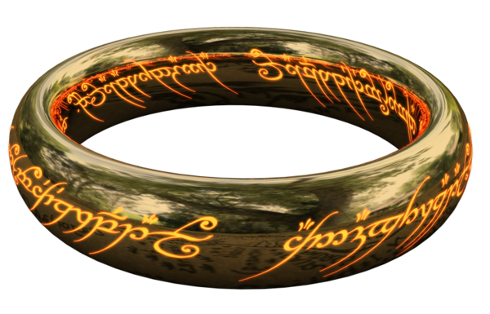
Page 81
What’s special about this ring?
What was Gollum planning?
What is the slight teensy weensy hole in this problem?
Notes:
“He wanted it because it was a ring of power, and if you slipped that ring on your finger, you were invisible.”

Slide 20
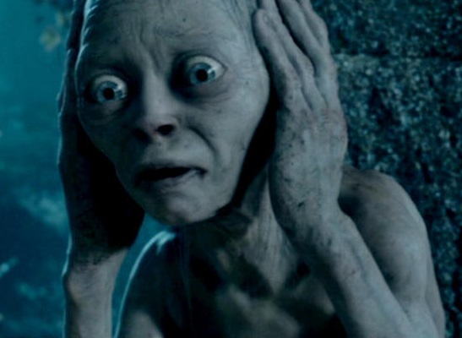
Page 82
It is, at this point, that the proverbial … stuff … has hit the fan.
Time to run.
Notes:
“Suddenly he heard a screech. It sent a shiver down his back. Gollum was cursing and wailing away in the gloom.”
“’Where iss it? Where iss it?...Losst it is, my precious, lost, lost!...What has it got in its pocketses? Tell us that.” – Gollum

Slide 21
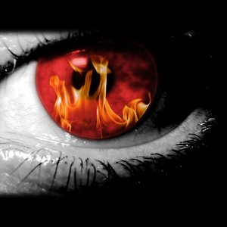
Page 83
Notice the eyes that glow like flame – perhaps another Beowulf reference to Grendel’s appearance.
At this point, Bilbo starts getting that idea that yes, he must run, and truly, something must be special about this little ring, if Gollum wants it so badly.
He puts it on…and…what happens?
Notes:
“But now the light in Gollum’s eyes had become a green fire, and it was coming swiftly nearer…such a rage of loss and suspicion was in his heart that no sword had any more terror for him.”

Slide 22
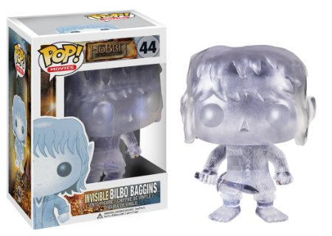
Page 84
Gollum runs right past Bilbo. Why?
Gollum grows more panicked and enraged by the second, realizing that not only is Bilbo is escaping, but his “precious” ring is, as well.
Notes:
Think about Gollum and his ring the way one might think about an addiction – an extremely strong addiction, yet stronger. Gollum is losing the one and only thing that can satisfy said addiction, and he’s been feeding it for who knows how many years.

Slide 23
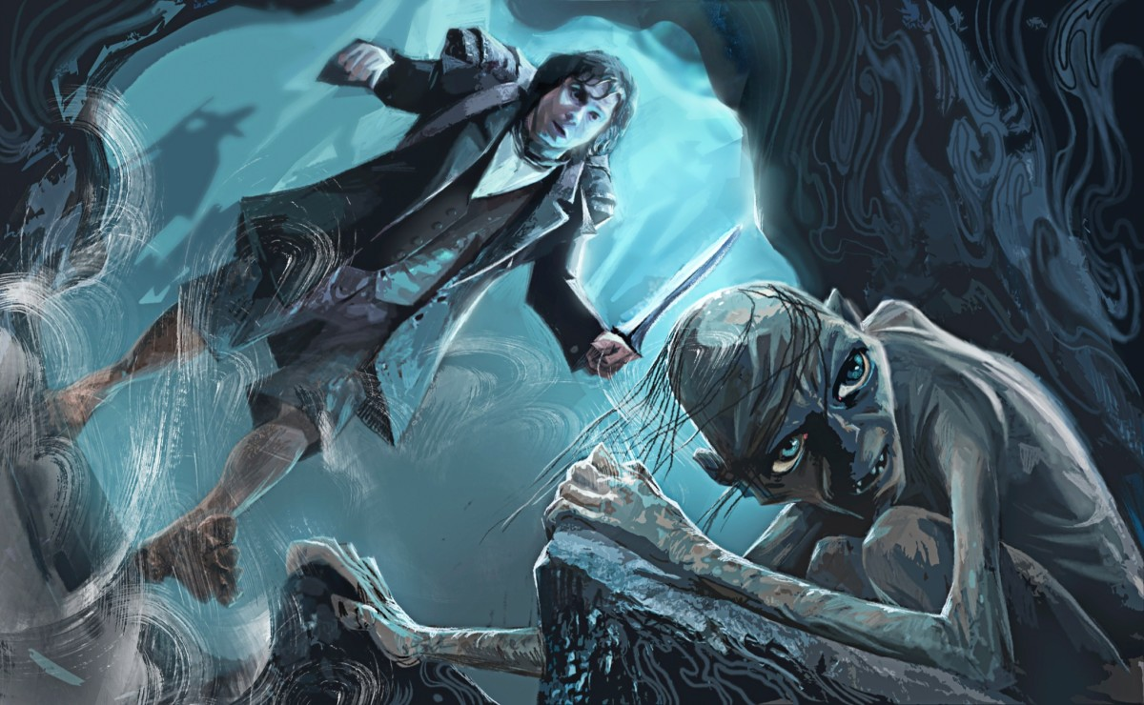
Page 85
In his haste, Gollum theorizes that because Bilbo knows a way in, he must know a way out, and heads for the exit.
Bilbo had hoped for this very opportunity, and cautiously follows Gollum to the exit.

Slide 24
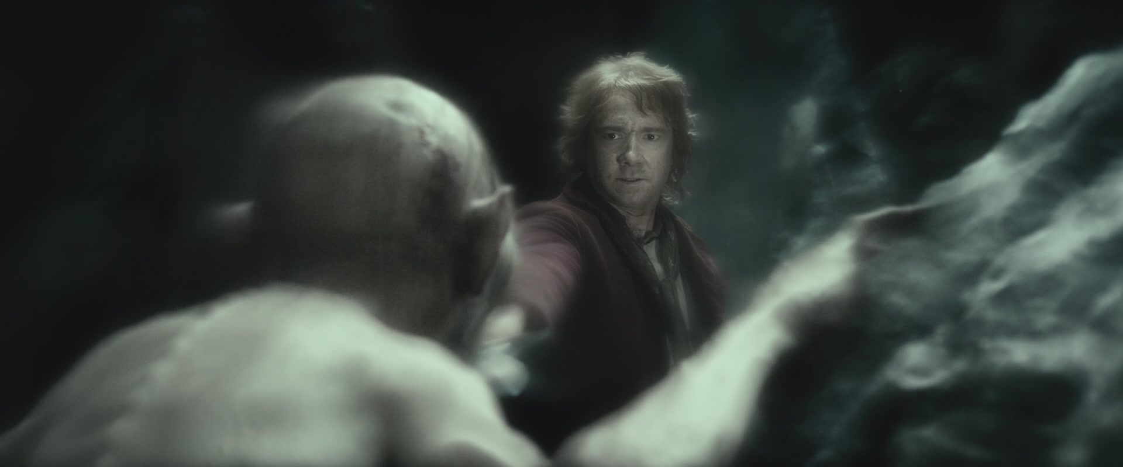
Page 86
Gollum scampers upward, but stops just short of goblin territory.
Why is Gollum afraid of goblins all of a sudden, which once were his food?
What problem does Bilbo encounter once he and Gollum reach the exit into the rest of the caverns?

Slide 25
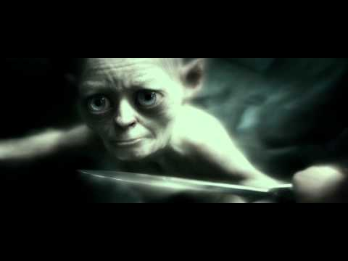
Page 87
Bilbo ponders killing Gollum, but doesn’t do it. Why?
Pity being the operative word, here. Think about why he pities Gollum.
Instead, Bilbo gives a flying leap over Gollum’s head, who does not bear him similar sympathies.
Notes:
“He was miserable, alone, lost. A sudden understanding, a pity mixed with horror, welled up in Bilbo’s heart: a glimpse of endless unmarked days without light or hope of betterment, hard stone, cold fish, sneaking and whispering.”
“Thief, thief, thief! Baggins! We hates it, we hates it, we hates it forever!” – Gollum.

Slide 26
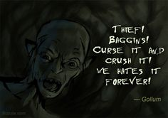
Page 88
Soon, all that lies between Bilbo and the exit to the surface (and the other side of the Misty Mountains) is one small doorway and a group of armed goblins.
Notice the personification of the ring.
Notes:
“Whether it was an accident, or a last trick of the ring before it took a new master, it was not on his finger.”

Slide 27
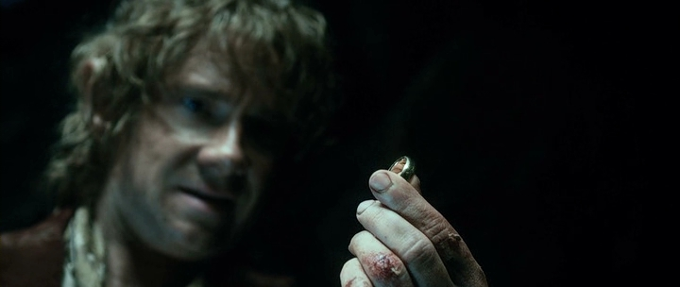
Page 88
Notice the dramatic effect this has on Bilbo.
Give thought to what Bilbo felt when he felt pity for Gollum.
As Gollum was once a Hobbit-turned-monster by the ring, did he see a sliver of himself inside the monster?
Notes:
“A pang of fear and loss, like an echo of Gollum’s misery smote Bilbo, and forgetting even to draw his sword he struck his hands into his pockets. And there was the ring still.”
Already, the addiction of the ring has affected Bilbo, and in so short a time. Predict what this might mean for Bilbo’s future.
Unfortunately, you will not see this prediction played out in The Hobbit. The full effects are only seen in The Lord of the Rings. For now, its negative effects give only hints.

Slide 28
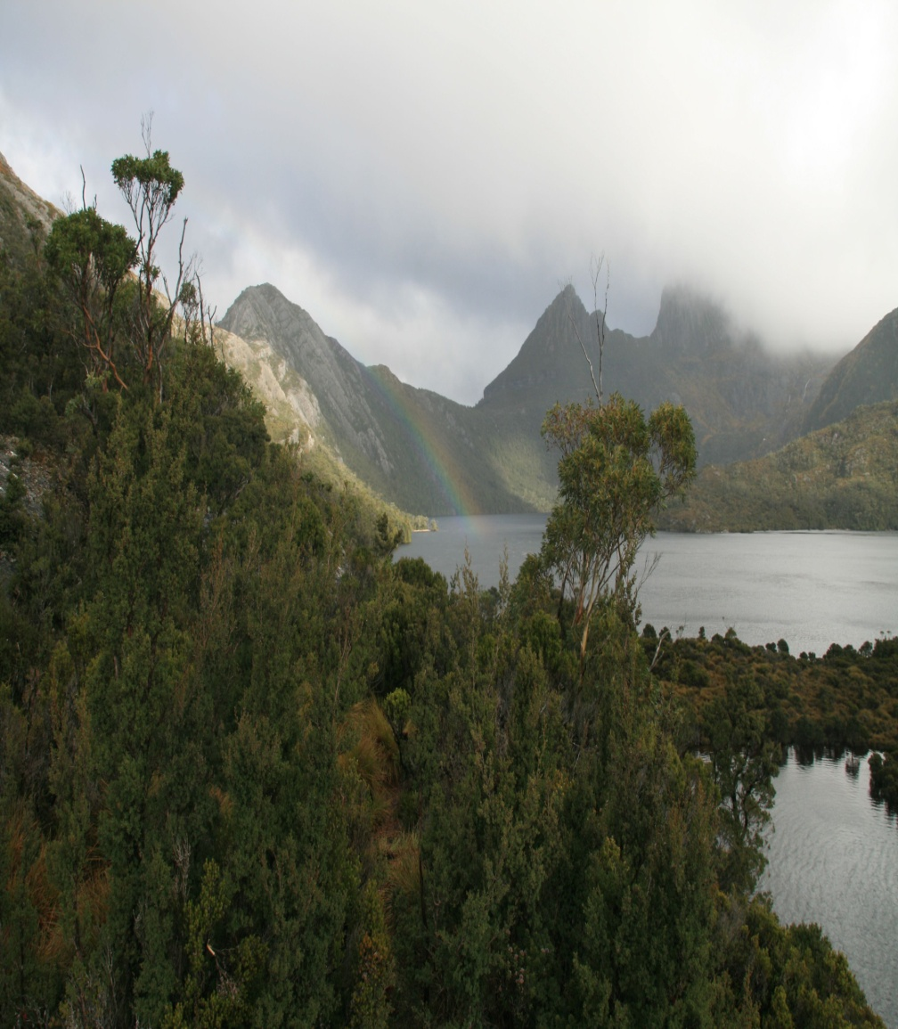
Page 89-90 (End of Chapter)
Either way, Bilbo makes it through the door and out of the caves of Goblin Town.
The goblins notice a shadow, but too late. Bilbo’s escape is sure, and we now transition into the next chapter.

