Slide 1
The Hobbit – Notes on Chapter 7

Slide 2
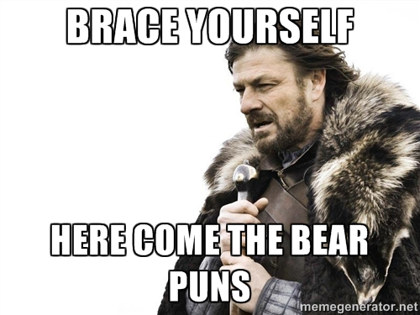
Previously on Guiding Hobbit
The group was rescued by the eagles, who flew them to the edge of lands belonging to Beorn.
Beorn is a “skin-changer,” able to be either man or bear. Gandalf hopes to gain some food and shelter for Bilbo and the dwarves.

Slide 3
Page 112 (Start of Chapter)
“Queer Lodgings”
Remember, this means strange in this context.
How are their current lodgings strange?
Notes:
The eagles ferry them even further, and once again, we get reference to Bilbo as a rabbit.
“’Don’t pinch’ said his eagle. ‘You need not be frightened like a rabbit, even if you rather look like one.’”

Slide 4
Page 113
And so, the group resumes their ground journey.
Notice the blatant foretelling of the return of the eagles, so that it’s no surprise, later.
Notes:
“’Farewell!” they cried, ‘Whereever you fare, till your eyries receive you at the journey’s end!’”

Slide 5
Page 114
What does Gandalf need to do yet again?
Who will Gandalf take them to see before parts, for one last bit of help?
Notes:
“I always meant to see you all safe (if possible) over the mountains.” – Gandalf.

Slide 6
Page 115
What does Gandalf hint at about the personality of their soon-to-be host?
Notes:
“Still I warn you, he gets angry easily.”
“His name is Beorn. He’s very strong, and he is a skin-changer.”

Slide 7
Page 116
Let’s read from the bottom of 115 – 116 together. This is a rather amusing passage.

Slide 8
Page 117
As they approach Beorn’s land, they come across bee hives where Beorn farms them for honey.
Bears – honey.
Let’s resume our reading again from “After a while” on 117 until the end.
Why does Gandalf space out his introduction of the dwarves to Beorn?
Think of what he says, and think back to Bilbo’s introduction to the dwarves as well.

Slide 9
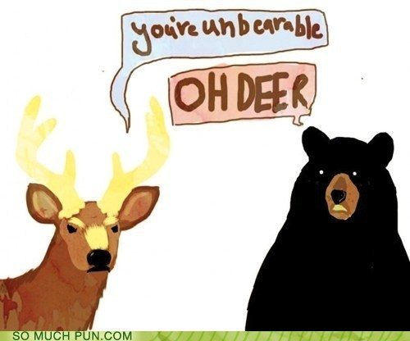
Page 121
One or two…a few…several…
Gandalf, a little at a time, introduces Beorn to his many companions, taking care not to infuriate the bear-man.

Slide 10

Page 122-123
Thankfully, Beorn was in good humor, and found the dwarves’ constant polite bowing and nodding amusing.
Little by little, the dwarves continued to show as Gandalf kept Beorn intrigued with his tale of their journey.

Slide 11
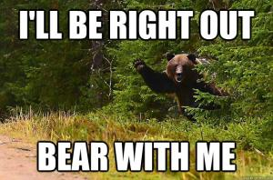
Page 124
In the end, the ploy works, and Beorn welcomes them all in for the night.
Notes:
“A very good tale!..The best I have heard for a long while. If all beggars could tell such a good one, they might find me kinder.”

Slide 12
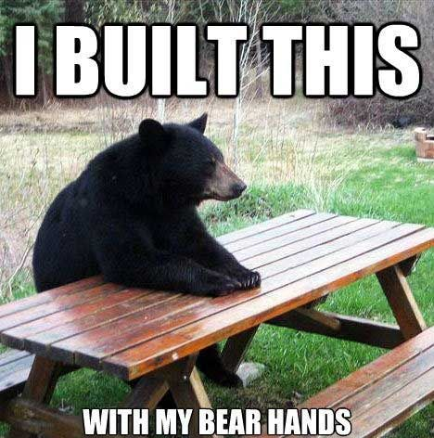
Page 125
Who or what serve / attend on the dwarves while at Beorn’s house?
How does it add to the whimsical nature of this place?
Notes:
And so Beorn shares his own tales, “of the wild lands on this side of the mountains, and especially of the dark and dangerous wood, that lay outstretched far to the North and South.”
Guess where they’re headed next?

Slide 13
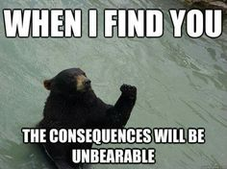
Page 126
Notice the difference in cultures. The dwarves care more for hand-made things, where Beorn seems to prefer things au natural.
Soon, the dwarves took up a new song to wind away the evening:

Slide 14
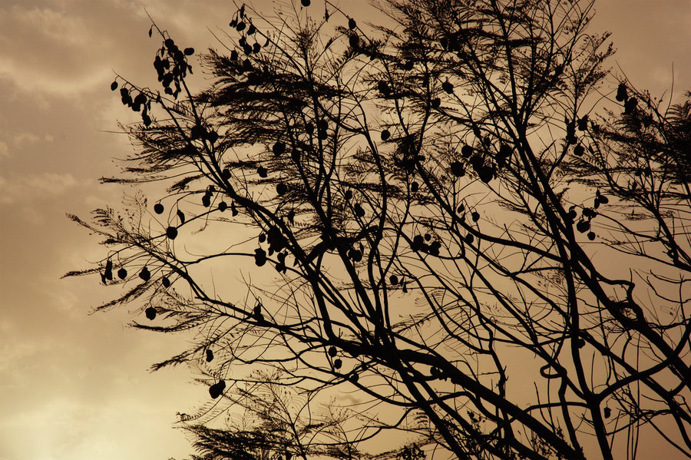
Pages 126-127
The wind was on the withered heath,
but in the forest stirred no leaf:
There shadows lay by night and day,
And dark things silent crept beneath.
The wind came down from mountains cold,
And like a tide it roared and rolled;
The branches groaned, the forest moaned,
And leaves were laid upon the mould.
The wind went on from West to East;
All movement in the forest ceased,
But shrill and harsh across the marsh its whistling voices were released.

Slide 15
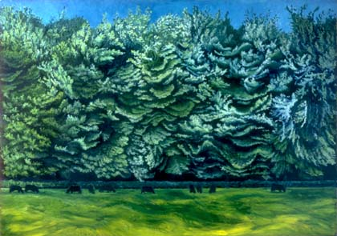
Pages 126-127
The grasses hissed, their tassels bent,
The reeds were rattling—on it went
O’er shaken pool under heavens cool
Where racing clouds were torn and rent.
It passed the lonely Mountain bare
And swept above the dragon’s lair:
There black and dark lay boulders stark
And flying smoke was in the air.
It left the world and took its flight
Over the wide seas of the night.
The moon set sail upon the gale,
And stars were fanned to leaping light.

Slide 16
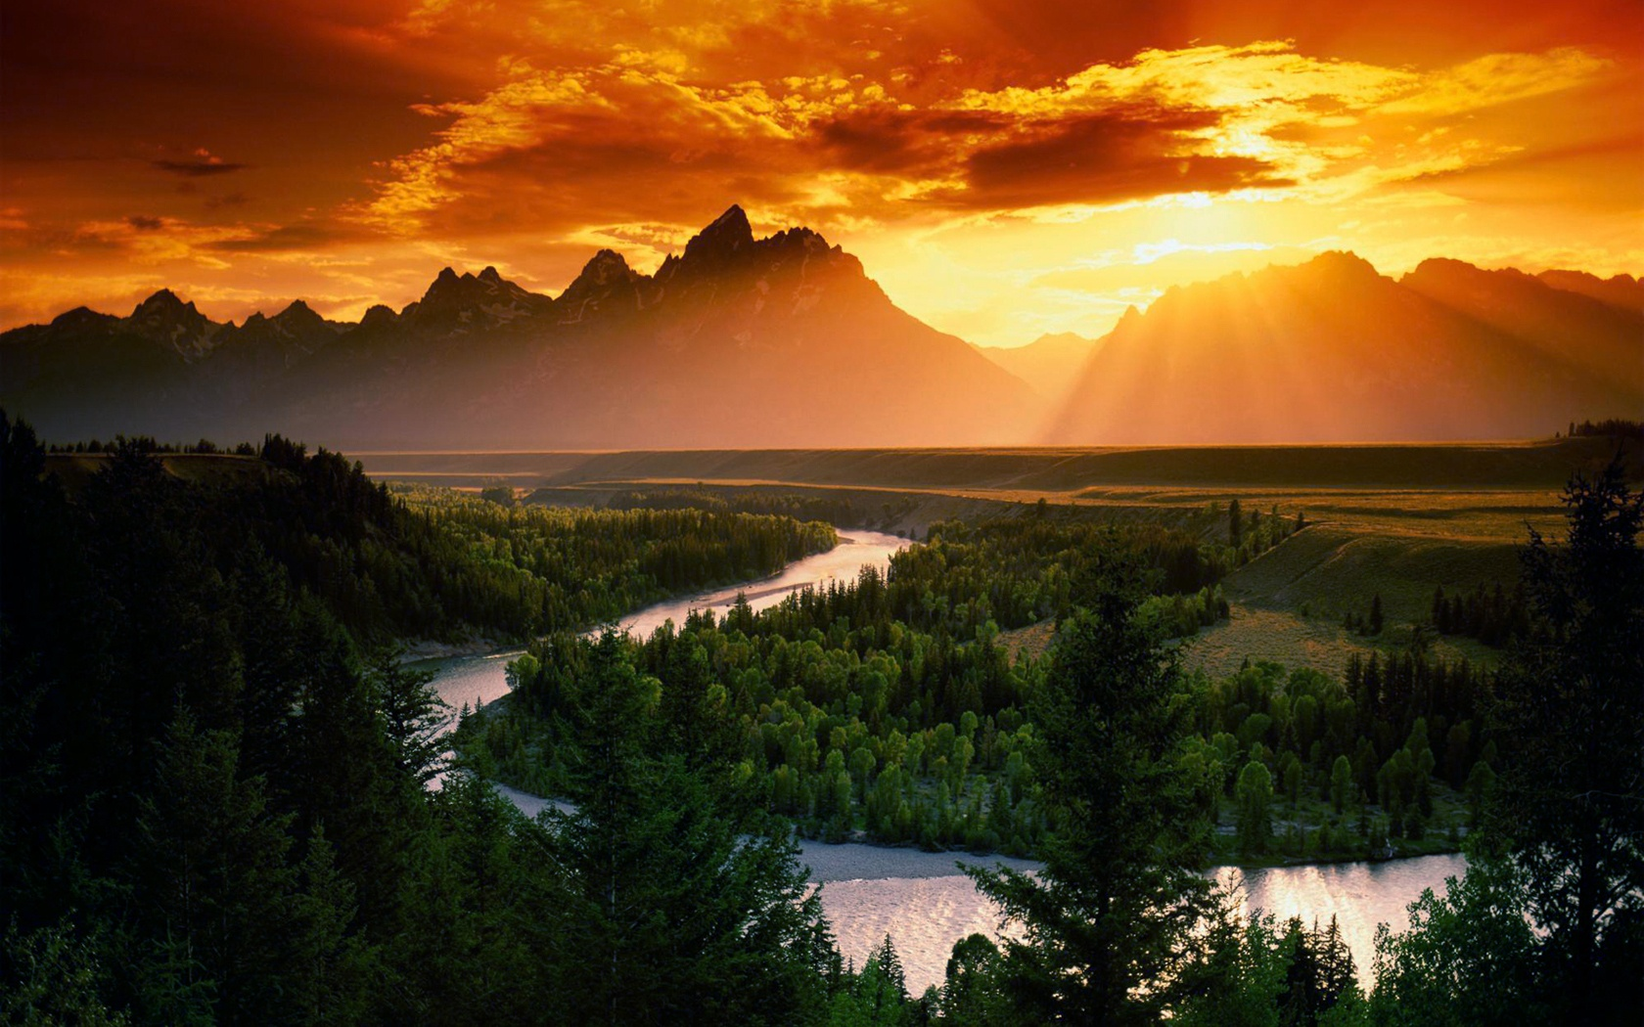
Page 128
Afterwards, they turned in for the night, woke, leapt at breakfast, and waited until evening for Gandalf to return.

Slide 17
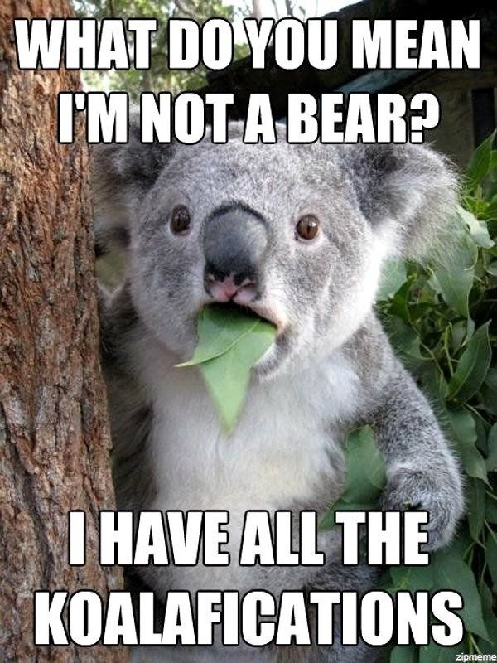
Page 129
After a feast and a few more smoke rings, reminiscent of their time at Bilbo’s, Gandalf begins filling the dwarves in on where he’s been.
What tracks has Gandalf been following?
How many were there?
Apparently Beorn had meant to check out their story.

Slide 18
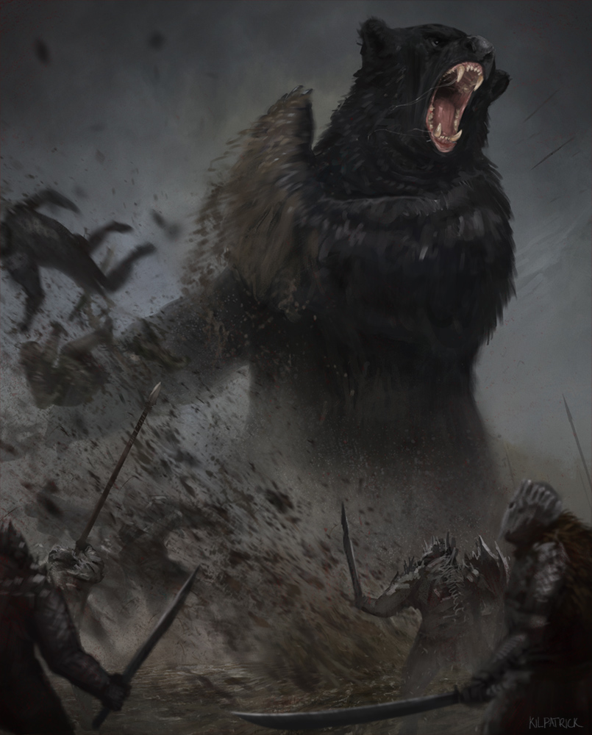
Page 130-131
The next morning Beorn himself wakes Bilbo, adding another rabbit comment to the mix.
Indeed, he’d checked every aspect of their story for himself, interrogated a stray goblin and warg.
What did he do with them?
Certainly doesn’t do to be his enemy.
Notes:
“Little bunny is getting nice and fat again on bread and honey.” – Beorn.

Slide 19
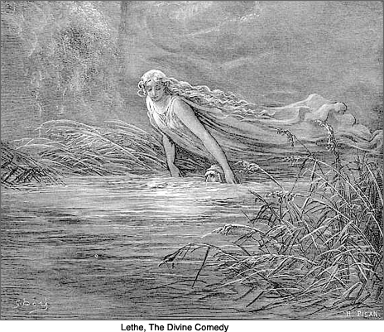
Page 132
Here, Gandalf finally gives Bilbo and the dwarves his final advice and warnings before letting them traverse Mirkwood alone.
Think about ancient epics – descents into dark underworlds, especially Greco-Roman ones, usually involve the River Lethe – the river of forgetfulness.
Notes:
“Your way…is dark, dangerous, and difficult…There is one stream there, I know, black and strong which crosses the path. That you should neither drink of, nor bathe in; for I have heard that it carries enchantment and a great drowsiness and forgetfulness.”

Slide 20
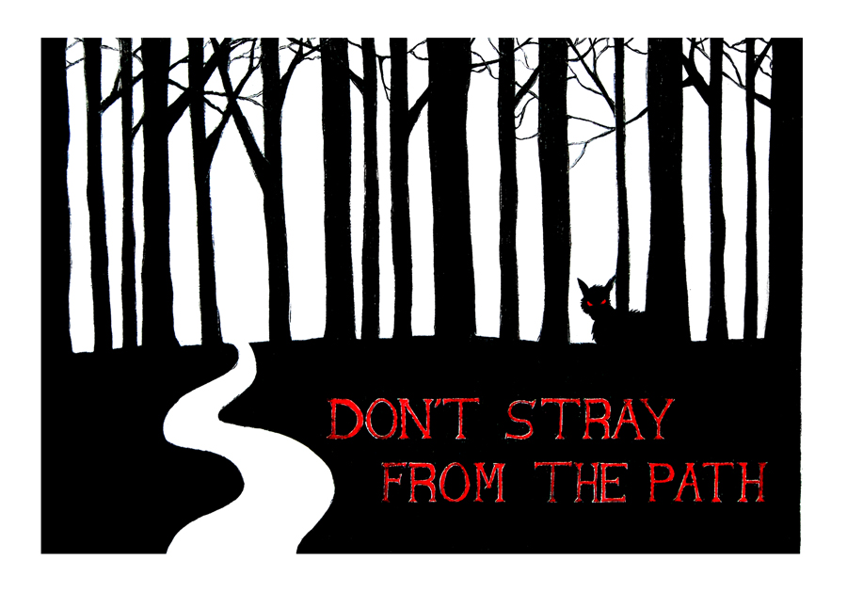
Page 132
Singular paths through dark and dangerous places often symbolize the “straight and narrow” path one must walk, i.e. a moral life, when going through life, a place filled with darkness, danger, temptations, etc.
Notes:
“Straying from the path…That you MUST NOT do, for any reason.”
This, also, becomes a motif in many fantasy stories – never straying from the path.
The Divine Comedy and The Pilgrim’s Progress, for instance, involve similar paths, with dangers off to the side. Another example is an old werewolf film titled In the Company of Wolves.

Slide 21
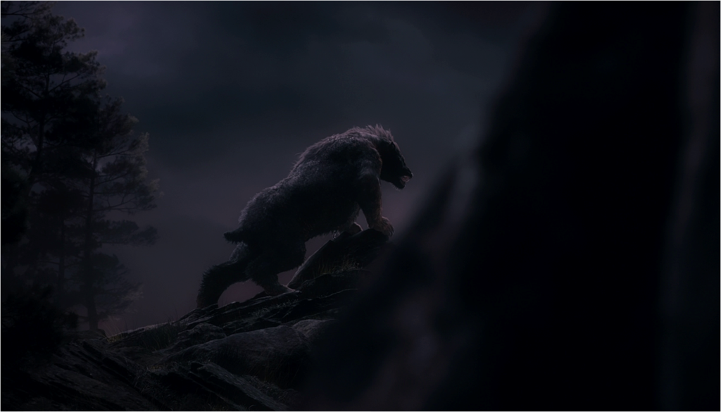
Page 133-135
And so Bilbo and the dwarves made their way to the entrance of Mirkwood, avoiding goblins and staying as close to Beorn’s lands as possible (as goblins seem to avoid them).
All the while, Beorn prowled near by in the shadows, keeping an eye on them as they left.
Why does Gandalf suggest he’s been watching?

Slide 22
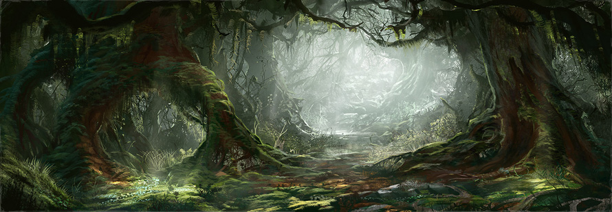
Page 136
Let’s read together from the middle of 136-140, wherein Gandalf leaves and they enter Mirkwood forest.

