Slide 1
The Hobbit – Notes on Chapter 8

Slide 2
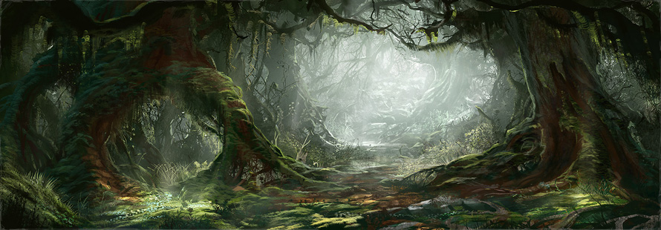
Previously on the Bold and the Hobbitful
Gandalf has led Bilbo and the dwarves beyond the lands of Beorn to the edge of Mirkwood forest, which lies between them and the Lonely Mountain.
There, he plans to leave them for urgent business with only a few parting words of advice – do not touch the river, and do not stray from the path.

Slide 3
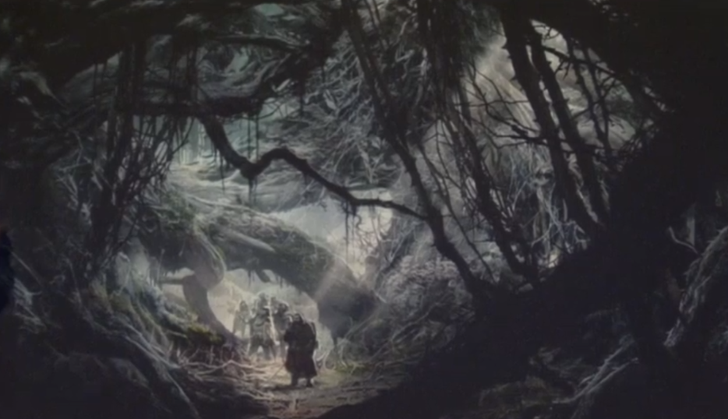
Page 141
Continuing in Chapter 8 – “Flies and Spiders.”
Overall, Mirkwood does not seem to be a pleasant place.
Dark, gloomy, “mirky” one might say.
Notes:
“The nastiest things they saw were the cobwebs: dark dense cobwebs with threads extraordinarily thick, often attached from tree to tree, or tangled in the lower branches on either side of them.”
However, notice the difference on the path:
“There were none stretched across the path, but whether because some magic kept it clear, or for what other reason they could not guess.”
Do you think this is magic? Symbolic? Both? Neither?

Slide 4
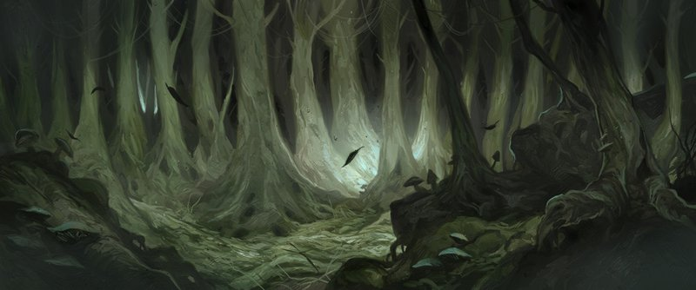
Page 141-142
What do they see in the darkness?
What happens when they try to make fires?
As their supplies dwindle, they make it to the aforementioned dark river.
What must they avoid?
How do they attempt to cross?

Slide 5
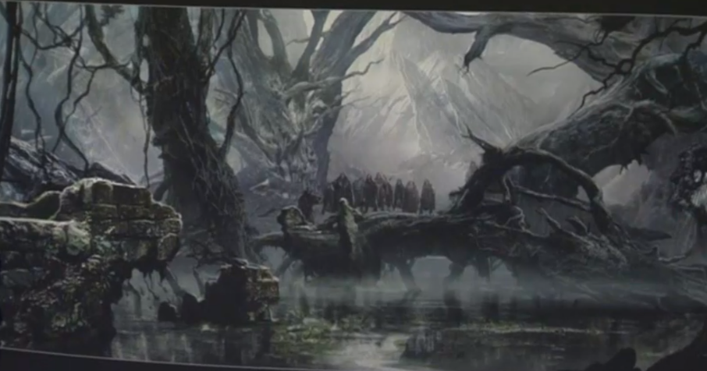
Page 143
As it turns out, an old boat (left by…who knows) lies on the other side of the river.
Using rope and hooks, they try to pull the boat across and ferry each other a little at a time.

Slide 6
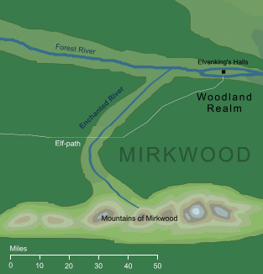
Page 144
As it turns out, the boat is tied, has no oars, and must be moved by the ropes and hooks.
Bombur complains. Why?
Thorin continues to order the company as they organize their journey across.

Slide 7
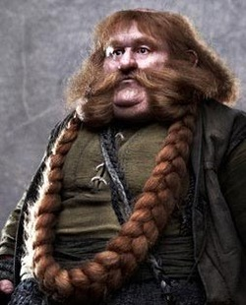
Page 145
What goes wrong when they try to cross?
Who does it happen to?
How could this pose a challenge to their continued journey through the forest?

Slide 8
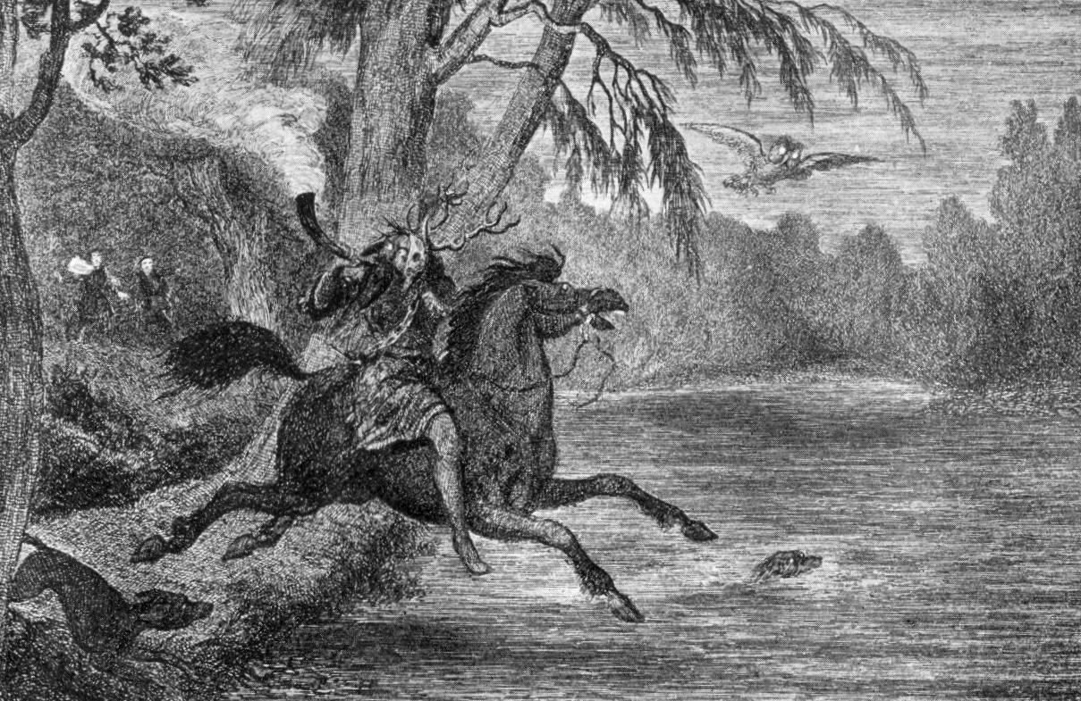
Page 146
“They became aware of the dim blowing of horns in the wood and the sound as of dogs baying far off. Then they all fell silent; and as they sat it seemed they could hear the noise of a great hunt going by to the north of the path, though they saw no sign of it.”
Ghostly hunts riddle European mythology, especially in the forms of the Wild Hunt and Herne the Hunter.

Slide 9
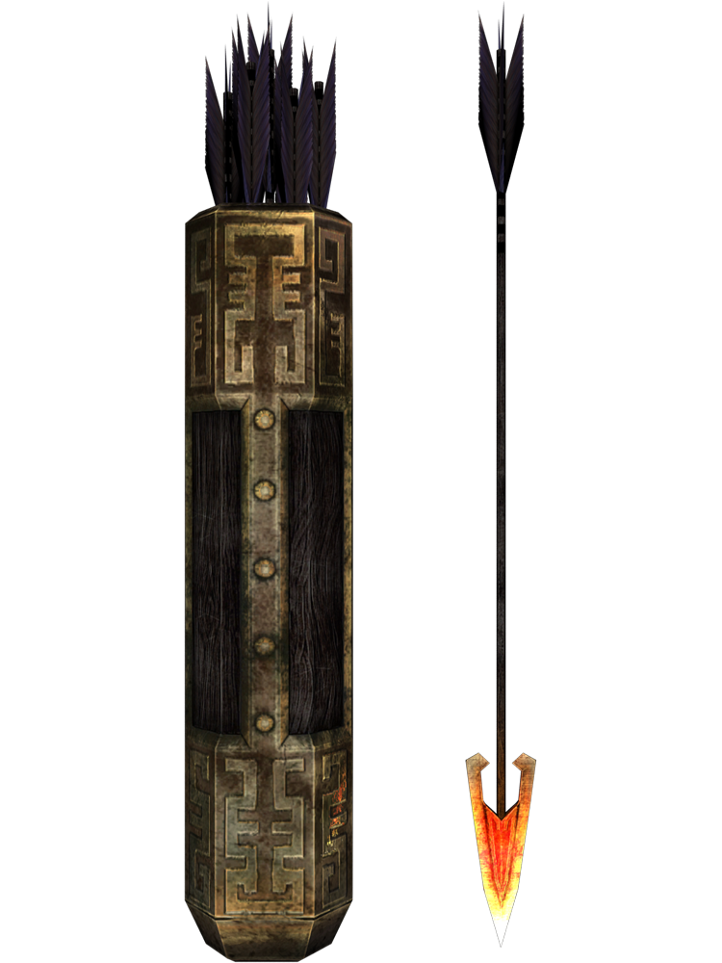
Page 146-147
What mistake do the dwarves make with their dwindling supplies?
Soon, with no arrows and little food or water, they wandered wearily through the woods, carrying Bombur all the way as he slept.
As the text says, they near the eastern edge of the forest, but wander the wrong way in their tiredness.

Slide 10
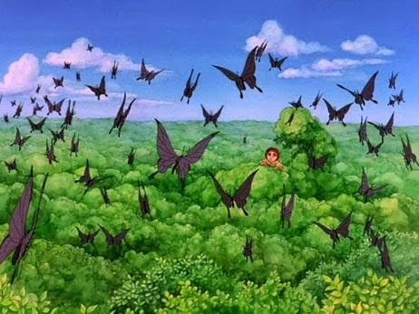
Page 148-149
Who do the dwarves ask to climb up the trees and have a look about?
What does he see?
Notice how, even in the midst of danger and gloom, he finds beauty.

Slide 11
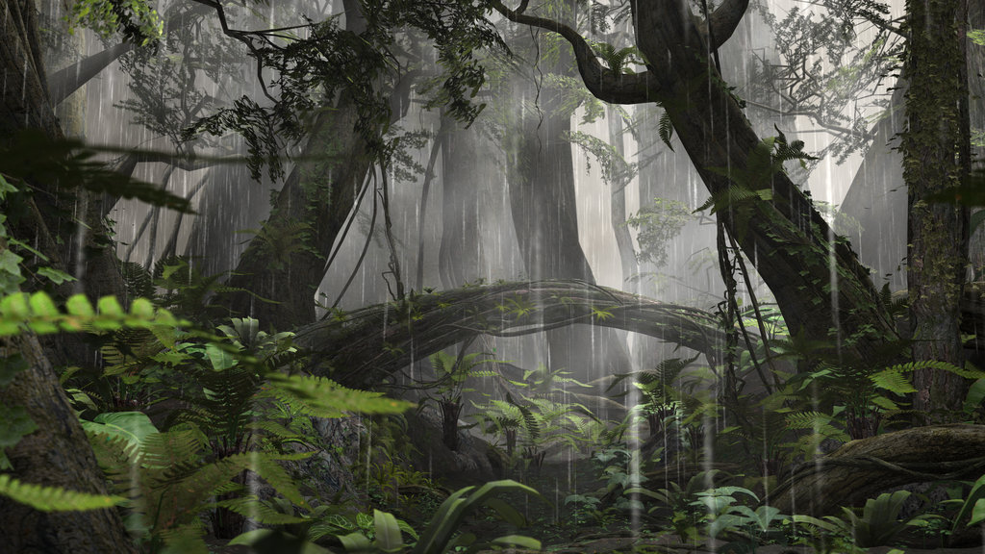
Page 149-150
And they continue on. Day and night. Rain and starvation.
What small reprieve do they get from their sleeping friend?
How does he still manage to complain?

Slide 12
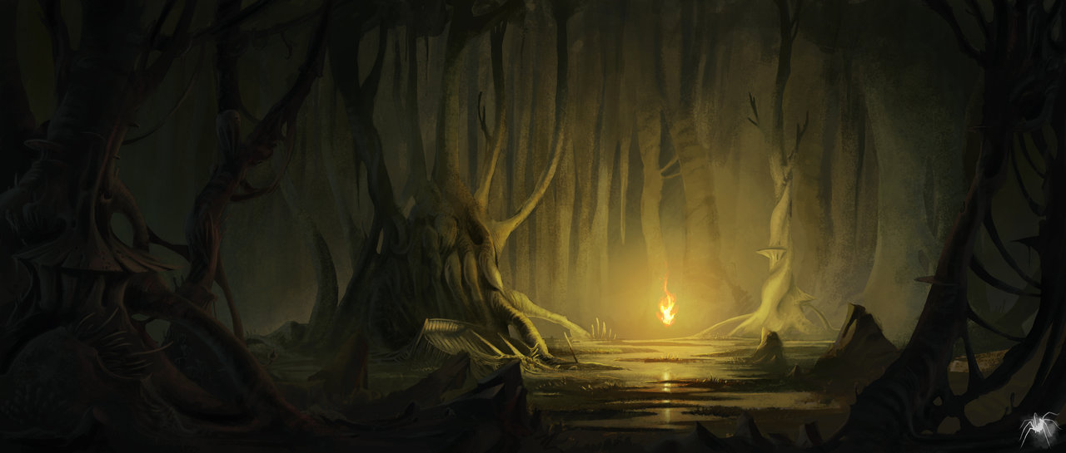
Page 151
Soon, they see twinkling lights in the dark forest.
They see a feast, yet it is off the path.
Thorin makes the very important point:
“A feast would be no good if we never got back from it alive.”
What do you think it is? Should they go for it? Why or why not?

Slide 13
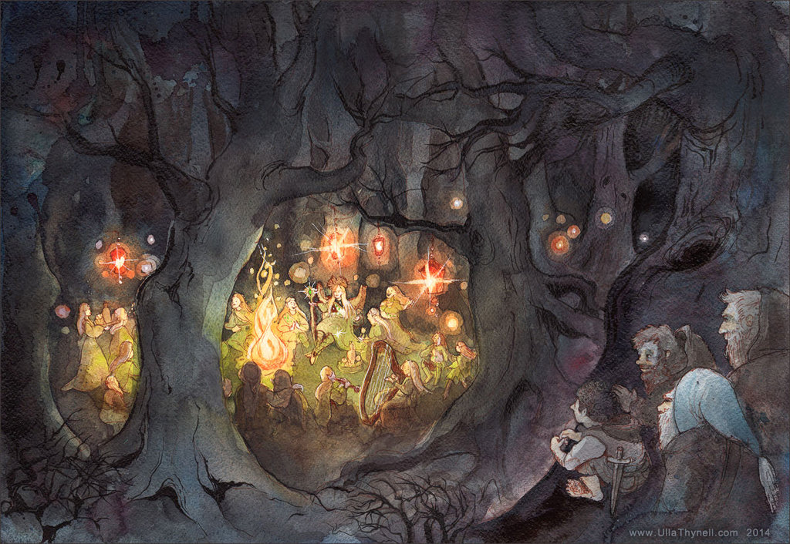
Page 152
“So they all left the path and plunged into the forest together.”
This never goes well.
What do they find there?
“There were people there, elvish-looking folk, all dressed in green and brown and sitting on sawn rings of the felled trees in a great circle…They were eating and drinking and laughing merrily.”
Seems legit…

Slide 14

Page 152-154
What happens when they approach the feast?
Is it real?
How is Bombur’s delirium spreading?
Soon, Bilbo loses the company of dwarves all together in the darkness of the forest.

Slide 15
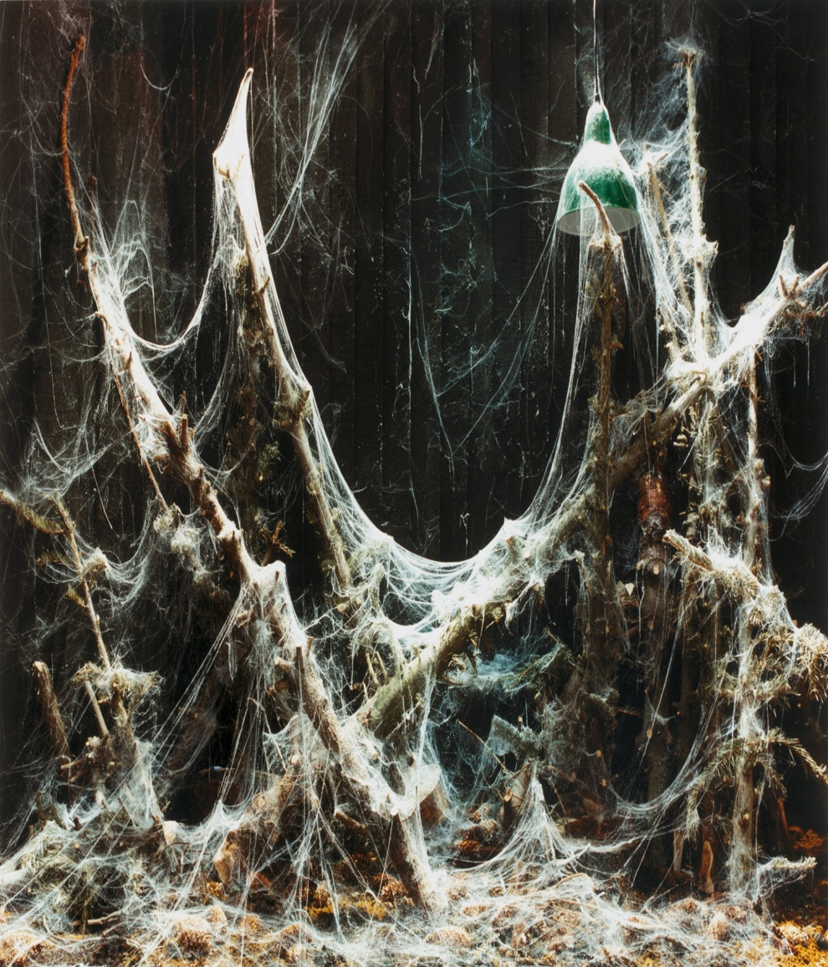
Page 155
As Bilbo tries to lay down and return to the food in his dreams, his hand and legs find something sticky about them…
What’s happening to Bilbo?
How does he escape?

Slide 16
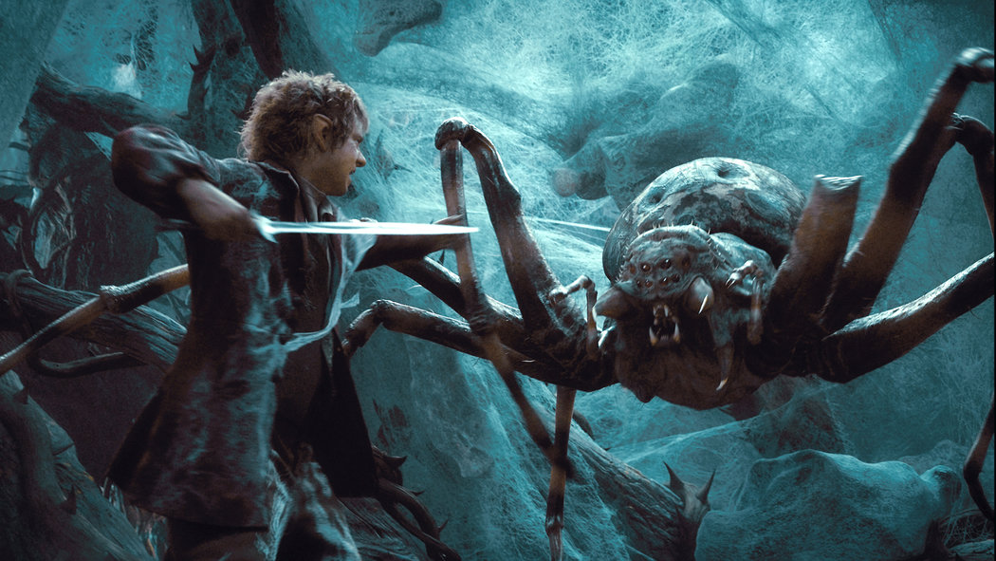
Page 156
When Bilbo wakes from his brief blackout:
“Somehow the killing of the giant spider, all alone by himself in the dark without any help of the wizard or the dwarves or of anyone else, made a great difference to Mr. Baggins.”
Note the change in Bilbo, in his confidence.
What does he name his sword?

Slide 17
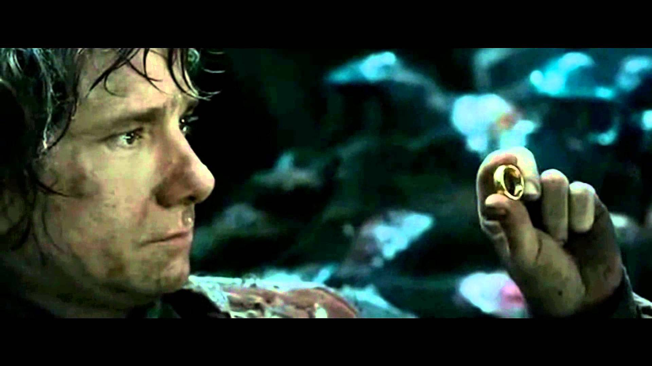
Page 157
In pages 157 – 160, Bilbo encounters the rest of the spiders.
Let’s read together and see how that goes.

Slide 18
Page 161-163
Bilbo continued to do battle with the spiders. Between his elven blade, Sting, and his ring of invisibility, he definitely holds his own.
Little by little, he rescued the dwarves and gained their assistance, though they were still rather sluggish from the poison.

Slide 19
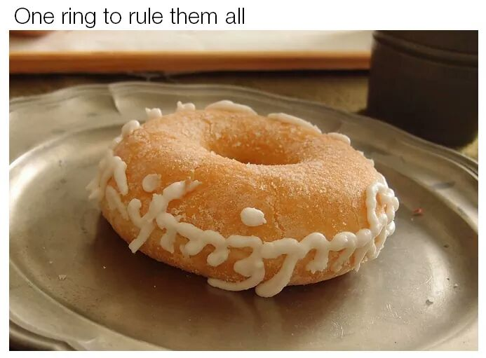
Page 164
What does Bilbo finally reveal to the dwarves?
His social security number?
His favorite color?
His password, including numbers and special characters?
Nope. The power of the ring.
In a last ditch effort, he fends off the spiders while the dwarves make a run for it, toward the last place they saw the elf fires.

Slide 20
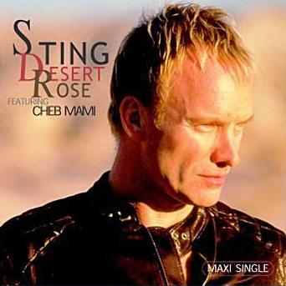
Page 165
And so Bilbo handed the spider’s butts to them:
“They had become mortally afraid of Sting.”
Eventually, Bilbo caught up with the dwarves and filled them in on the whole story of his exploits in the Misty Mountain caves, ring and all.

Slide 21
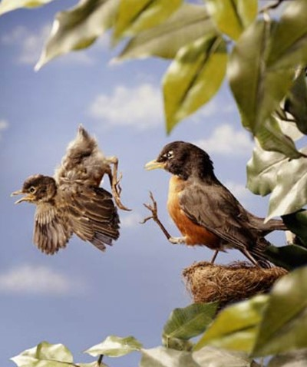
Page 166
Eventually, they came back to pondering their current predicament; however, with new found respect for Bilbo.
Do note this – if Gandalf had never made himself absent, would there ever have been room for Bilbo to prove himself?
Wouldn’t there always be temptation to rely on a wizard when one is around?
i.e. No room for growth.
Has kind of a “coming of age” flair to it, this situation – like leaving home to become one’s own adult, prove one’s self in life, etc.

Slide 22
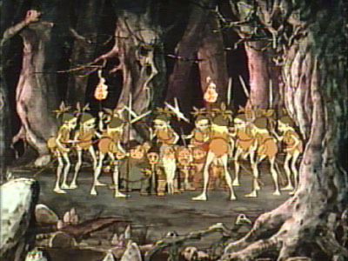
Page 167
Who were the feasting elves in the forest, specifically?
Let’s read how Tolkien characterizes Wood Elves (and other varieties) in the passage on 167.
How do they treat the Thorin they encounter each other?

Slide 23
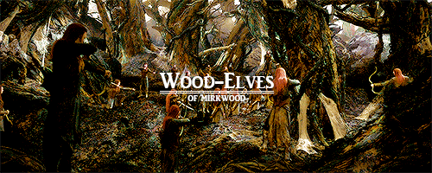
Page 168
The wood elves guide Thorin through the beautiful and majestic halls of their kingdom…to its dungeons.
As it turns out, wood elves are very distrustful of strangers. Seems to be a trend beyond Elrond’s last homely house. Dangerous lands seem to breed that attitude.

Slide 24
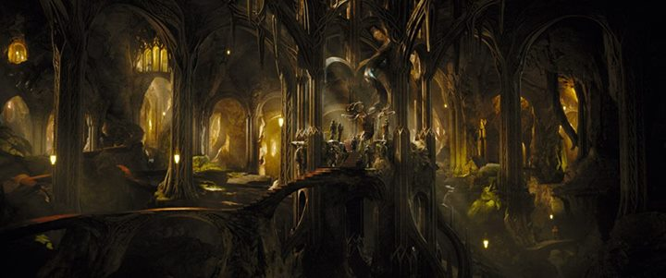
Page 169-170 (End of Chapter)
When Elvenking (referred to in later works as Thranduil) interrogates Thorin, what does he say?
Notice the comical / stubborn repetition in Thorin’s story.
What does he not say?
Why?
What does his secret-keeping get him?
How is being a prisoner of elves compared to being prisoner to say, goblins or other creatures?

