Slide 1
The Hobbit – Notes on Chapter 9

Slide 2
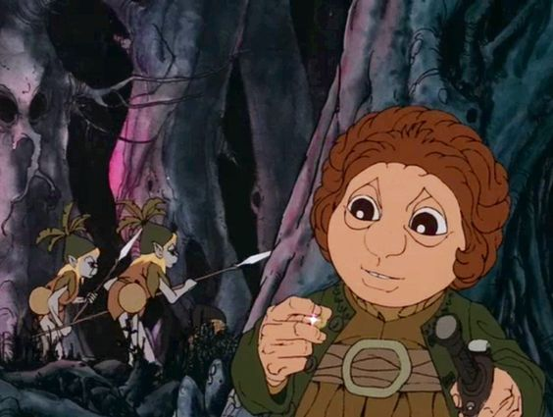
Page 171 (Start of Chapter)
“Barrels out of Bond”
Soon enough, the remainder of the dwarven company is captured and taken to the Wood Elf dungeon.
How does Bilbo evade capture?

Slide 3
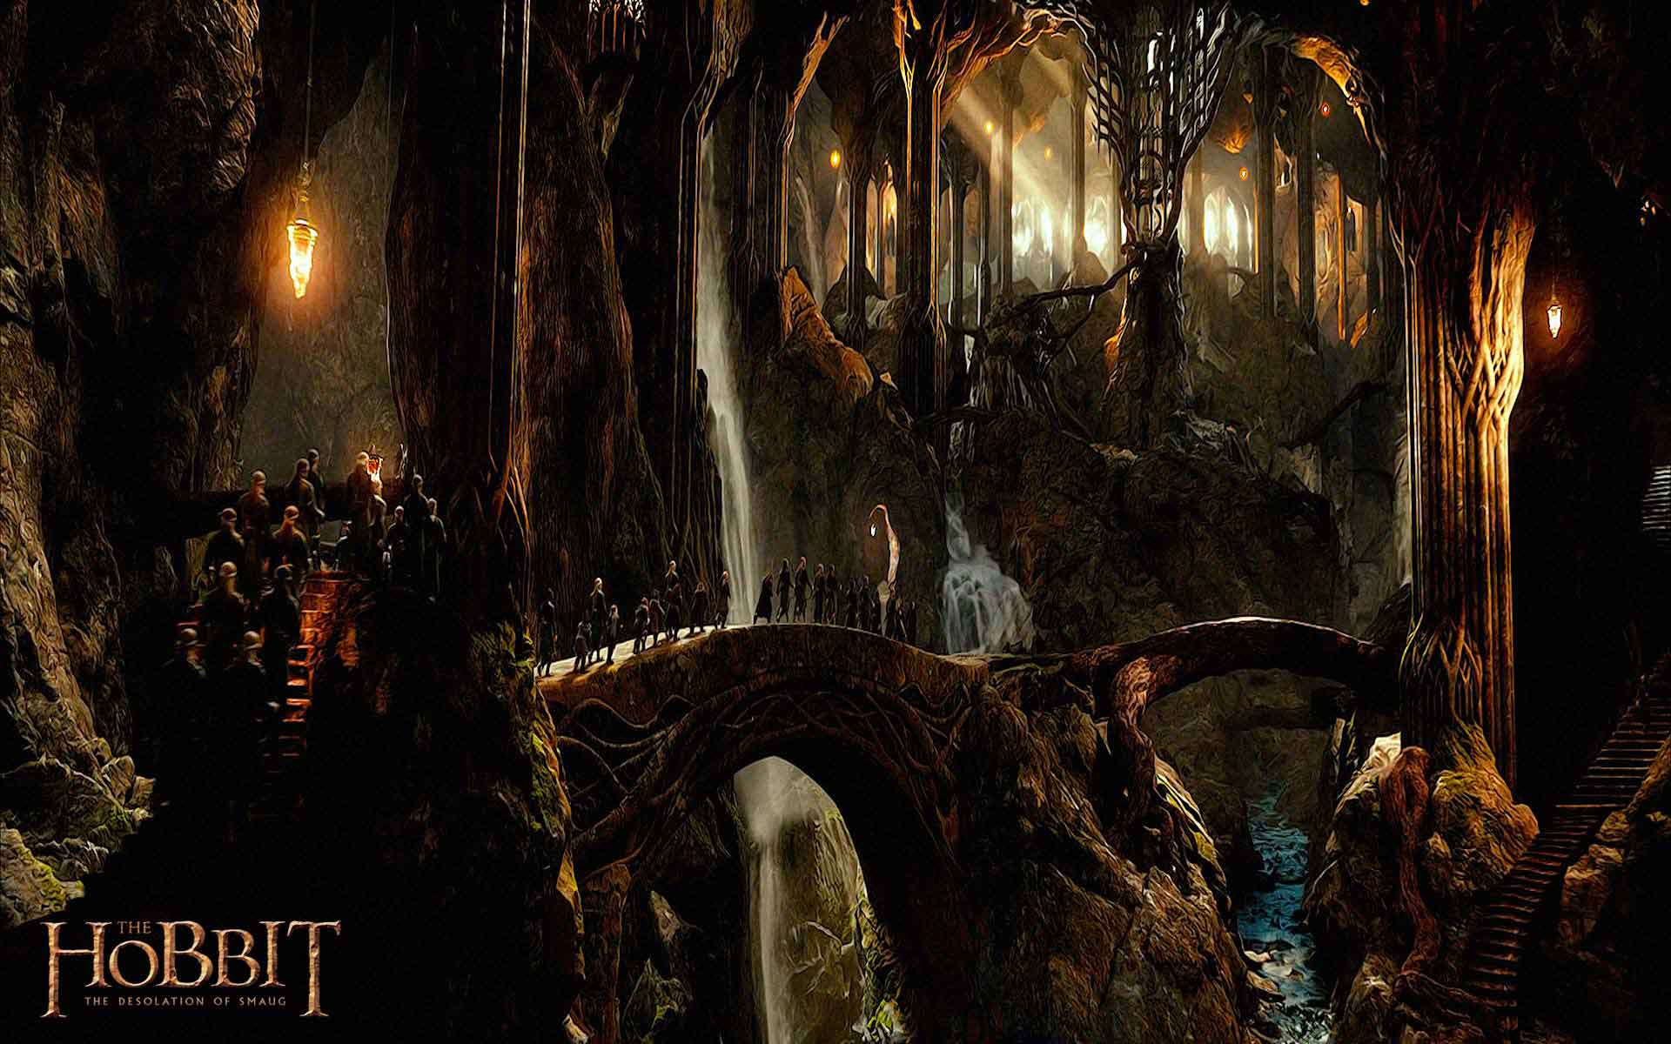
Page 172
Notice the marked contrast between the two cavern realms – goblin and wood-elf – 2nd to last paragraph.
The Elvenking has them unbound. Why?

Slide 4
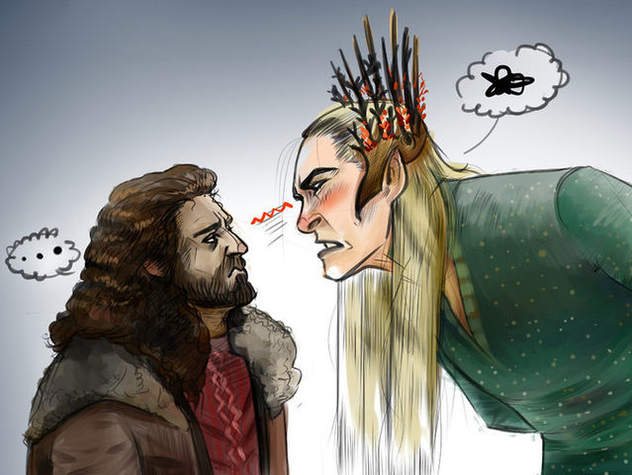
Page 173
“What have we done, O king?”
The dwarves plead their innocence, ask if killing spiders is a crime, if they are beloved by the Elvenking, only angering him further.
What might they have done to earn mercy?
Again, like Thorin, they refuse.

Slide 5
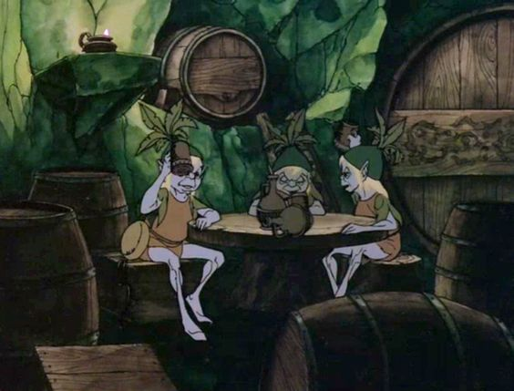
Page 174
Bilbo, still invisible, spends a great deal of time observing the various workings of the wood elves’ kingdom.
He marks their paths, movements, routines, habits, etc.
“I am like a burglar that can’t get away, but must go on miserably burgling the same house day after day.”
He does not see the benefit of his position at first, yet later, it becomes invaluable.

Slide 6
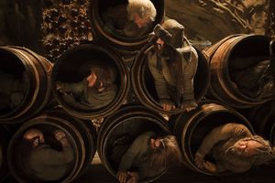
Page 175
At this point, Thorin is worn down – ready to tell the Elvenking everything.
What stops him?
After much message carrying between the dwarves, Bilbo slowly orchestrates an escape plan.

Slide 7
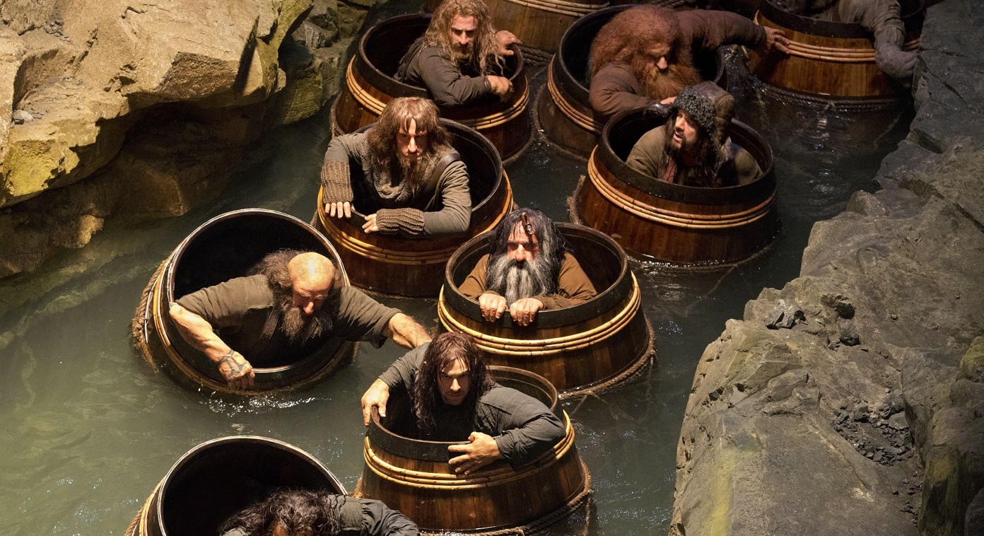
Page 176
“Bilbo, however, did not feel nearly so hopeful as they did. He did not like being depended on by everyone, and he wished he had the wizard at hand.”
Notice again, that if Gandalf had been here, Bilbo would miss yet another opportunity to prove himself.
This would be the story of Gandalf, not of Bilbo the hobbit.

Slide 8
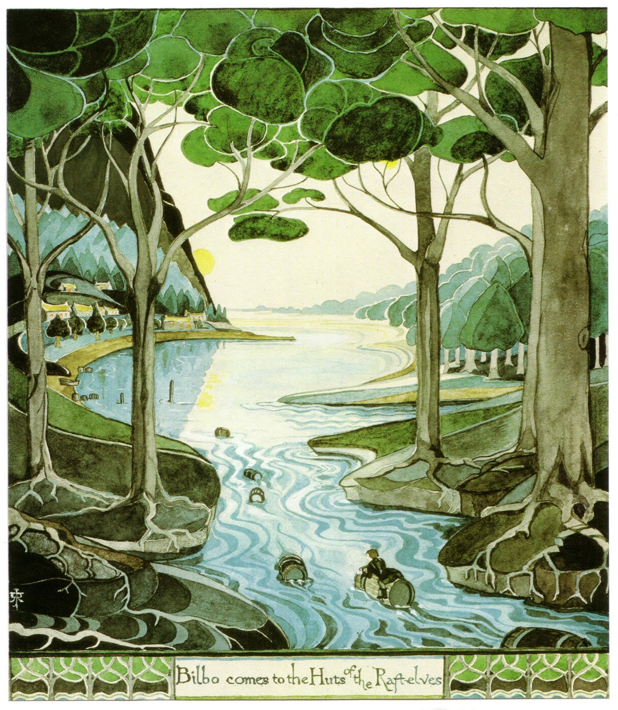
Page 176-177
Slowly, Bilbo observes the drinking habits of the elves.
How do the elves get their wine?
What do they do once they’re done with it?

Slide 9
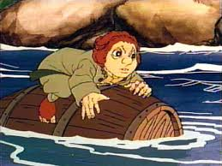
Page 178
Soon, Bilbo executes his plan – again, blatantly hinted at in the chapter title.
He waits until the elves are in a deep and wine-filled sleep, takes their keys, and frees the dwarves from their cells.

Slide 10
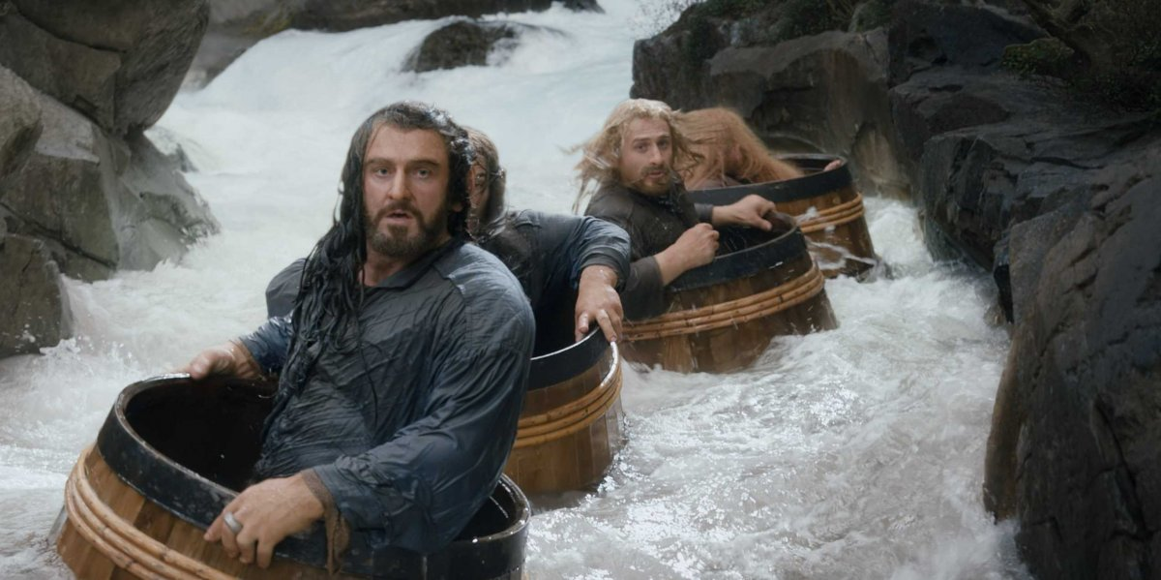
Page 179
How will Bilbo get the dwarves out of the wood elf kingdom?
Notice their extremely positive feelings for him upon being freed, and the near immediate turn around when they see “how” they are to be freed.
Always a moment’s breadth away from complaining.

Slide 11
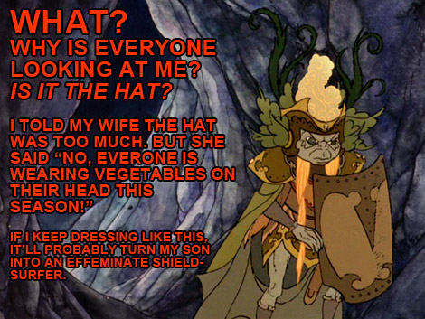
Page 180
Soon enough, Bilbo guides the dwarves to the barrels they are ride in.

Slide 12
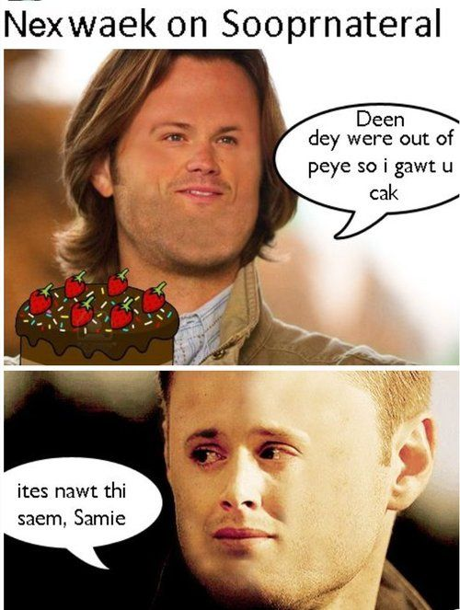
Previously on Hobbinatural
~Cues “Wayward Son” by Kansas~
The dwarves, weak from the spider attacks and starving from their long trek through the forest, are captured by the Wood Elves and detained in their dungeons – partly for charging at their feasts, partly for refusing to tell of their quest.
Bilbo maintains his invisibility with the ring, observes the Wood Elves, and manages to get all of the dwarves into empty wine barrels to escape via the river.

Slide 13
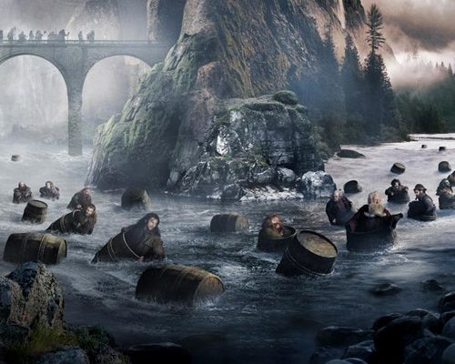
Page 181-182
Thirteen dwarves stuffed into barrels, straw for padding, ready to go.
Some wood elves come to wake the drunk / sleeping ones, yet all are too concerned with wine for carefully checking the barrels, and release them all into the water.

Slide 14
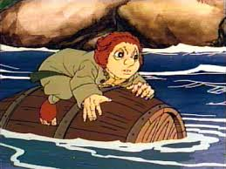
Page 183
The narrator reminds us that there is one small flaw in Bilbo’s plan.
What is it?
What does he do?
All the while, the wood elves sing while they work:

Slide 15
Page 183-184
Down the swift dark stream you go
Back to the lands you once did know!
Leave the halls and caverns deep,
Leave the northern mountains steep,
Where the forest wide and dim
Stoops in shadows grey and grim!
Float beyond the world of trees
Out into the whispering breeze,
Past the rushes, past the reeds,
Past the marsh’s waving weeds,
Through the mist that riseth white
Up from the mere and pool at night!
Follow, follow stars that leap
Up the heavens cold and steep;
Turn when dawn comes over land,
Over rapid, over sand,
South away! And South away!
Seek the sunight and the day,
Back to pasture, back to mead,
Where the kine and oxen feed!
Back to gardens on the hills
Where the berry swells and fills
Under sunlight, under day!
South away! And South away!
Down the swift dark stream you go
Back to the lands you once did know!

Slide 16
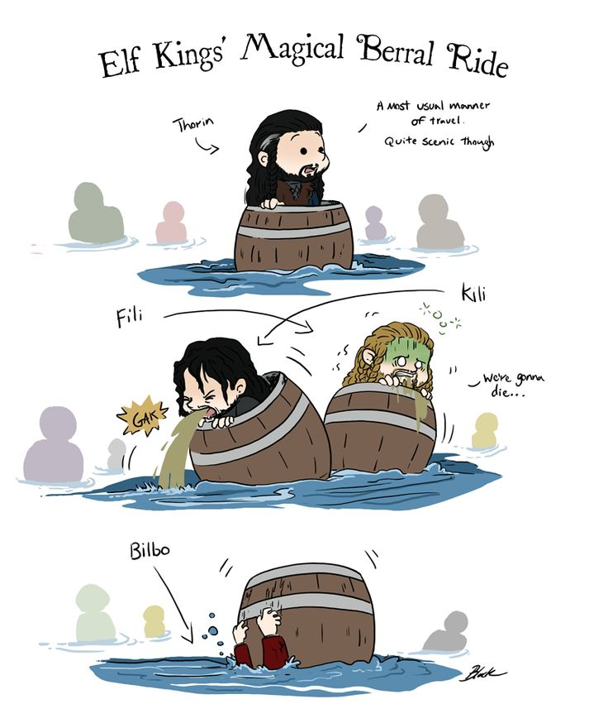
Page 185
And so, Bilbo rides the outside of the barrels as the dwarves ride within, hurdling down the river and making all efforts not to drown.
“I do hope I put the lids on tight enough!” – Bilbo.

Slide 17
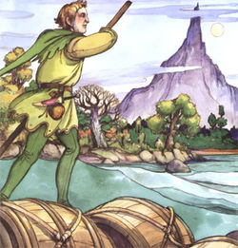
Page 186
In time, they floated beyond the edge of Mirkwood.
Now within the realm of humans, the barrels are brought up onto shore by men with long poles, tied up, and left to be dealt with the next day.

Slide 18
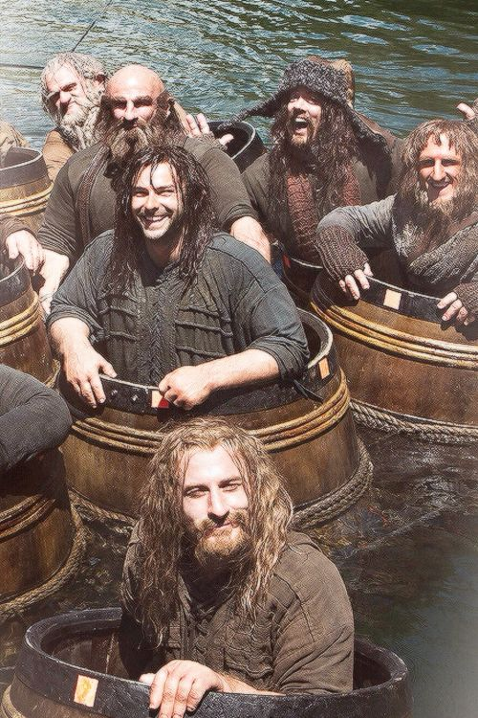
Page 187-188 (End of Chapter)
Bilbo remained invisible, stole food and drink from the nearby village, and made it back to the barrels…
…Just in time to see them tied together on rafts and pushed farther down the river. Bilbo hitches a ride as well, and the journey continues.

