Slide 1
Historical Introduction to the Renaissance – 1485-1660
“Humanism”
Based on pages 236 – 245 of Elements of Literature, Sixth Edition.

Slide 2
Humanism: A New Intellectual Movement – Pg236
Studia humanitatis – humane studies
Today, we call this area of studies the humanities.
Humanities includes the following areas of study:
  Philosophy
  History
  Languages
  Art
  Music
  Literature
Humanism emphasizes studying both the Bible and the Greek and Latin classics for wisdom and knowledge.

Slide 3
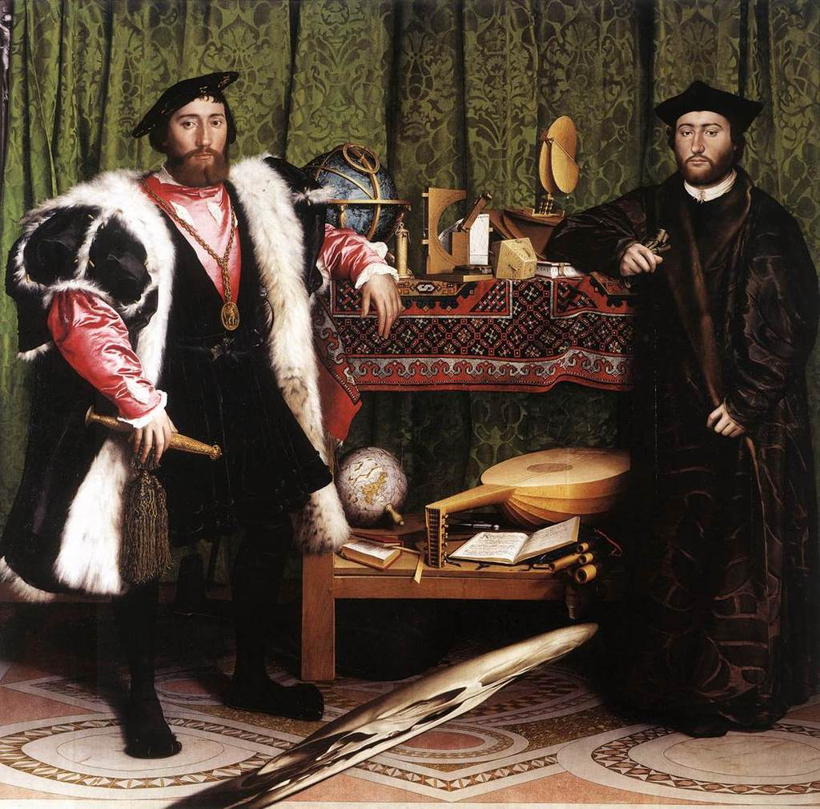
The Ambassadors by Hans Holbein the Younger (1533) – Pg232

Slide 4
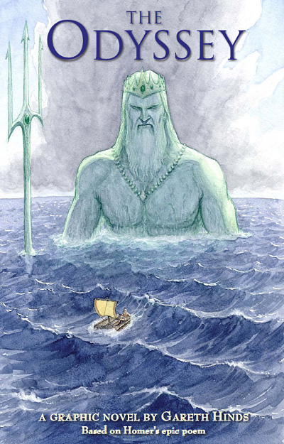
Rediscovering Ancient Greece and Rome – Pg240
Renaissance – “Rebirth” – refers to the renewed interest in classical learning.
The term “Classical” refers to the writings of ancient Greece and Rome.
These include such writers as Plato, Aristotle, Homer, Virgil, and Ovid.

Slide 5
A Renaissance man! - 241
Renaissance Man
  Energetic
  Productive
  Interested in
    Science
    Literature
    History
    Art
In other words, the ideal person of this time, or “Renaissance” person dabbles in all things.

Slide 6
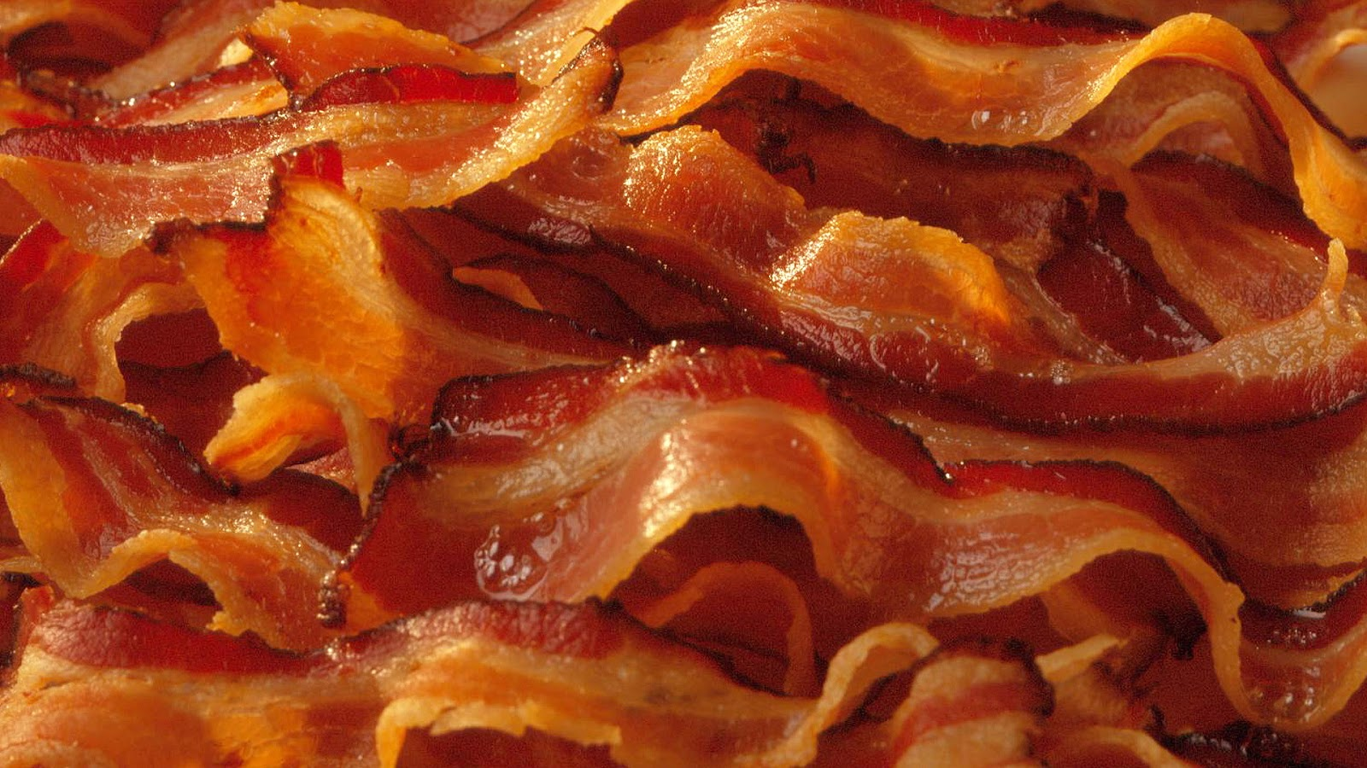
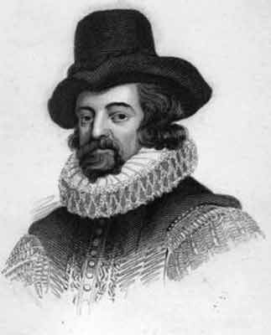
Sir Francis Bacon – Pg 240
British philosopher, scientist, and writer.
1561-1626
“Some books are to be tasted, others to be swallowed, and some few to be chewed and digested.”
Yes, this quote is from a guy named Bacon,
And books, like bacon, are awesome.

Slide 7
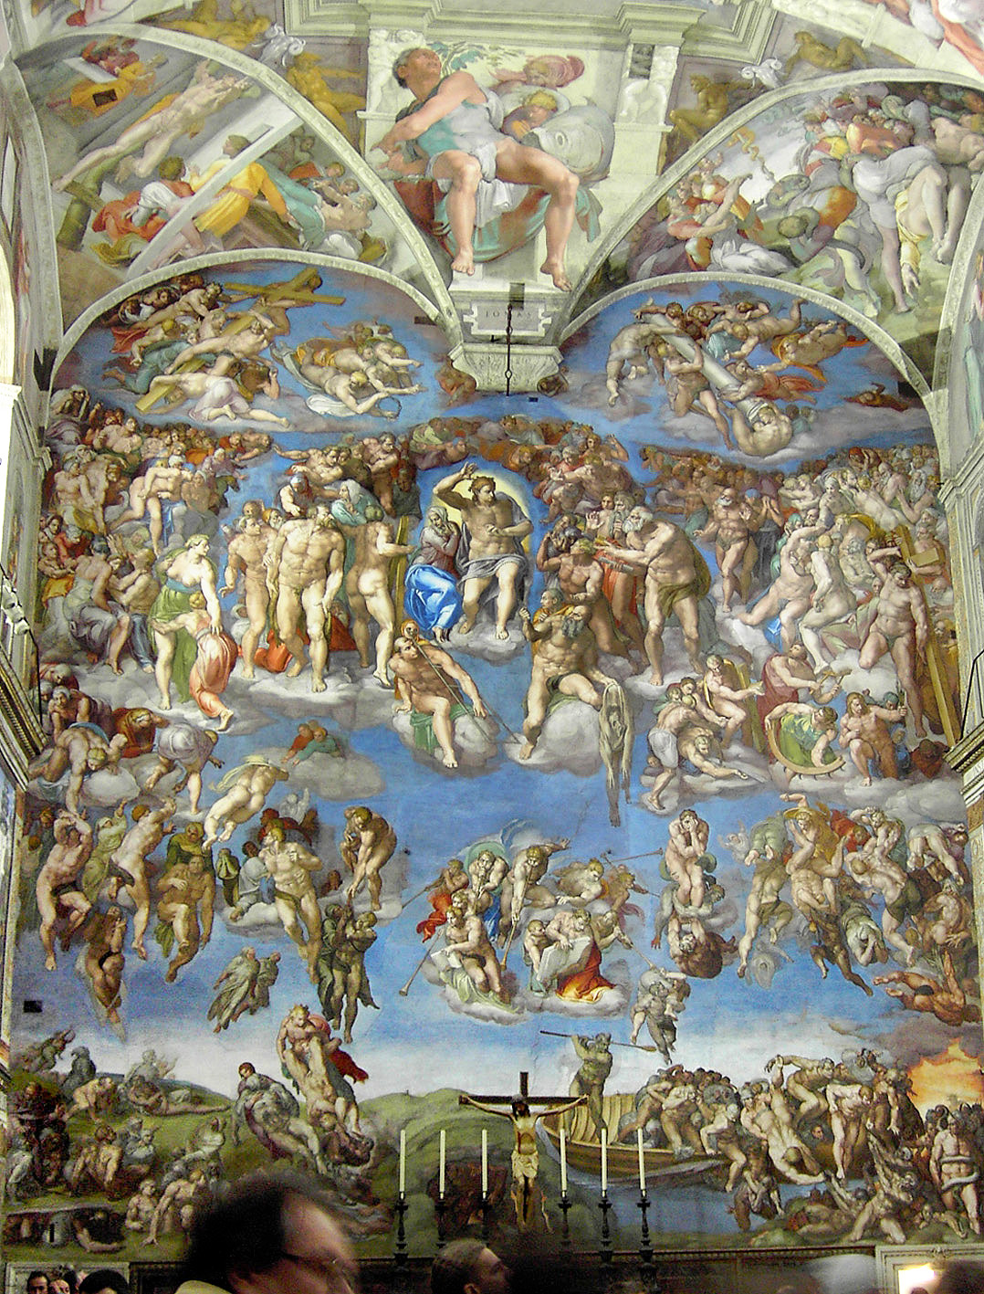
Artists in Italy – 241
In this time, many big names from Italy made their mark on history:
  Leondardo da Vinci
  Michelangelo
  Christopher Columbus
  Galileo

Slide 8
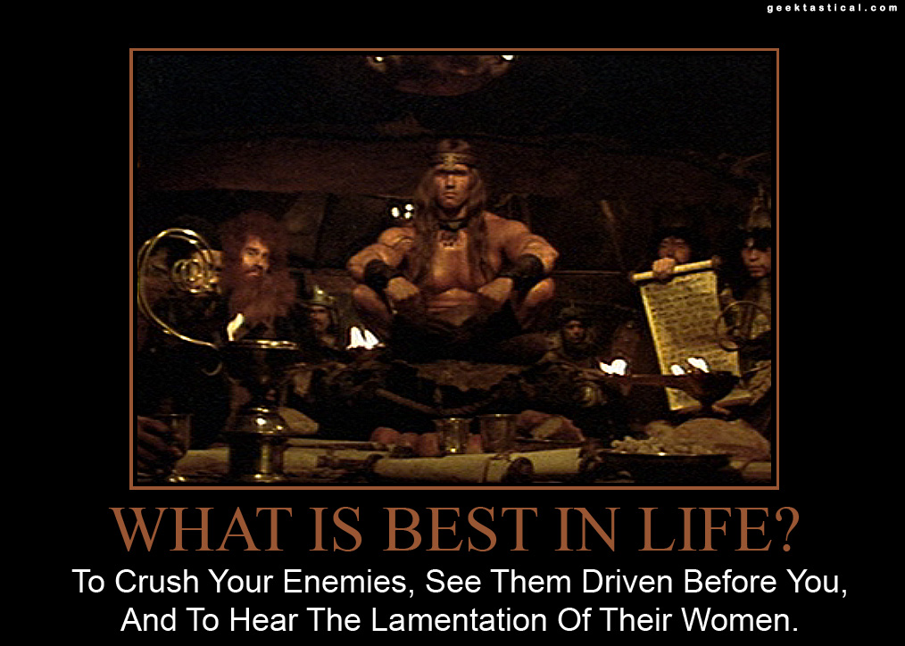
The Questions of Humanism – Pg 242
Humanist philosophers pondered the following questions:
  What is a human being?
  What is good in life?
  How do I lead a good life?

Slide 9
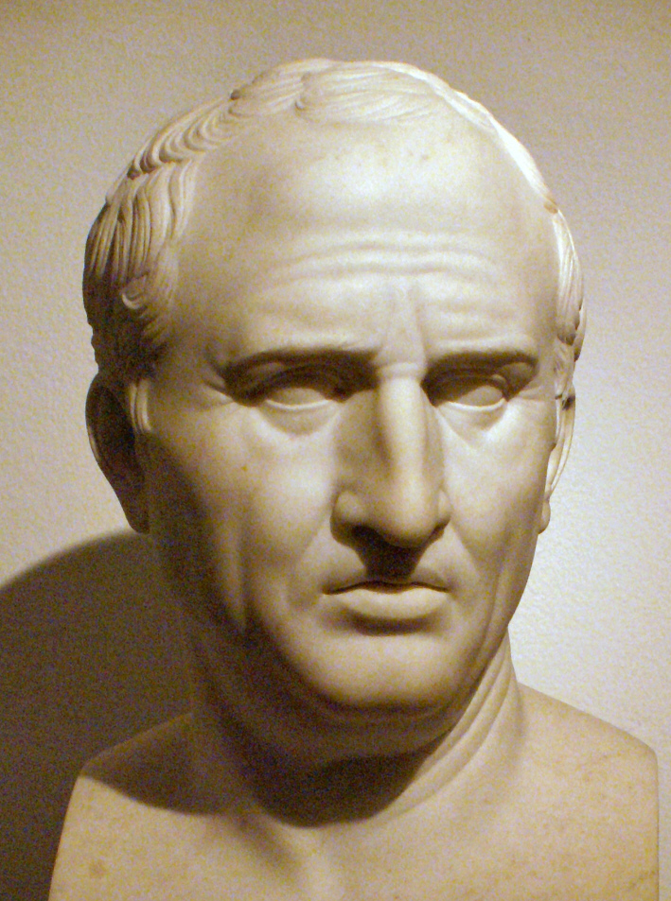

Humanist Philosophy – Pg243
Believed both in the religious teachings of the Bible and the church, and in the writings of classical philosophers, such as Cicero and Plutarch.
“Gratitude is not only the greatest of virtues but the parent of all others” - Cicero

Slide 10
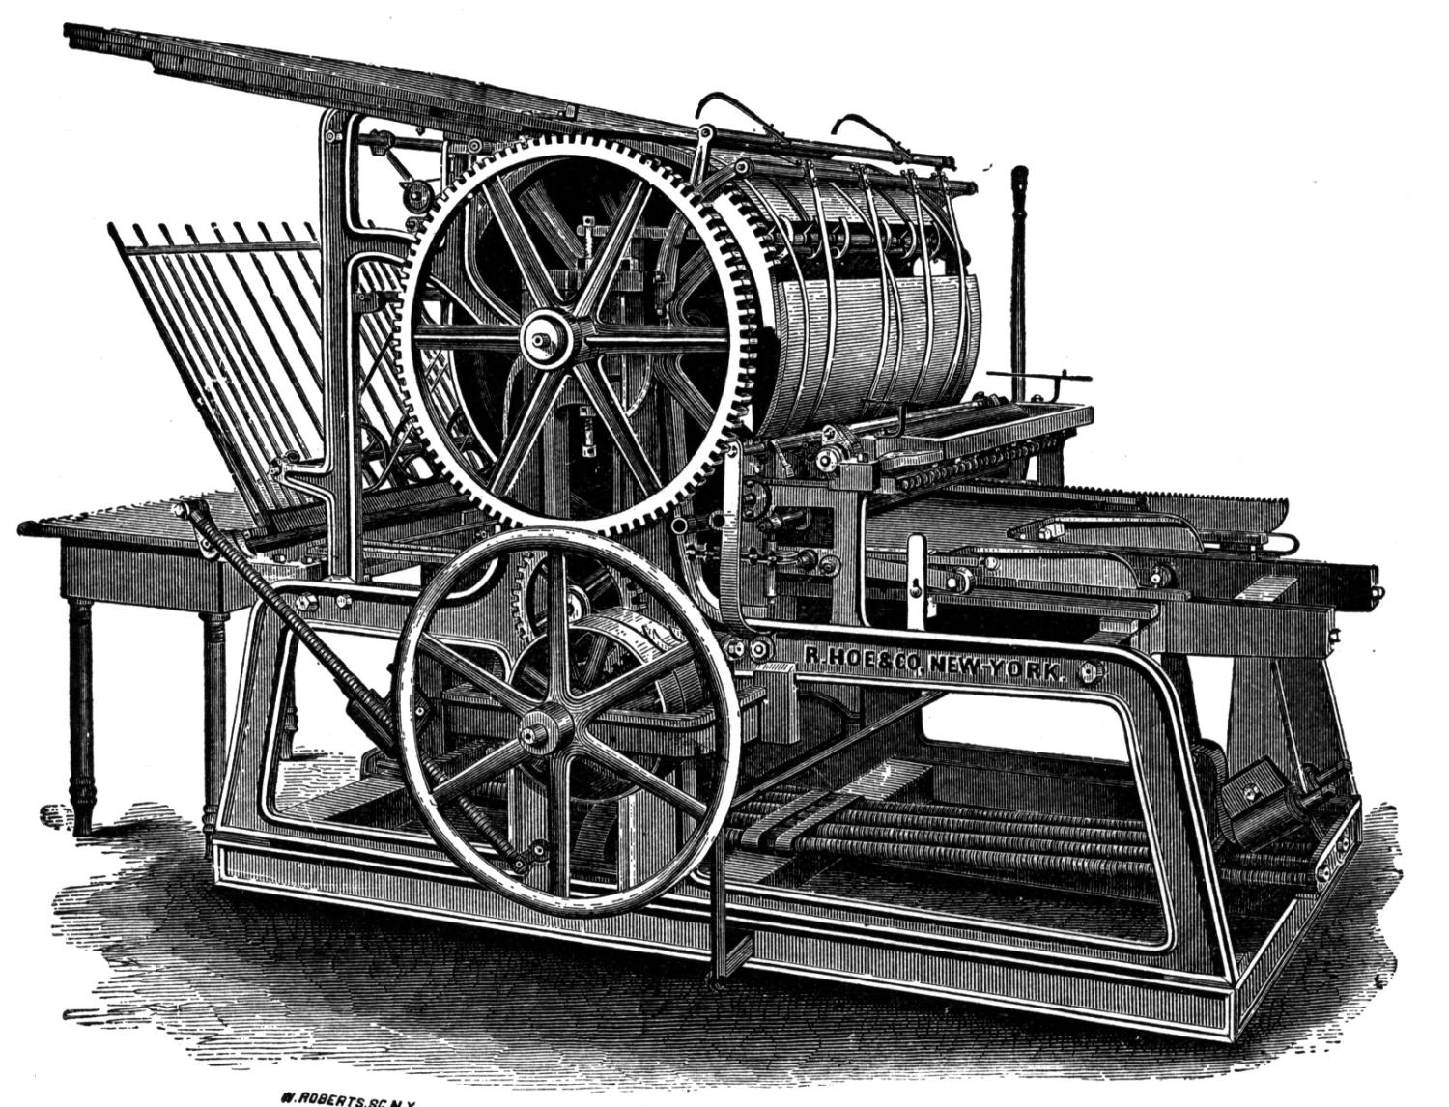
Inventions: The Printing Press – Pg243
In this time, Johannes Gutenberg invented the printing press.
Now books could be mass produced cheaply and easily (compared to the hand-copied books of the monks of previous ages).
With more books, more people were able to read and learn. Literacy among people in general grew as a result.

Slide 11

Im-PRESS-ive, Isn’t it?

Slide 12
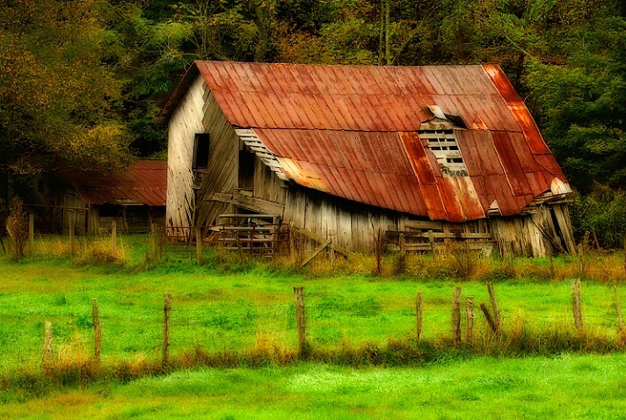
Literary Mini-Lesson: The Pastoral –Pg257
Switching gears a little, the Renaissance wasn’t just all humanists and printing presses.
Several genres of literature were important to this time, including the pastoral.
A pastoral poem takes its name from the Latin word “pastor,” meaning “shepherd.”
A pastoral poem “depicts country life in idyllic, idealized terms. The characters in pastoral poems are naïve and innocent yet express themselves with poetic sophistication.”

Slide 13
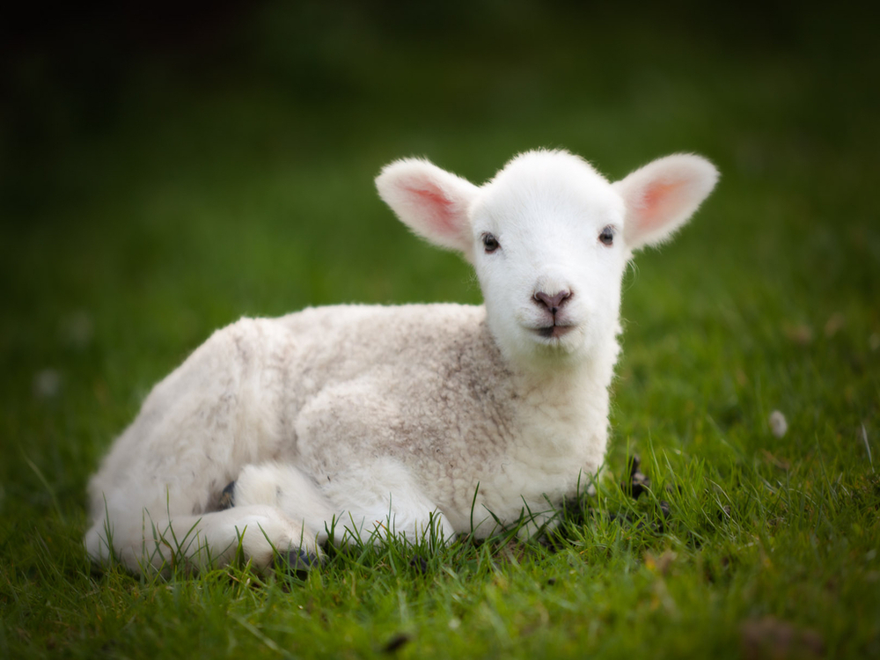
The Pastoral – Activity 1
Get into groups of 3 or 4.
Send a spokesperson up to me to draw a card at random.
Each card has a poet’s name, a title of a pastoral he wrote, and corresponding page numbers.
In your group, read over the poet’s biography and poem in question.
Write down, together, a few interesting facts about this author, what you think this poem is about, and what you think it means.
We will reconvene and share what we’ve learned / written at ________.
Bad Pun: Feeling a little…sheepish?

Slide 14
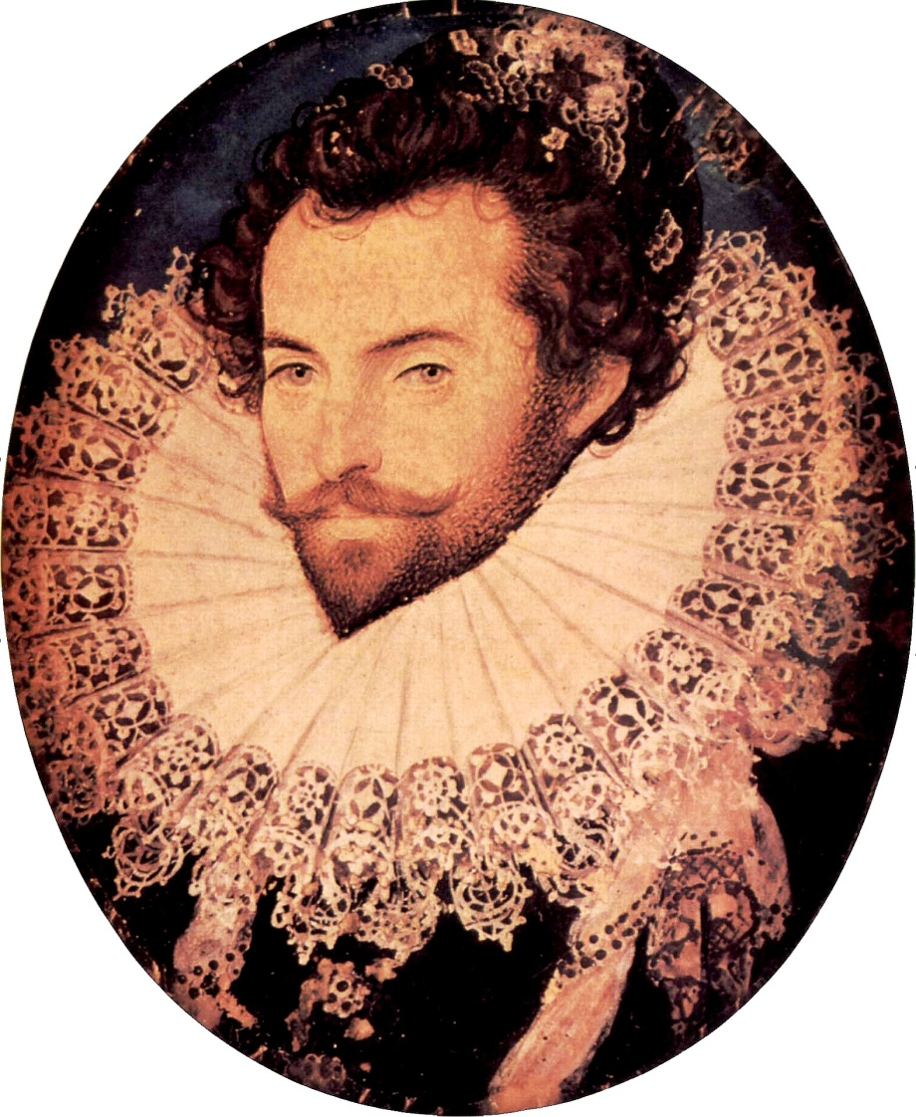
The Pastoral – Activity 2
Now that you’ve learned a bit about pastorals, it’s time to write one of your own!
Remember, pastorals are about idealized countrysides, shepherds, fair ladies (nymphs), and country life.
Send your spokesperson up again for another randomized card.
This card will give you the “point of view” from which you will write your pastoral.
Each point of view is a little different, and some are…just plain odd.
When you have your point of view cards, return to your groups, share, and use our remaining time to create your own pastoral poem.
This poem should be between 20 and 30 lines.
If we do not finish today, we will finish and share our poems tomorrow, after the day’s “read and discuss” lesson.

