Slide 1
A Brief Lesson on the Works of William Shakespeare
Crafted by Mr. Valentine, based on things and stuff.

Slide 2
Step 1 – The Bio
The textbook offers a brief biography of William Shakespeare.
Let’s read it together before moving on.
It can be found on pages 272-274.

Slide 3
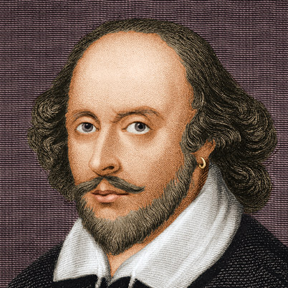
William Shakespeare – The Man

Slide 4
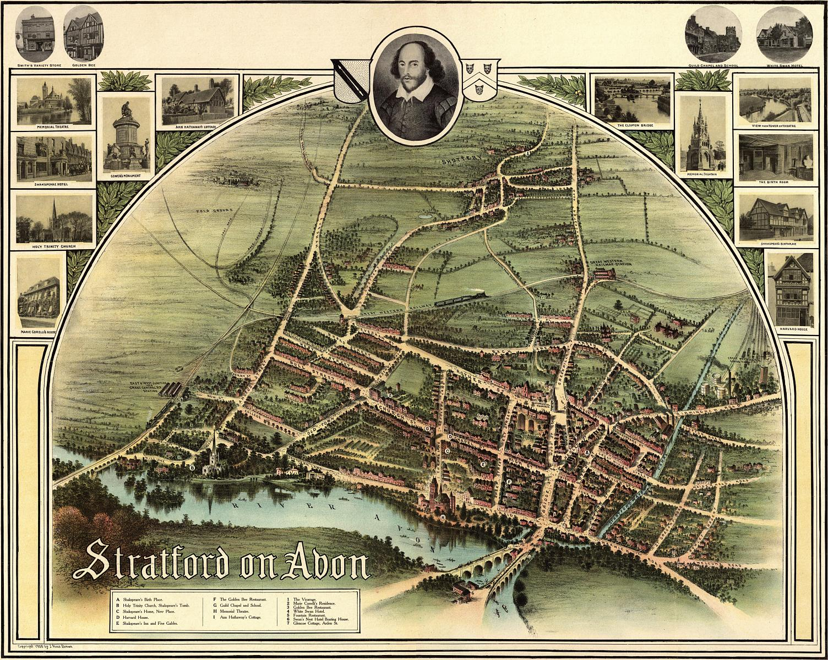
Stratford-on-Avon – His home town.

Slide 5
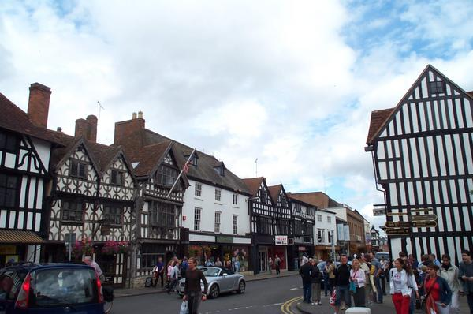
Stratford-on-Avon – His hometown today.

Slide 6
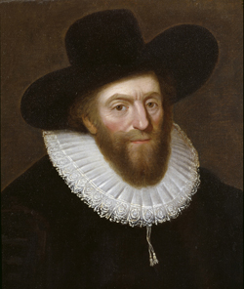
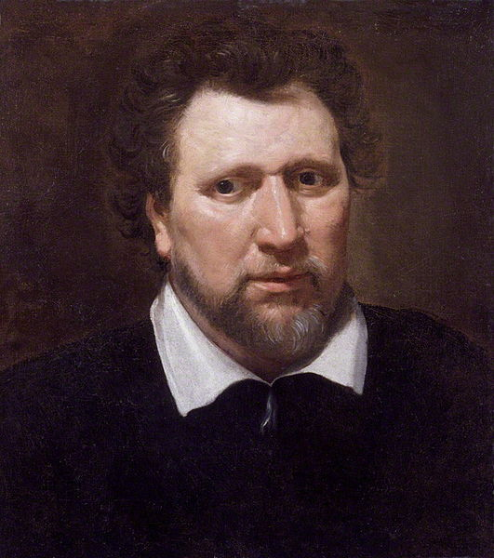
Fans and Critics
Robert Greene
Ben Jonson

Slide 7

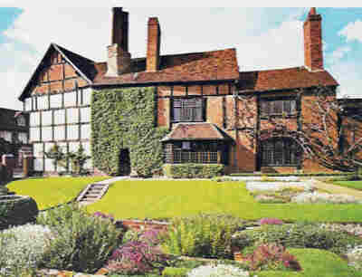
Rubbing Shoulders with the Aristocracy – Pg 273
Coat of Arms
New Place

Slide 8
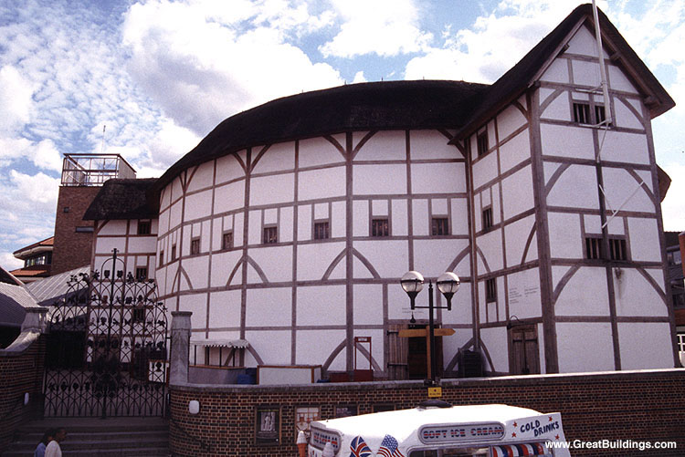
The Globe Theater - Outside

Slide 9
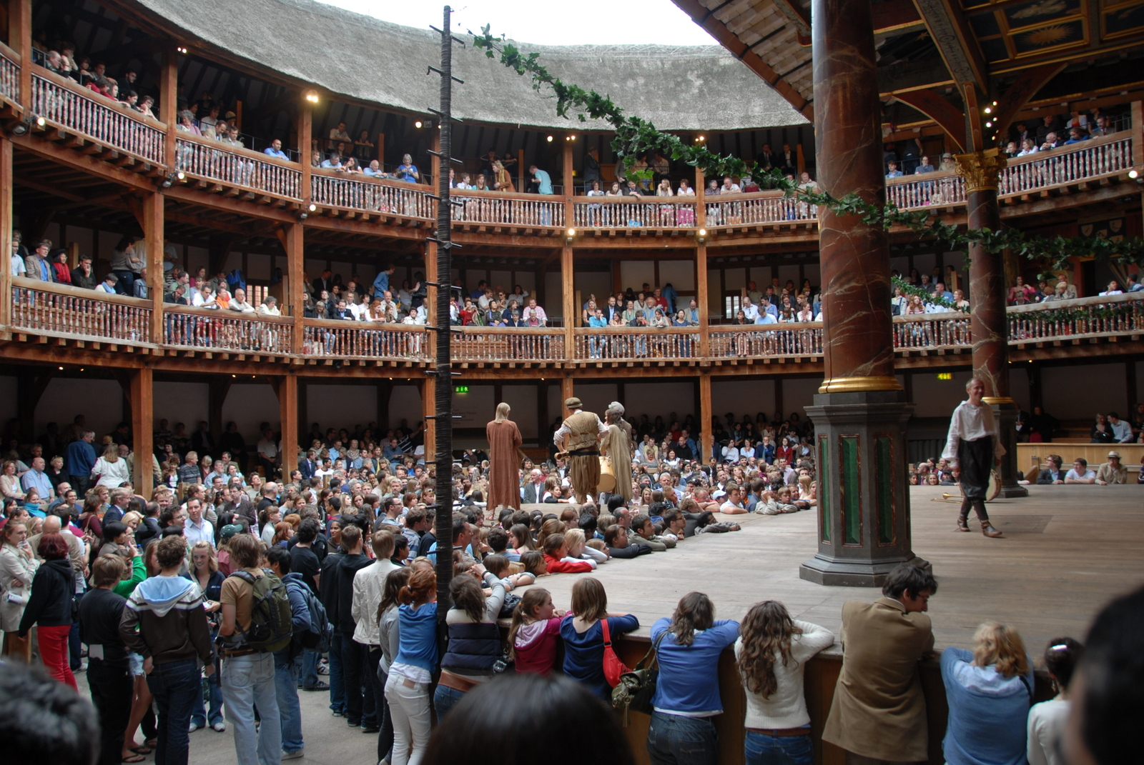
The Globe Theater - Inside

Slide 10
Now that we’ve read his bio…
It’s time to talk about four or five basic genres that Shakespeare wrote in.
William Shakespeare wrote in two basic forms:
  Drama, or plays.
  Sonnets, or 14 line poems.
We will explore each of these in-depth, starting with the drama.

Slide 11
You don’t want no drama.
Shakespeare’s plays, or dramas, “usually” fit into three categories, or genres:
  Tragedies
  Comedies
  Histories
Admittedly, some of his plays have been difficult to classify, with some scholars arguing that they are comedy, some that they are like the romance (of medieval times), and others that they are different altogether. We will call these, for the sake of neutrality, as the “other” plays.

Slide 12
Shakespearean Tragedy
Shakespeare’s tragedies were defined by these key elements:
  A tragic hero – a generally noble man with one flaw that will likely lead to his downfall (i.e. his tragic flaw)
  Death is more common in these plays, and the play itself usually ends in death.

Slide 13
Shakespearean Comedy
Not “comedy” in the modern sense, though humor could certainly be a part of them (and often was).
Rather, Shakespean comedies usually –
  Have protagonists with more flaws than the tragic hero, but not of them could be considered “tragic” or leading to downfall. Often they result in awkward and humorous situations. Said protagonists are not necessarily “noble,” either, but can be of nobility or common folk.
  Greater emphasis on situation than characters.
  Deception and disputes among characters
  A clever servant.
  Multiple, intertwining plots.
  Pastoral settings.
  Death is rare in a comedy.
  Unlike the tragedy, a comedy typically ends in a wedding or the promise of a wedding, not death (i.e. happy endings).

Slide 14
Shakespearean History
Shakespeare’s history plays typically deal with the exploits of figures from the royal family, usually with regard to events surrounding kings and their courts / conspirators in the Wars of the Roses.

Slide 15
Not a rigid system.
Shakespeare himself ridiculed the notion that plays rigidly fit into one genre or another, even though he often followed genre formulas in his writings.
One character, Polonius, from Hamlet, makes this speech, thus enabling Shakespeare to mock classification within his greatest tragedy:
  [The acting troupe coming to do the play within the play are] best actors in the world, either for tragedy, comedy, history, pastoral, pastoral-comical, historical-pastoral, tragical-historical, tragical-comical-historical-pastoral; scene individable, or poem unlimited. Seneca cannot be too heavy, nor Plautus too light. For the law of writ and the liberty, these are the only men.
As it happens, a few of Shakespeare’s plays dabble in multiple genres or alternative genres, such as the romance.
  (A story often having adventure, magic, a wise old man, etc, as with the medieval romances we studied in the late middle ages).

Slide 16
Fun with classification
While we can’t read the entirety of Shakespeare’s work together, then try to classify them, we can attempt to classify plays by way of brief summaries.
The following are summaries meant to be both brief and humerous, taken from a website titled rinkworks.
See if you can guess the genre (tragedy, comedy, history, or other) from the description.

Slide 17
Hamlet
Hamlet - Whine whine whine...To be or not to be...I'm dead.
THE END

Slide 18
Julius Caesar
Caius Cassius Brutus, we're plotting to kill your best friend Caesar. Wanna help?
Marcus Brutus Because I love Rome more, I will. (They all stab Caesar.)
Julius Caesar Et tu, Brute? In that case, I'd better die. (dies)
(The nation mourns, and everybody commits suicide.)
THE END

Slide 19
King Lear
King Lear I am senile and old. Flatter me, and I'll write my will.
Regan and Goneril Daddy, you are way the oh too awesome bomb. We would totally not ever, like, backstab you and take your land.
Cordelia Dad, if you believe that, you're a fool.
Fool I can dance. Bye.
King Lear I give everything to the suck-ups.
Regan and Goneril We're in charge now, pops. Go away and go insane.
Everyone (dies)
THE END

Slide 20
Midsummer Night’s Dream
Hermia, Lysander, Demetrius, and Helena We love each other the wrong way around. (Everyone goes into the woods. They have wacky experiences, pair off correctly, and live happily ever after.)
THE END

Slide 21
Othello
Iago Your wife's cheating on you.
Othello She is? (kills wife) Darn, she wasn't really. (Kills self).
THE END

Slide 22
Richard III
Edward IV I'm dying.
Richard III Hurray! (Richard Three KILLS and MARRIES. And he keeps KILLING and MARRYING until it makes him KING.)
Ghosts Behold how foreboding we art. Richard III (dies)
THE END

Slide 23
Romeo and Juliet
Romeo Oh, Juliet!
Juliet Oh, Romeo!
Romeo Oh, Juliet!
Juliet Oh, Romeo!
Romeo Oh, Juliet! (dies)
Juliet Oh, Romeo!......Romeo?......Darnit.
THE END

Slide 24
The Taming of the Shrew
Katharina Spit. Hiss.
Petruchio Shut your mouth before I hit you.
Katharina I can be civilized now that a man has bossed me around. I love you madly, Petruchio.
THE END

Slide 25
The Tempest
Prospero Ariel, help me strand my enemies on my magic island.
(Prospero and Ariel use their magic to trap his enemies and exact revenge.)
Prospero That's enough. Enemies, I forgive you all, and one of you can marry my daughter. I'm going home.
THE END

Slide 26
On to the sonnets – Pg 276-277
Alrighty then.
Now that we’ve covered the various types of plays Shakespeare wrote, let’s look at his much shorter works, the sonnets.
Sonnets are, at their most basic, 14 line poems.

Slide 27
Shakespearean Sonnet - Form
A shakespearean sonnet is broken into three quatrains (four line stanzas) and a heroic couplet (two line stanza) – see the right for a visual.
Usually, the first three quatrains present a situation.
At the end, there is a twist or turning of the situation, near the end of the third quatrain / heroic couplet.
His were much better than this one.
How can I compare thee to a summer’s day, Blahdee blahdee blah, blah dee blah dee doh. Yippee dippee dooo. Badeedoo.
Maybe I’ll compare thee to a winter’s day, those are nice too, yep yep, yepperoo. Winter dayz. Days of winter are cold and wintery, like ice.
However, spring and autumn are nice too, perhaps I’ll compare thee to those. Perhaps I’m a man For all seasons, perhaps I like
Season salt. On cottage cheese.
And on french fries. Mmm, good.

Slide 28
Shakespearean Sonnet – Rhyme Scheme
The lines in a Shakespearean sonnet follow this rhyme scheme:
A
B
A
B
C
D
C
D
E
F
E
F
G
G

Slide 29
Meter – Iambic Pentameter
An iamb is a poetic foot – a pair of syllables, one unstressed, one stressed.
Penta means five.
Meter means the syllables / rhythm of a line of poetry.
2 X 5 = 10 syllables per line of poetry.
Mr. Valentine, read Sonnet 18 on page 277 in a really goofy horse-clomping way to demonstrate.

Slide 30
Now, get into groups, and choose a sonnet:
1 - Sonnet 29, pg 279
2 – Sonnet 30, pg 280
3 – Sonnet 71, pg 281
4 – Sonnet 73, pg 282
5 – Sonnet 116, pg 283
In your groups of 3 – 4, choose a sonnet, read it, and do your best to interpret what you think it means.
Write this down together as you go, and be prepared to share it with the class in fifteen minutes.

Slide 31
Sonnet 130 – A Parody – Pg 284
My mistress’ eyes are nothing like the sun,
Coral is far more red than her lips’ red.
If snow be white, why then her breasts are dun,
If hairs be wires, black wires grow on her head.

Slide 32
Sonnet 130 – 2nd Quatrain
I have seen roses damasked, red and white,
But no such roses see I in her cheeks.
And in some perfumes is there more delight
Than in the breath that from my mistress reeks.

Slide 33
Sonnet 130 – 3rd Quatrain
I love to hear her speak, yet well I know
That music hath a far more pleasing sound.
I grant I never saw a goddess go,
My mistress, when she walks, treads on the ground.

Slide 34
Sonnet 130 – Heroic Couplet
And yet, by Heaven, I think my love as rare
As any she belied with false compare.

Slide 35
Write Your Own Sonnets
Now it’s time to write your own sonnet.
Return to your groups.
Craft a 14 line poem with 3 four line stanzas and 1 two line stanza.
Usually these are about love, but you may choose the subject, so long as it is class appropriate.
Be prepared to share by __________ .

