Slide 1
Historical Introduction to the Renaissance – 1485-1660
“The Monarchy”
Based on Elements of Literature,
Sixth Edition

Slide 2
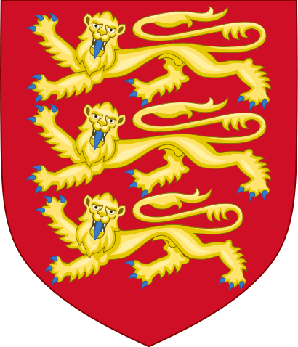
At the end of the middle Ages…
The royal house or family of England, called the Plantaganets, had split into two factions: The Yorks and the Lancasters.

Slide 3
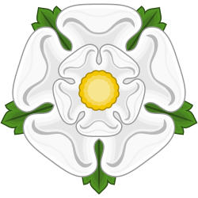
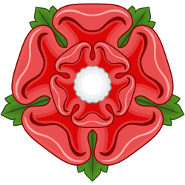
The Wars of the Roses
The Yorks took the white rose as their symbol,
While the Lancasters took the red rose for theirs.

Slide 4
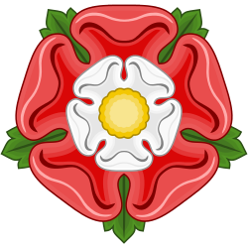
Peace through marriage
In time, the fighting came to an end.
Henry VII, a Lancaster, married into the York family to create a new, unified family line – the Tudors.
Notice how their new emblem is a combination of both previous emblems.

Slide 5
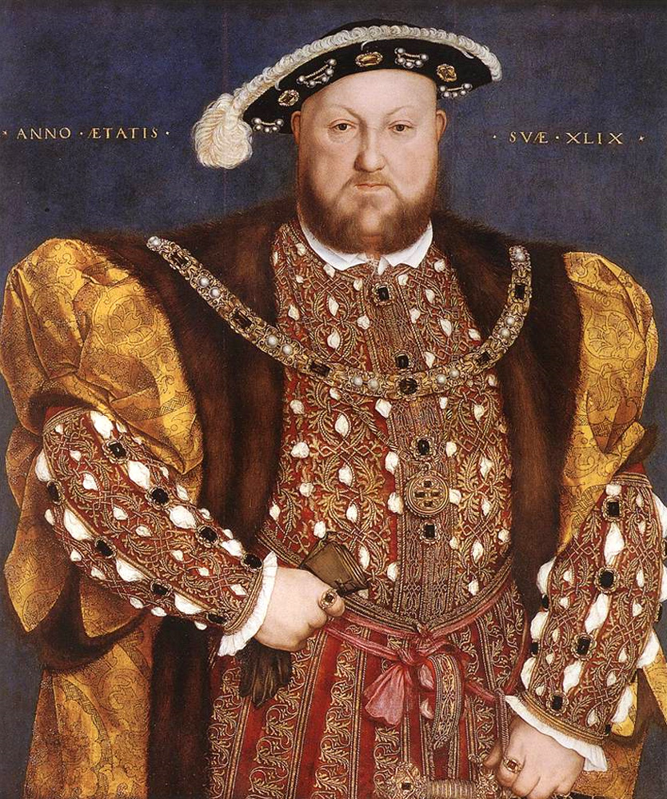
From 7th to 8th
In time, Henry VII was succeeded by his son, Henry VIII.
Henry VIII had a somewhat…unorthodox love life – having had six wives in all before he died.

Slide 6
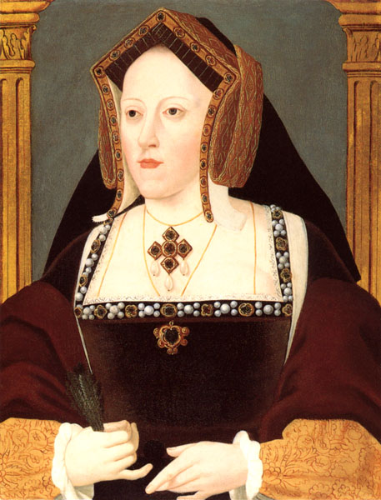
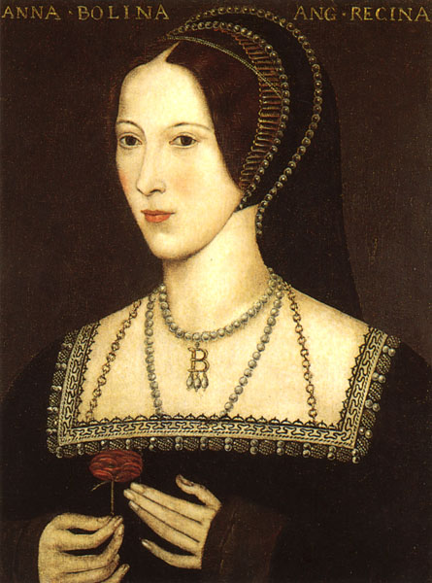
Out with the old, in with the new – Pg246
Catherine of Aragon Anne Boleyn
This string of marriages started with Henry’s marriage to Catherine of Aragon.
Henry and Catherine had been, as of yet, unable to have any living sons.
Furthermore, another girl had caught Henry’s eye – Anne Boleyn.

Slide 7
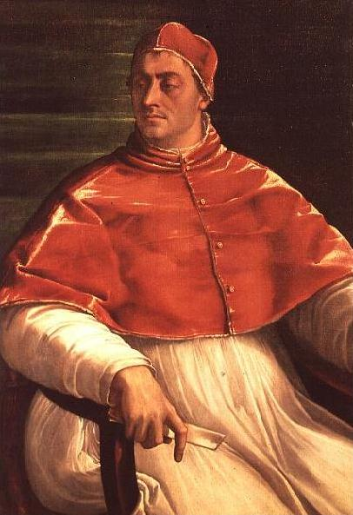
But why not? – Pg246
However, when Henry asked Pope Clement VII for an annulment of his marriage to Catherine, he was denied.
Catholics do not believe in divorce, and annul marriages only under very specific circumstances (usually, the marriage cannot already have been consummated).
This was not one of those circumstances.

Slide 8
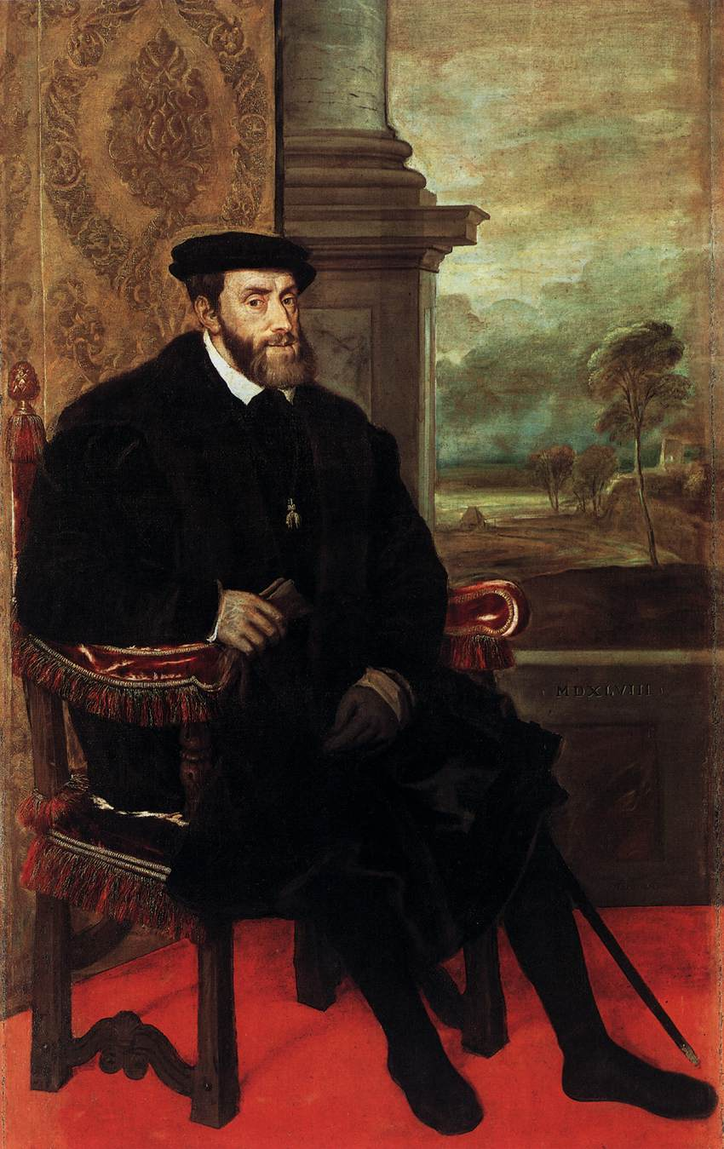
Political motivations – Pg247
Furthermore, the Roman Catholic Church was allied with the King of Spain, Charles V, nephew to Henry’s first wife, Catherine of Aragon.
Even if annulment were possible, they would not allow such a slight / insult to the Spanish princess or their royal family.

Slide 9
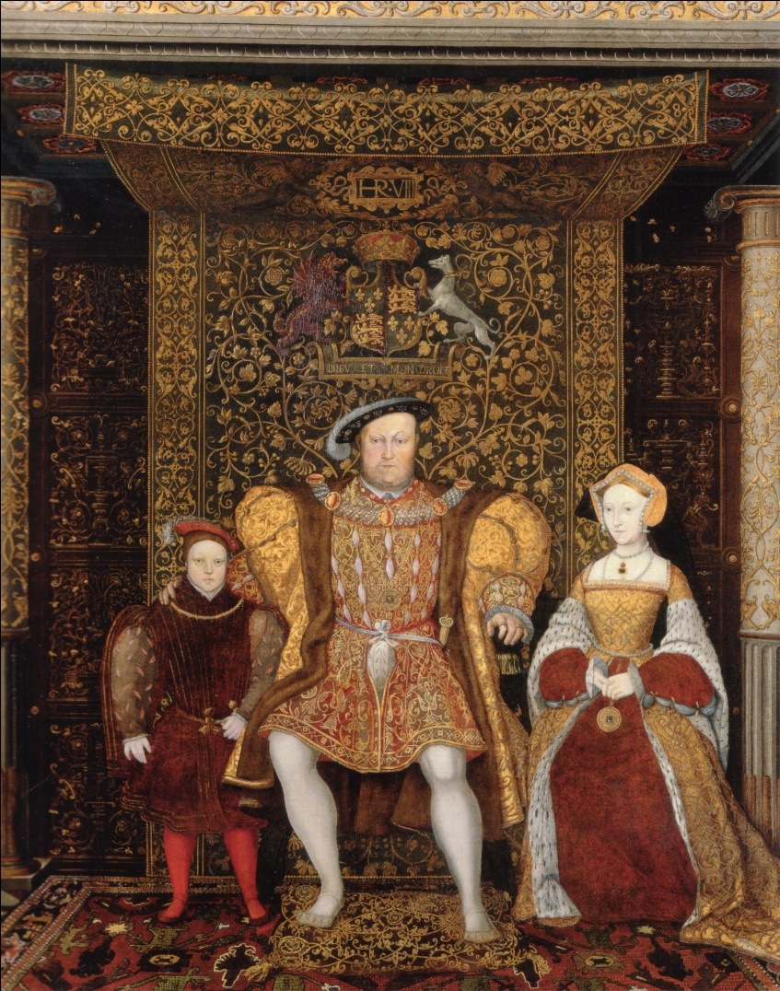
Now I’m in Charge! – Pg247
In response, Henry VIII decided to split with the Catholic church entirely, rejecting their authority.
Instead, Henry chose to set up his own church – the Church of England (i.e. the Anglican Church) – and make himself it’s head.
Being the head of his own church, Henry gave himself a divorce and married Anne Boleyn.

Slide 10
The honeymoon is over – Pg 248-249
But, believe it or not, it didn’t last.
In fact, Henry married six women over the course of his life:
  Catherine of Aragon
  Anne Boleyn
  Jane Seymour
  Anne of Cleves
  Catherine Howard
  Catherine Parr
These lucky ladies met with the following fates (respectively):
  Divorced
  Beheaded
  Died
  Divorced
  Beheaded
  Survived

Slide 11
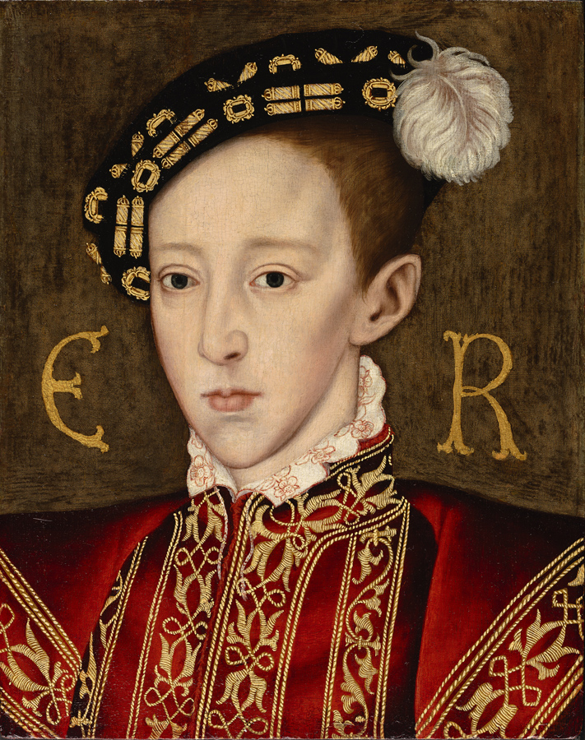
After Henry VIII – pg 249
His only living son, Edward (born of Jane Seymour) took the throne at age nine.
His older sisters guided most of his actions during his brief rule.
Eventually, he died of tuberculosis, leaving the throne to Mary, daughter of Catherine of Aragon.

Slide 12
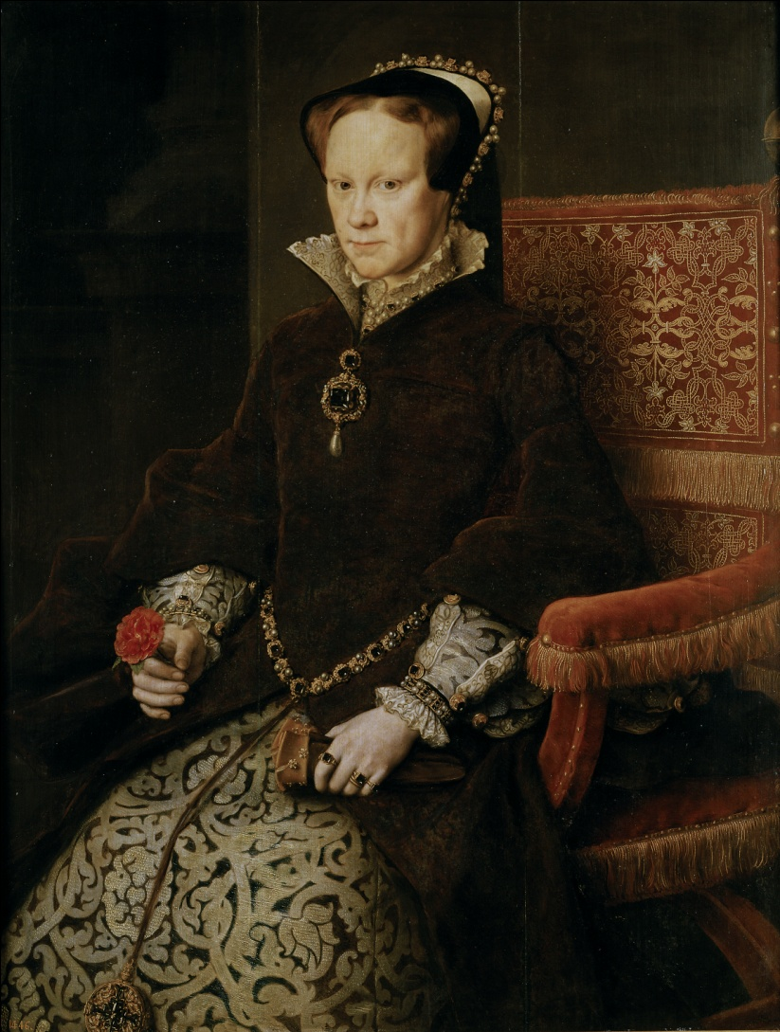
Bloody Mary – pg 249-250
Mary earned said title by seeking vengeance for the mistreatment of her mother, Catherine, by her father, Henry.
She did so by gathering and slaughtering Protestants.
In one event, Mary burned 300 Protestants at the stake.
Her people did not like this very much.
Eventually, she died of fever, leaving the throne to Elizabeth, daughter of Anne Boleyn.

Slide 13
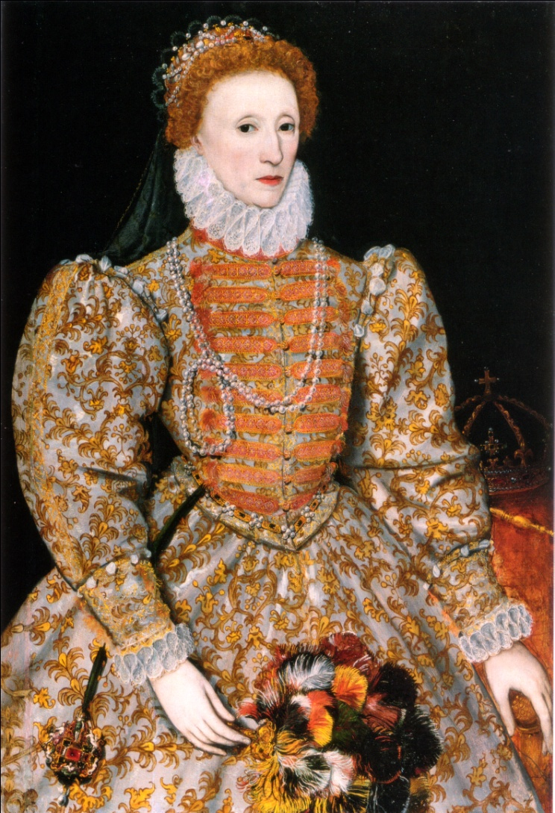
Queen Elizabeth I – pg 250-251
Elizabeth I reigned from 1558 to 1603.
She re-established the Church of England and continued to reject the Pope’s authority, as her father had done.
For her entire reign, she remained unmarried, never wishing to relinquish her power to a husband / King.
This strategic choice of reigning unmarried gained her the title “The Virgin Queen” among the people.

Slide 14
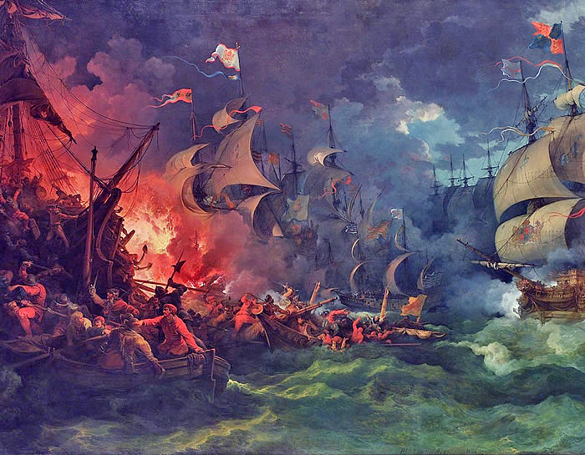
England’s Independence – pg 252
Queen Elizabeth put down many assassination plots, including one from her cousin, Mary Stuart, Queen of Scots.
Also, under her reign, England defeated the Spanish Armada in battle – the fiercest navy in the world at that time.
All in all, Elizabeth solidified England’s independence from all mainland authorities that sought to influence it, religious or political.

Slide 15
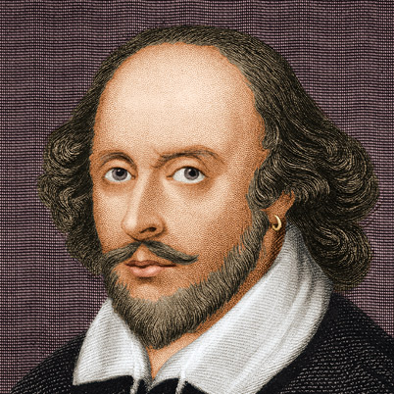
Patrons of the arts – pg 253
Furthermore, during her rule she sponsored many great artists and writers, including William Shakespeare and his acting troupe, the Lord Chamberlain’s Men.
We will learn more about William Shakespeare in tomorrow’s lecture and in the weeks to come.

Slide 16
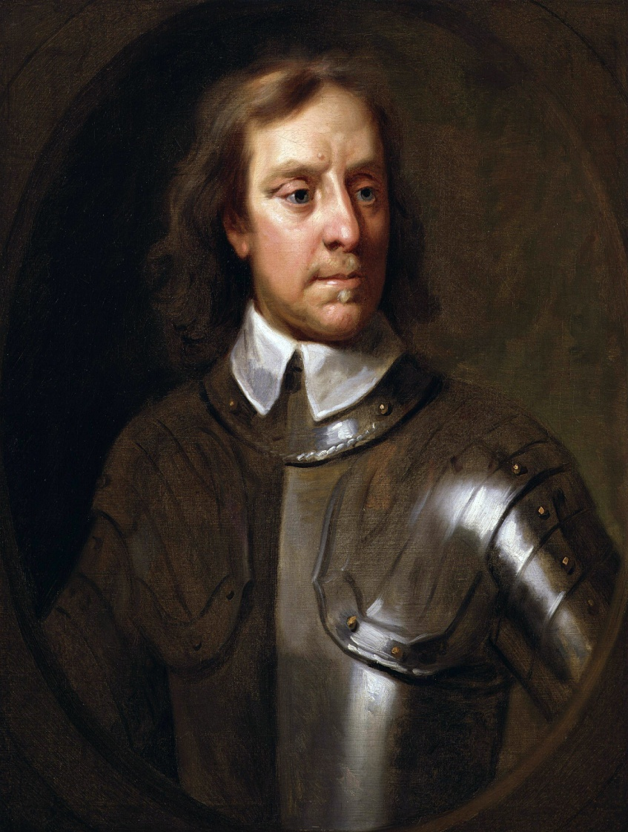
The Puritans – pg 253-254
One consequence of never marrying is that she died without an heir).
After Elizabeth I, second cousin James VI of Scotland took the throne as next in line, becoming James I of England
The people did not care much for James VI. They also did not care much for his successor, Charles I.
In time, a protestant group called the Puritans, led by Oliver Cromwell, rebelled against the monarchy.
For a time, they succeeded. Charles I was beheaded, and the Puritans ruled for eleven years.
The monarchy would not regain power until 1660 with Charles’ son, Charles II – but by that time, England had changed dramatically and, as such, will be discussed in another historical period / unit.

Slide 17

Henry VIII - Documentary

