Slide 1
The Faces of the Kojiki
Characters from Japan’s great epic tale and Shinto mythology.

Slide 2
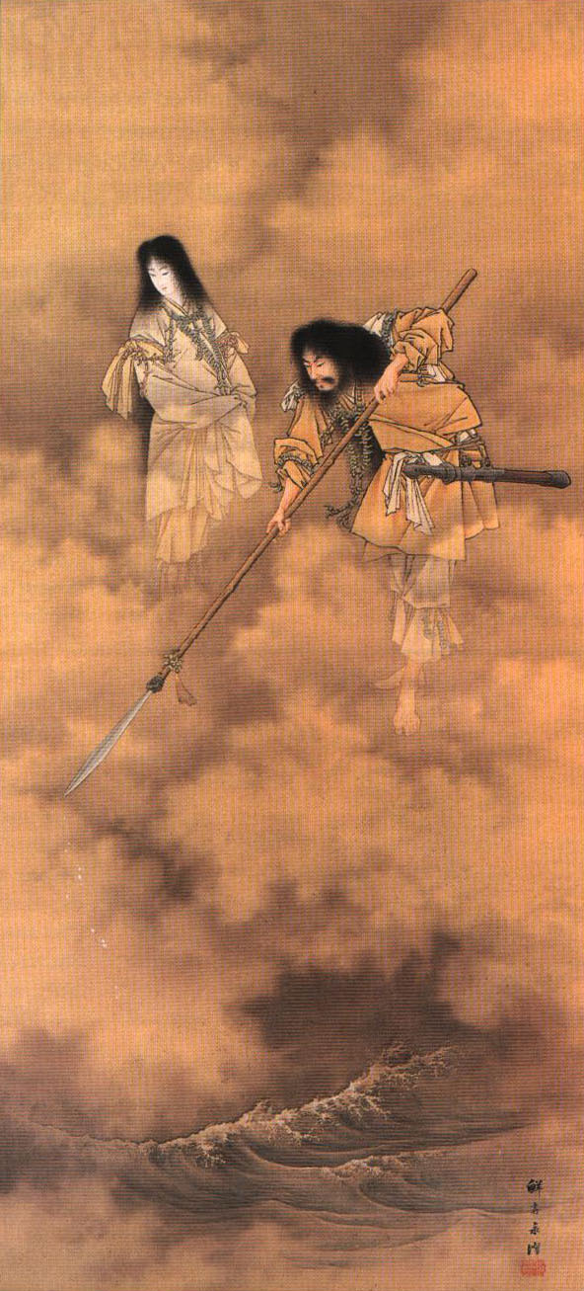
Izanagi and Izanami
While many deities are listed earlier in the text, Izanagi and Izanami are considered the first two gods of actual significance.
The couple comes down to the waters of Earth with a spear, stir the waters, and form an island. Their first children are the islands of Japan.
This couple also doubles as sort of Adam and Eve figures, the gods, and then humanity, descending from them.
Eventually, Izanami gives birth to the fire god, and dies in childbirth.

Slide 3
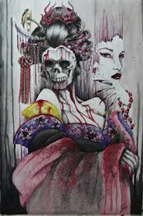
Yomi / The Underworld
Izanagi misses his wife, Izanami, and goes to the underworld of Yomi to see her.
He asks if she can return to him, to the world of the living, but she reveals that she has already eaten the food of the underworld, and therefore, she does not think she can leave.
However, she does consent to discussing the matter with the gods of the underworld. She forbids him from looking at her during this time, requiring him to wait outside.
Izanagi grows impatient, goes in, and sees her true form – a decaying maggot-ridden corpse. Izanagi is horrified, but Izanami is enraged at her true form being exposed. She sends hags of Yomi to chase Izanagi.
He eventually gets away, seals the path to Yomi with a boulder, and strikes a balance with his late wife for the fate of the world – how many each day will be born, and how many each day will die.

Slide 4
Amaterasu, Tsukuyomi, and Susano-O
Amaterasu
About-
Child of Izanagi after the death of Izanami.
Sun goddess, goddess of the heavens and the day.
Replaces Izanagi as the top god and remains so for present-day Shinto mythology (kind of like Zeus replacing Cronus in Greek Mythology, but much more amicable).
She has two siblings.

Slide 5
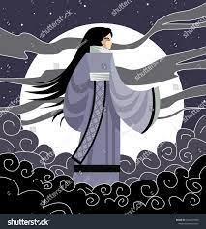
Amaterasu, Tsukuyomi, and Susano-O
About-
Tsukuyomi
Child of Izanagi after the death of Izanami. Sibling to Amaterasu.
God of the night sky and the moon.
Yomi, the name for the underworld, is part of his name, perhaps suggesting an association with the dark / night and the underworld.

Slide 6
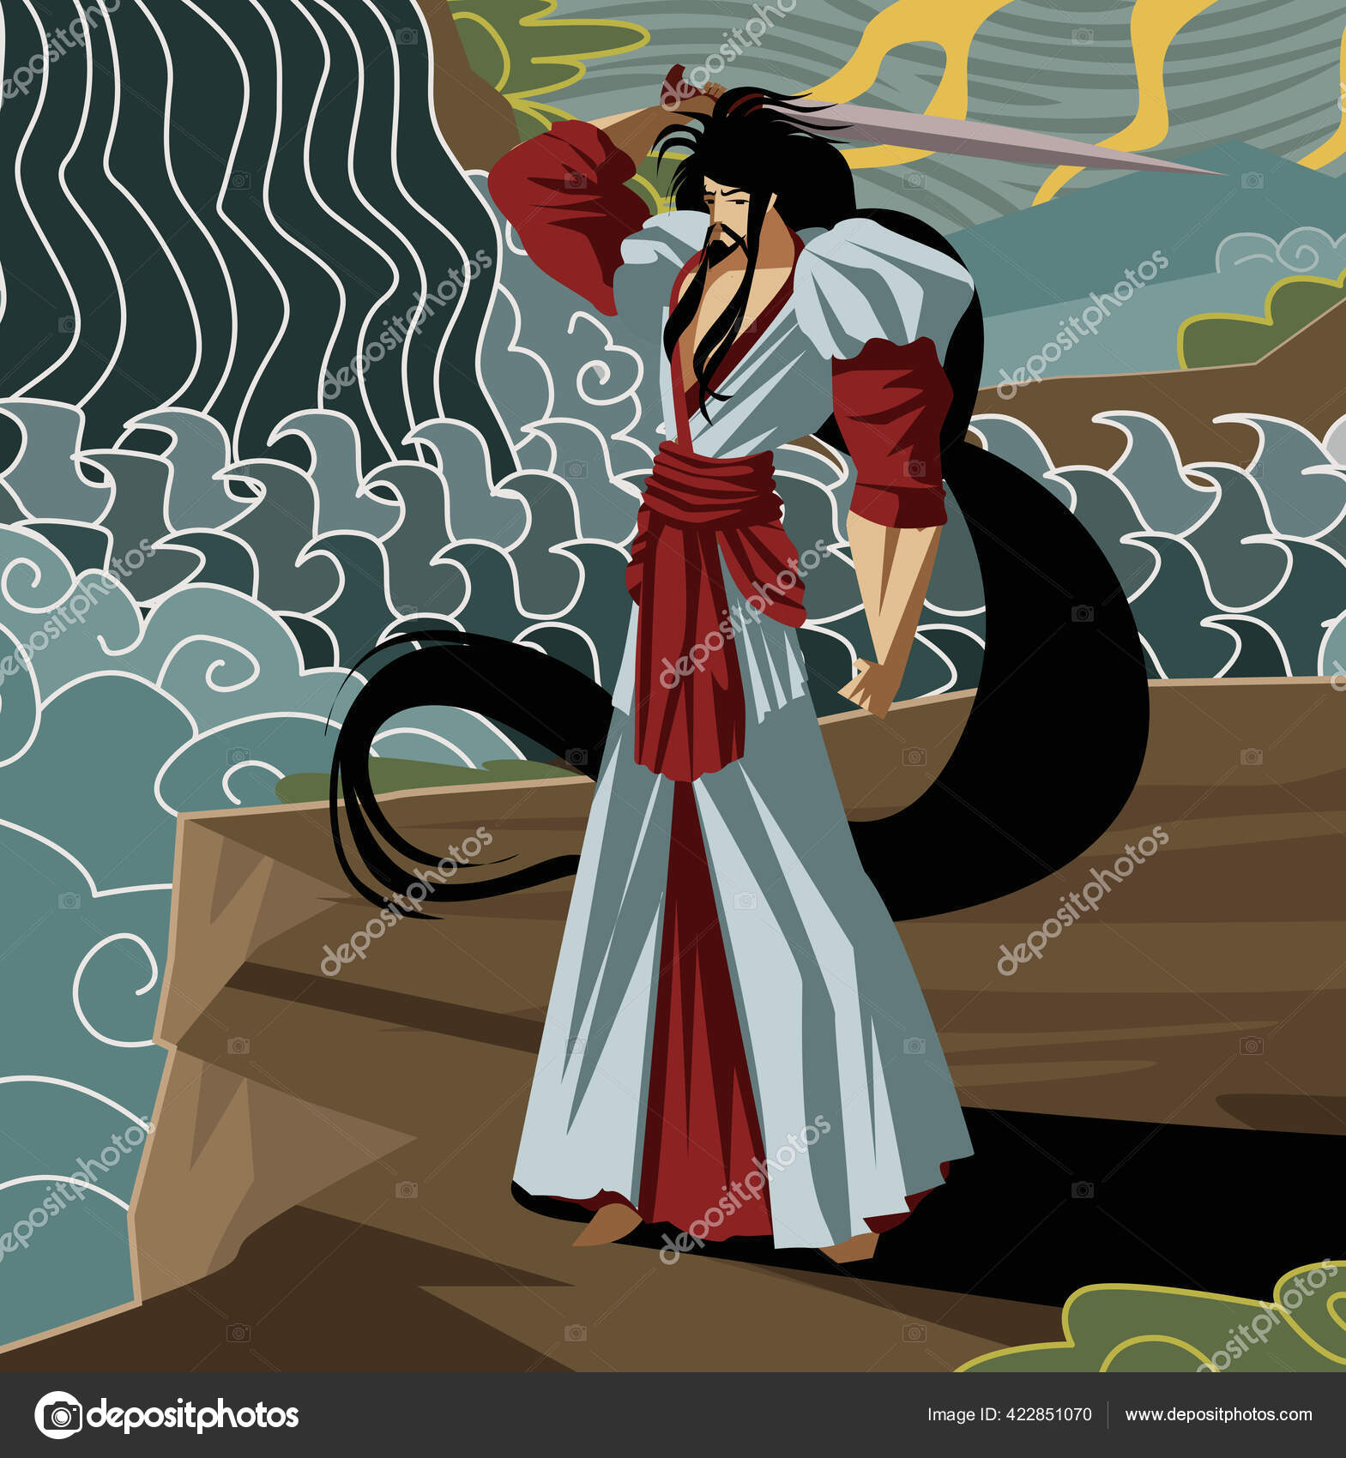
Amaterasu, Tsukuyomi, and Susano-O
Susano-O
About-
Child of Izanagi after the death of Izanami, sibling of Amaterasu and Tsukuyomi.
God of the ocean (and storms).
A trickster figure / trouble maker.
Not entirely good or evil, much like the volatility of the ocean or the dual nature of storms, nurturing and destructive.

Slide 7
Orochi, the Eight-Headed Dragon
About-
Susano-O Battles Orochi
A major event in Shinto mythology, in the epic the Kojiki, in our readings this week, is when Susano-O battles an eight-headed dragon called Orochi.
Orochi troubles the mortal lands, and must be slain if Susano-O wishes to take a mortal for his wife.
For whatever reason, epic heroes frequently must slay dragons in their journeys, whether in epics from Europe or Asia (perhaps, throughout the world).

Slide 8
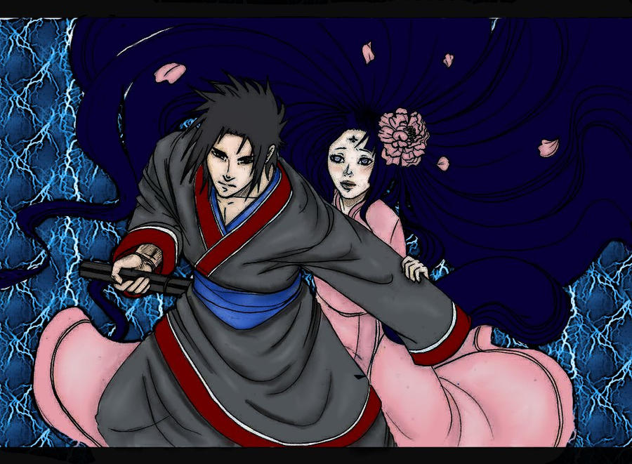
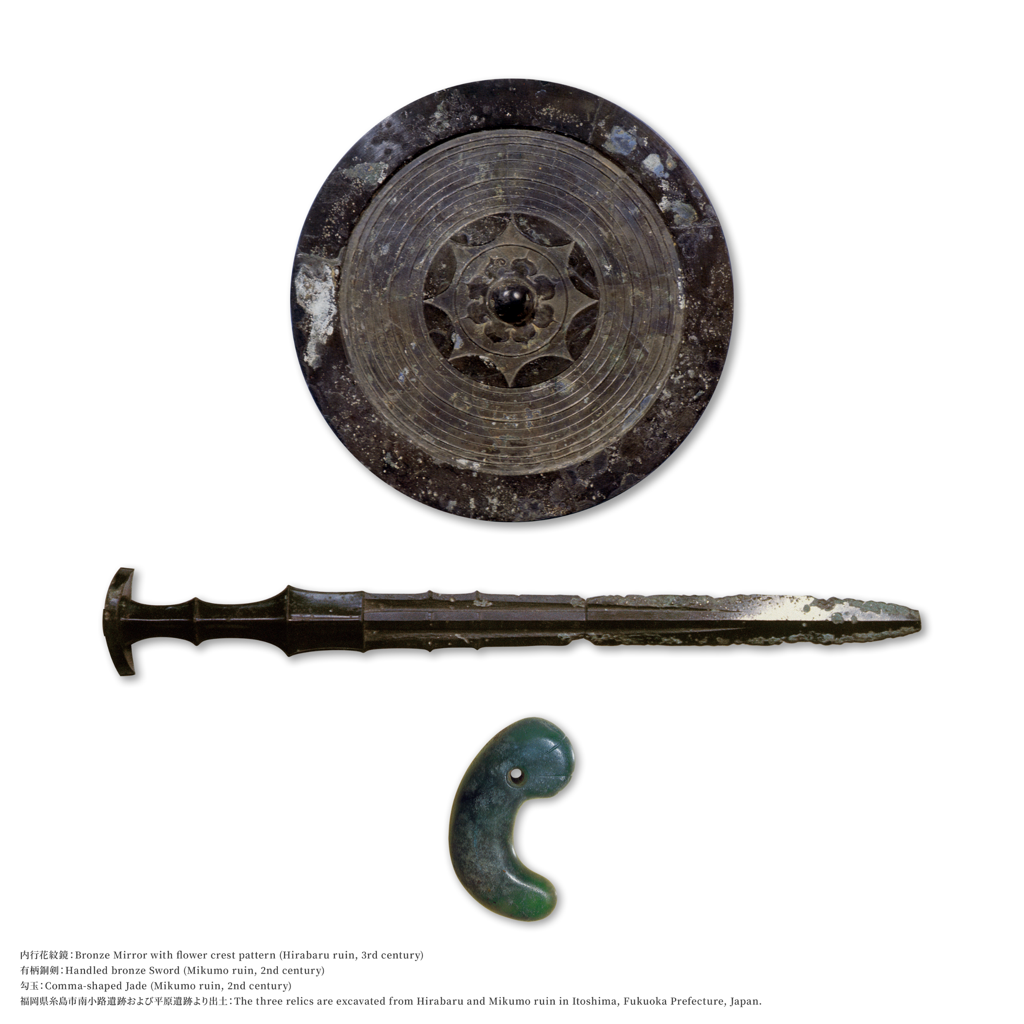
After the Dragon
Kusinada / Kushinada, new wife of Susano-O
Kusanagi, magical sword and part of the royal regalia of Japan. Translates to grass cutter.

