Slide 1
Unit I – Epic Heroes
Based on concepts and information from Elements of Literature, Cuchulain of Muirthemne, and Beowulf.

Slide 2
Genre: The Epic
The textbook defines the epic as a long, narrative poem that tells of the exploits of a national hero.
The hero in question, the epic hero, often embodies the virtues and values of their society. Thus, one may study the hero to learn about the culture, or vice versa.
In Unit I, you will have the option of reading / studying either of the following two epics from the Early Middle Ages in the British Isles:
  Cuchulain of Muirthemne (Celtic Ireland) (Harder Option)
  Beowulf (Anglo-Saxon England) (Easier Option)
Each hero (and thus, each culture) share some traits, but differ on key points.

Slide 3
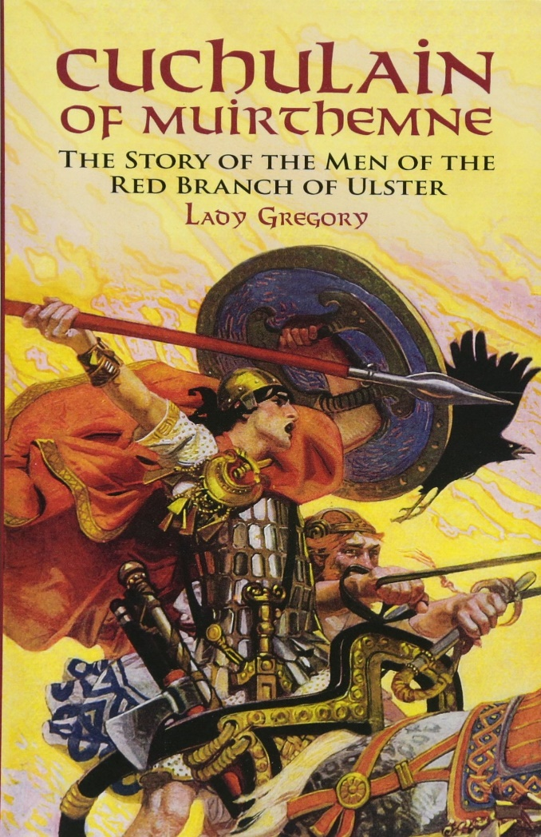
Cuchulain
  Cuchulain (aka Cuchulainn, Cu Chulainn, sometimes pronounced Coo-Cullen, sometimes Coo-Hoolen) is an epic hero of Celtic Ireland.
  Theirs was a warrior culture.
  Their values included strength, courage, wit, honor, and being… “romantically successful.”
  Even in the heat of battle, Irish heroes tend to be merry and upbeat.
  He is a demi-god, having the Irish god of light, Lug, for his father, and the human, Deichtine, for his mother.
  His known “super powers” include his skill with the spear Gae Bolg, his “salmon leap,” and his berserker-like “warp spasm.”

Slide 4
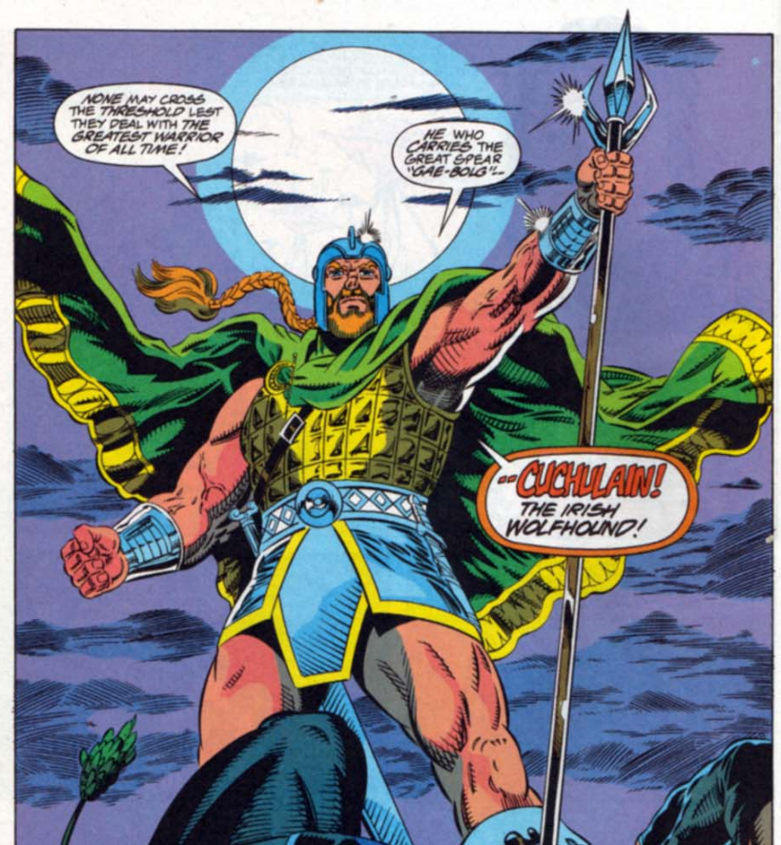
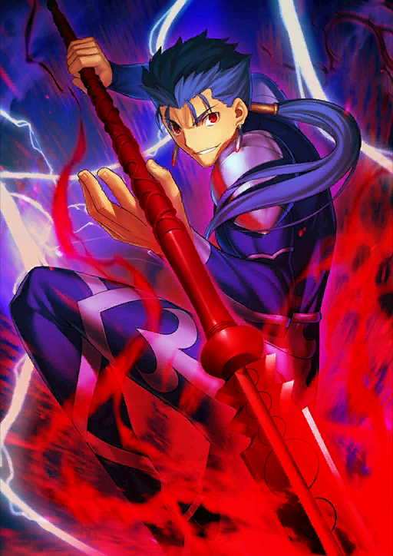
Other Depictions of Cuchulain
Fate / Stay Night Series
Guardians of the Galaxy Annual #3

Slide 5
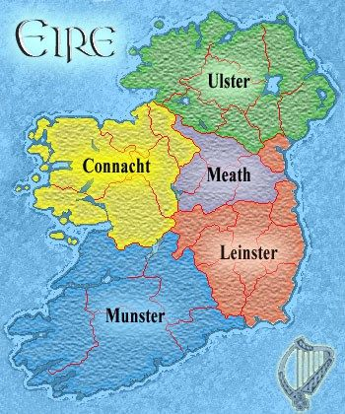
Cuchulain – Plot and Character
Much of Cuchulain of Muirthemne focuses on a war over cattle – yes, cattle. Back in ancient Ireland, wealth was measured just as much, if not more so, in cattle than in gold. Just think of how many uses we have for cattle – milk (and thus, all dairy products), meat, leather, etc.
At this time, Ireland’s many territories were ruled by many kings. Queen Maeve of Connacht wants the cattle of King Conchubar of Ulster, and is willing to go to war to get it.
Due to a curse from the Morrigan (Celtic goddess of war, death, and crows), the men of Ulster would lose their strength for nine days and nine nights whenever they needed it the most. Thus, only one man, one not fully of their bloodline, was strong enough to defend them when Maeve attacked – Cuchulain.
Much of the epic is Fergus, one of Cuchulain’s foster fathers, telling Maeve stories of Cuchulain’s might in order to convince her that this war is NOT a good idea.
We will read excerpts from Cuchulain’s childhood, his courting of Emer, his training with the warrior-woman Scathach, his battle against Maeve and her armies, and his death.

Slide 6
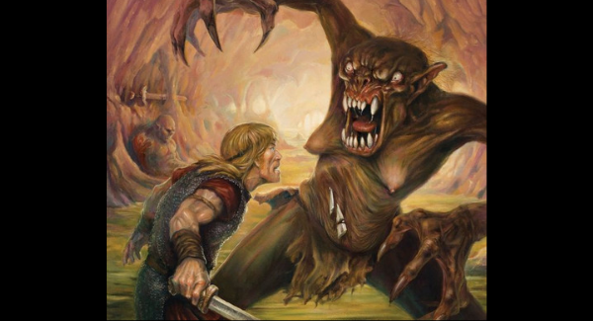
Beowulf
  Beowulf (Pronounced Bayo-wolf) is an epic hero of Anglo-Saxon England.
  Theirs was also a warrior culture, closely related to the Vikings (much like Greek and Roman cultures were related).
  Their values included strength, courage, loyalty, generosity, friendship, fame, and gold.
  Anglo-Saxon culture believed in not being able to escape one’s fate, being doomed to die, but needing to earn fame in battle before death so that one might live on in songs and tales.
  Beowulf is not a demi-god.
  His main power is strength, though he also seems to be a very talented swimmer.

Slide 7
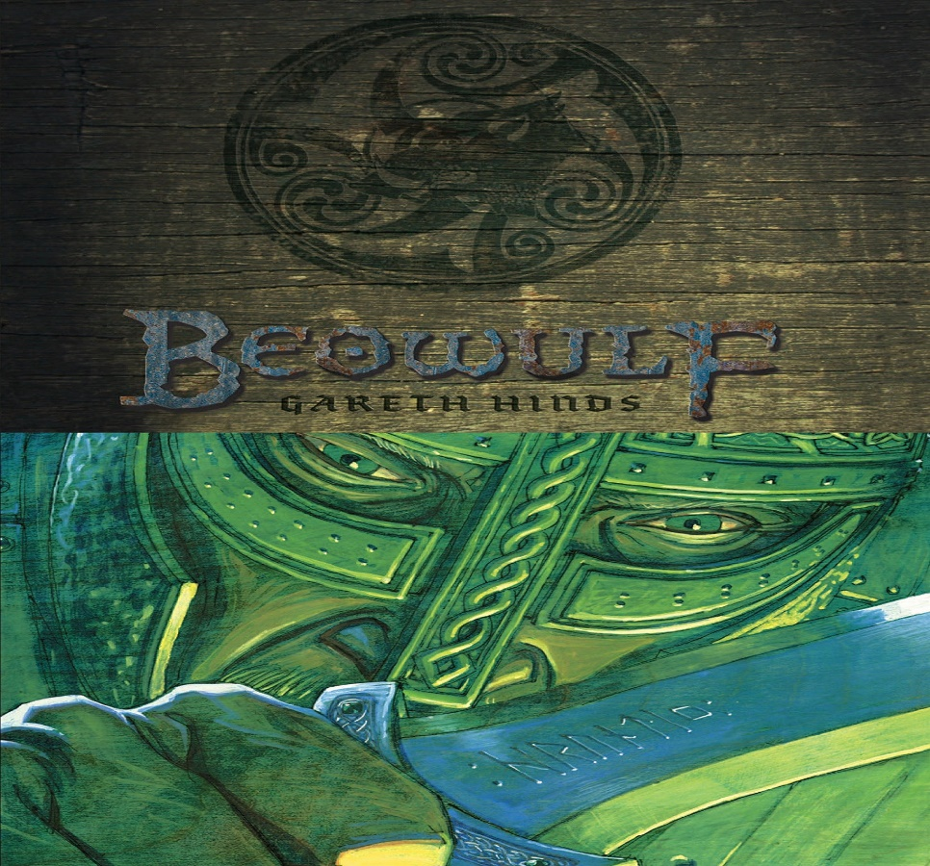
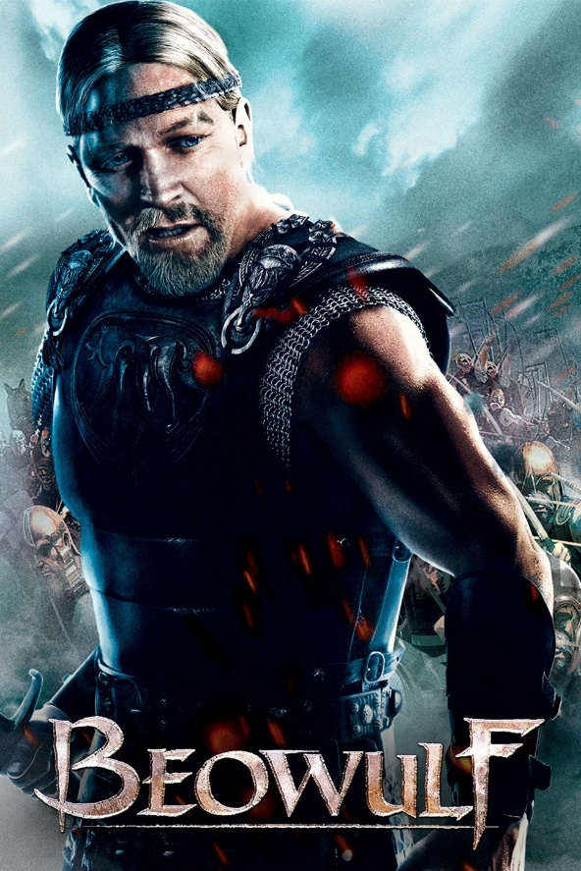
Modern Depictions of Beowulf
Comics and Graphic Novels
Films

Slide 8
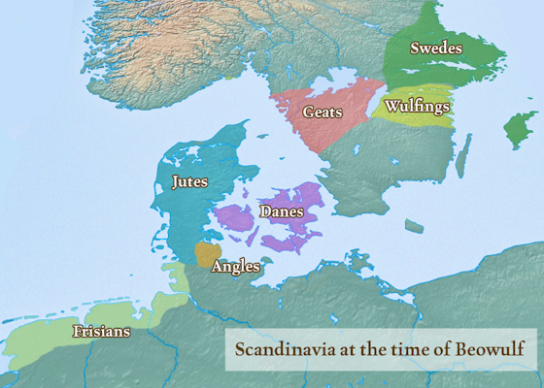
Beowulf – Plot and Character
Beowulf focuses on monster slaying, vengeance, fame, fate, death, and loss.
The Danes, a Viking clan famous for its success in battle, decides to build a mighty mead-hall to party and celebrate their victories.
The noise of their partying, and the Christian stories they tell, awake the anger of the local monster, Grendel.
Grendel kills and eats the Danes for years, and King Hrothgar and his men are unable to defeat him.
Then, along comes a warrior, Beowulf, from the neighboring clan of the Geats, to help them with their monster problem.
In time, Beowulf slays many monsters, and even becomes king in his own land. However, his problems never end, for there is always another monster to face.

