Slide 1
Historical Introduction to the Early Middle Ages
Based on Elements of Literature – Sixth Edition.

Slide 2
When English Literature Begins
British literature does not begin as early as literature from other regions of the world. The oldest civilization history classes discuss is typically Mesopotamia, Sumeria, the fertile crescent valley – some few thousand years BC. The world’s earliest great work of literature, The Epic of Gilgamesh, hails from Sumeria from about 2000 BC.
However, British literature “begins” closer to the Middle Ages (Roughly 500 – 1500 AD). As many changes occur in history, politics, religion, and literature across a thousand years, this period is often broken into two or three sections for the sake of study and conversation. We will examine it in two sections (and thus, two separate units): Unit I, The Early Middle Ages (410 – 1066 AD) and Unit 2 – The Later Middle Ages (1066 – 1500 AD)

Slide 3
Migrations, Invasions, and Missionaries
From ancient times to the end of the Early Middle Ages, many peoples have come to the British Isles, whether by migration, invasion, or missionary work.
Those peoples include (but may not be limited to) the following: the Iberians, the Celts, the Romans, Christian missionaries, the Anglo-Saxons, the Danes, and the Normans.
We will examine each of these, in turn, over the next few days.

Slide 4
The Iberians
The people of modern Britain, Ireland, Scotland, and Wales are the result of many, many peoples migrating into or conquering the British Isles over the years and intermingling with those already there.
Ruins suggest prehistoric settlers in the area as early as 11000 BC. Initially, as far as peoples for which we have a name are concerned, scholars believe the Iberians (from Spain, and before that, Greece) inhabited the British Isles, migrating there from Spain around 4000-5000 BC.
The Iberians have ties as far back as the ancient Greeks. Unfortunately, little is known about the Iberians’ presence in the British Isles, and what is known is mostly speculation.

Slide 5
The Celts
Eventually, through either conquest or slow migration (scholars still dispute which is the most accurate, though they increasingly lean toward the latter theory), the Celts come in from the mainland and occupy the British Isles around 500 BC.
Those Celts that inhabited Britain at this time were known as Britons -- the people from which Britain gets its name.
In their time, the Celts occupied not only the British Isles, but much of mainland Europe.
The migration of various Celtic tribes in order to flee wars meant that eventually they occupied Territory from the Iberian peninsula to Turkey.

Slide 6
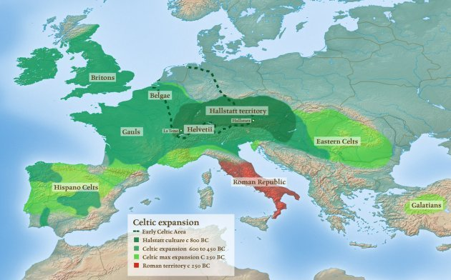
The Celtic Peoples

Slide 7
The Celts
Originally, the British Isles was home to the Celts.
One specific group of Celts were the Britons, from which the nation gets one of its names (Britain).
The following poem, “Marzhin Divinour,” is an example of the Breton language (and its modern English translation):
Marzhin, Marzhin, pelec'h it-hu Ken beure-se, gant ho ki du Bet on bet kas kaout an tu, Da gaout dre-man ar vi ruz Ar vi ruz eus an naer-vorek War lez an aod, toull ar garreg Mont a ran da glask d'ar flourenn Ar beler glas ha'n aour-yeoten Koulz hag uhel-varr an dervenn E-kreiz ar c'hoad, 'lez ar feunteun
Merlin, Merlin, where do you go With your black dog in the morning glow? Yoo, oo, yoo.
I have been searching for a mean To gain here the red egg marine,
Laid by the serpent of the sea, On the rocky shore or the reef.
I seek on the river's green slime Herb of gold and watercress vine.
And mistletoe, the oak entwine, Amidst the wood, near the fountain.

Slide 8
Celtic Culture
The Celts believed in animism, the belief in spirits in all aspects of nature, including rivers, trees, stones, ponds, fire, and thunder.
Their priests were called druids, who acted as intermediaries between the gods / spirits and people.
Their religious practices included such things as ritual dances and human sacrifices.

Slide 9
Celtic Myths and Legends
Many Celtic myths became the basis for literature in the Late Middle Ages, especially those of King Arthur.
Many legends emphasized female leaders:
Queen Maeve of Connacht
Battled over the ownership of a great white bull.
Queen Boedicea of the Britons
Rebelled against the Romans, who whipped her, killed her husband, and robbed him.

Slide 10
Celtic Myths and Legends
The Celts also believed in such creatures as:
Fairies – A large category for a variety of magical beings.
Leprechauns – Fairy beings generally concerned with shoe-making.
Banshees – pale lady-like fairy beings, sometimes beautiful and young, sometimes ugly and old, known for their loud high-pitched wails, or keening. Generally, an omen of death.
Dullahans – headless horsemen. Also omens of death.
Merrows – Fairy beings that live under water (i.e. mermaids and mermen).
Selkies – Beings that live as seals in the sea, but as humans on land, shedding their seal bodies like a coat and leaving it behind.

Slide 11
Celtic Creatures
Banshees
Dullahans

Slide 12
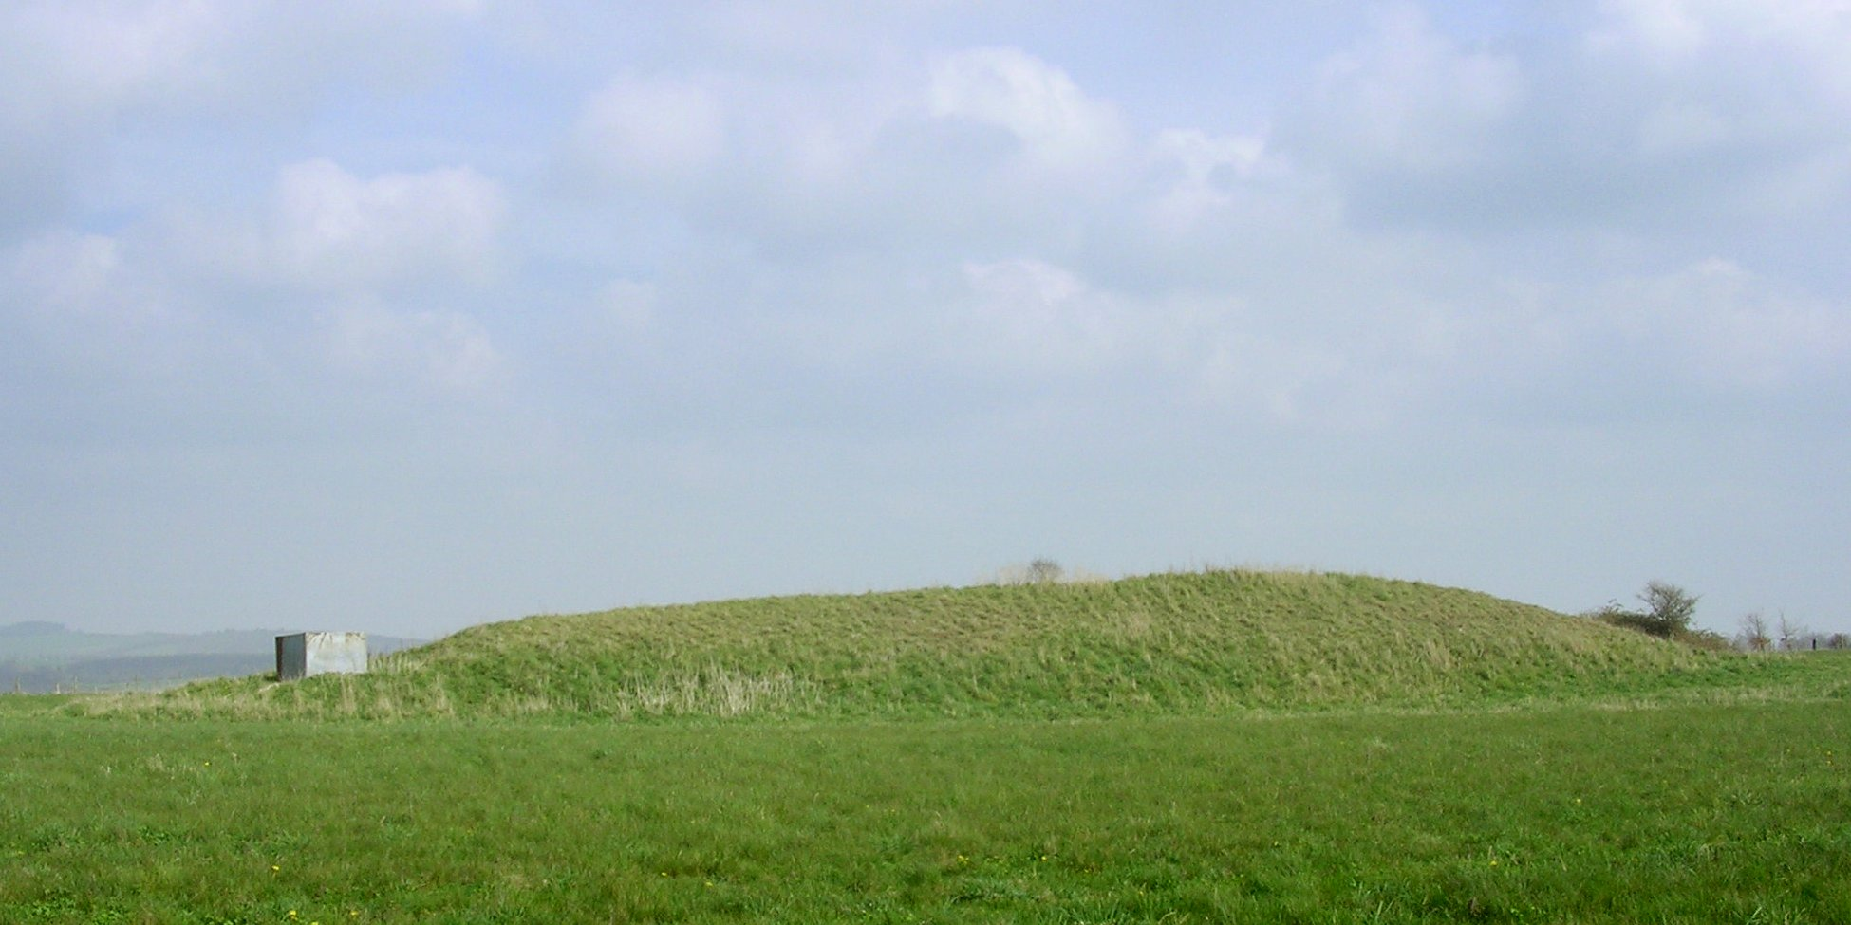
Celtic Burials
Celts used barrows - burial mounds - to bury the dead.

Slide 13
Standing Stones
The ancient Celts frequently used large standing stones, and they can be found throughout England and Ireland.
The official term for a standing stone is a menhir.
Sometimes they are found alone, sometimes in circles.
The most famous circle of standing stones is, of course, Stonehenge.

Slide 14
Stonehenge

Slide 15
Standing Stones in Popular Culture
The allure and mystery of the menhirs have given rise to Celtic-themed works of horror and fantasy in modern fiction, such as in the computer game Barrow Hill, centering around an archaeological dig that awakes the spirits of a stone circle. Therein, the protagonist is chased by a deadly stone sentry that wills victims to touch it and incinerate.
(45 min and 59:30 min)

Slide 16
The Romans
In 55 B.C., Julius Caesar invaded England.
The Romans stayed there for about 500 years.
While there, they did the following:
Built a network of roads.
Built Hadrian’s Wall (A defensive wall 73 miles long).
Introduced Christianity.
In 409 A.D., the Romans left due to troubles at home, leaving the Britons defenseless.
This left England open for invasion from various Germanic peoples from the mainland.

Slide 17
Hadrian’s Wall

Slide 18
Hadrian’s Wall

Slide 19
Celtic Culture and Roman Invasion
Many Celtic myths focus on rebellion against the overwhelming Roman forces:
King Arthur – In some myths, takes on all of Rome. In others, he takes on the Anglo-Saxons, instead.
Queen Boadicea – As mentioned previously, led a small rebellion against the Romans for murdering her husband. Her monument still stands in Britain.

Slide 20
Boedicea
In Roman History, Dio Cassius described Boedicea like this: “She was very tall, the glance of her eye most fierce; her voice harsh. A great mass of the reddest hair fell down to her hips. Around her neck was a large golden necklace, and she always wore a tunic of many colors over which she fastened a thick cloak with a broach. Her appearance was terrifying.”

Slide 21
The Anglo-Saxon Invasion
After the Romans left, England was without government, without military, without defenses.
Warrior peoples in mainland Europe saw this, and chose this time to invade.
These Germanic clans – the Angles, the Saxons, and the Jutes – invaded England, conquered, and stayed, driving some of its native peoples west and north, blending with others.
In time, they came to be known as simply the Anglo-Saxons.
Their language, Old English, is where modern English started.

Slide 22
Map of the Anglo-Saxon Invasion

Slide 23
The Danes
In time, the various Anglo-Saxon peoples united under a common king, King Alfred the Great, and a common faith, Christianity (brought over originally by the Romans, then later by Catholic monks and missionaries over the years).
Unified under these common banners, they stood a chance against the next group of invaders: The Danes.
The Danes were a clan of Vikings from (you guessed it) Denmark.

Slide 24
The Normans
For a time, the Anglo-Saxons held them off, defeating them in the Battle of Edington in 878 AD (Alfred the Great).
However, the Anglo-Saxons did not have much time to rest.
In time, the Normans invaded from France, conquering England in 1066 and thus capping off the Early Middle Ages (BBC).

Slide 25
To summarize…
Prehistoric Settlers | First inhabitants of the British Isles | Around 11000 BC
Iberians | Second inhabitants of the British Isles | Around 4000-5000 BC
Celts | Third inhabitants of the British Isles | Around 500 BC Onward.
Romans | The first group to invade the British Isles | 55 BC to 410 AD
Anglo-Saxons | The second group to invade the British Isles. | 410 AD to 1066 AD
Danes | The third group to invade the British Isles | ~700AD to ~900 AD
Normans | The fourth group to invade the British Isles | 1066AD Onward.

Slide 26
Anglo-Saxon Culture - Religion
Anglo-Saxon culture was very different from that of the Celts.
They believed many things in common with the Vikings, though under different names:
Anglo-Saxon Name | Viking Name | Role
Woden | Odin | Top god, god of death, poetry, and magic.
Thunor | Thor | God of thunder and lightning.
Tiw | Tyr | God of single-combat, victory, and heroic glory.

Slide 27
Anglo-Saxon Culture – Values and Virtues
The Anglo-Saxons valued the following virtues:
Strength
Bravery / courage
Loyalty
Generosity
Friendship
A character that embodies the values of a particular society is called an epic hero.
A long, narrative poem about such a hero is called an epic.

Slide 28
Anglo-Saxon Culture - Burial
Pyre Replica
Ship Pyre - Joke

Slide 29
Anglo-Saxon Burial
Barrows (Burial Mounds)
Kingdom of East Anglia

Slide 30
Anglo-Saxon Life – Kings and Thanes
Anglo-Saxon culture survived by observing a mutual bond of loyalty and protection between a king, his trusted warriors – thanes – and his people.
A king had to protect his people from animals, other tribes/clans, invaders, etc.
A king that could not protect his people, could not fulfill his duties as king.
Thanes were given armor, weapons, land, and gold in exchange for undying loyalty to the king, to fight for him, and to never leave the field of battle before him. They were often given rings to signify this office. Thus, they are sometimes referred to as ring-bearers (and kings, givers of rings).

Slide 31
Anglo-Saxon Literature – The Chronicle
King Alfred, aside from unifying the various Anglo-Saxon peoples under a banner of Christianity against the Viking invaders, formed a chronicle of his people’s writings and history so as to preserve them for future generations – The Anglo-Saxon Chronicle.

Slide 32
Anglo-Saxon Literature – The Bards
Bards, or scops, were both story-tellers and keepers of the afterlife.
As the Anglo-Saxons did not believe in an afterlife, warriors did great deeds so as to be remembered forever in song and tale.
The bards sang these tales and thus, the warriors “lived on.”
Fame became immortality. Bard-songs were more than just entertainment, but vital to many aspects of society.

Slide 33
Historical Jigsaw Activity
Now that we've introduced the various peoples of Early Medieval Britain, it's time to learn more about them.
All students should "break-out" into six groups of roughly-equal size.
Each group should choose a spokesperson to represent their group (a minor job -- all you'll be doing is getting the assigned reading and bringing it back to your group, as well as turning them back in at the end if the readings are hard copies).
The readings for this activity are as follows:
BBC -- Earliest Evidence of Humans in Ireland
A Brief History of Anglo-Saxon England
From Germania by Tacitus - Click specifically on Chapters 4, 6, 7, and 14
Slavery in Anglo-Saxon England
Celts - Ancient History Encyclopedia
History.com -- The Celts
Each group should read over the article together, discuss it, then summarize what the article’s about. Be prepared to present your summary to the class when we’re done. Once all summaries have been shared, place your summary (with everyone’s names on it) into the turn-in box.

Slide 34
Early Middle Ages - Literary Introduction
Before we begin, there are two terms you should know: prose and verse.
Prose is natural speech. Most of what we read, speak, and hear in our day-to-day lives is in prose.
Verse on the other hand, also known as poetry, is writing wherein special attention has been given to the sound and rhythm of the language.
Many genres of literature thrived during the Early Middle Ages in Britain, most (but not all) of which was written in verse, or poetry (as opposed to natural speech, or prose).

Slide 35
Early Middle Ages – Literary Introduction
In modern times, we sometimes assume that all poetry must rhyme.
However, rhyme is but one poetic device; in Early Medieval British poetry, some more popular devices were alliteration (the repetition of consonant sounds), kennings (descriptive two-or-three word names used in place of the actual name), and caesuras (a pause in the middle of the line, dividing it into two sections).
The popular poetic genres of the time included riddles, elegies, religious writings, war writings, folk tales, and epics.

Slide 36
Riddles
Riddles – “(from Old English roedel, from roedan meaning "to give council" or "to read"): A universal form of literature in which a puzzling question or a conundrum is presented to the reader. The reader is often challenged to solve this enigma, which requires ingenuity in discovering the hidden meaning” (“Literary Terms”). Riddles were very popular in Old English literature; many such riddles were preserved by Catholic monks in a book called The Exeter Book. Each of these riddles asks the same question: What am I?

Slide 37
Elegies
Elegies – A song or song-like poem that mourns the passing of a person, people, or even a whole way of life. These poems can be of any length, whether a short passage within a larger work, a poem a couple pages in length like “The Seafarer” (see the following passage), or even a full book-length poem, as is the case with Beowulf.

Slide 38
Religious Writings
Religious Writings -- Religion was a big part of people's daily lives in Early Medieval Europe. Without most modern technology or amenities (no binge-watching Netflix or all-day gaming sessions), many people's lives were consumed either with those tasks needed to survive or with religious activities and obligations. Thus, many of their writings and dramatic performances were religious in nature, -- some in prose, some in verse. Indeed, whatever one's personal views on the matter, one cannot fully understand Medieval European culture or literature without some attention to religion.

Slide 39
War Poems and Pseudo-History
War Poems / War Stories / Pseudo-history -- Many poems were written about wars, battles, and other historical events. Bear in mind, whether prose or verse, historical accounts from this time were not always entirely accurate, as we assume modern histories to be. Myths and tales were freely interwoven with historical facts, artistic license was often taken to make an event sound more interesting or poetic, and the "peer reviewing" that holds modern historians accountable did not necessarily exist. Some truths might be contained in these accounts, but exactly how much is difficult to say -- hence the term pseudo-history.

Slide 40
Folklore and Folktales
Folklore / Folktales – “Sayings, verbal compositions, stories, and social rituals passed along by word of mouth rather than written down in a text. Folklore includes superstitions; modern "urban legends"; proverbs; riddles; spells; nursery rhymes; songs; legends or lore about the weather, animals, and plants; jokes and anecdotes; rituals at births, deaths, marriages, and yearly celebrations; and traditional dance and plays performed during holidays or at communal gatherings” (“Literary Terms”).

Slide 41
Epics
Epic – “a poem that is
(a) a long narrative about a serious subject,
(b) told in an elevated style of language,
(c) focused on the exploits of a hero or demi-god who represents the cultural values of a race, nation, or religious group
(d) in which the hero's success or failure will determine the fate of that people or nation. Usually, the epic has
(e) a vast setting; it covers a wide geographic area,
(f) it contains superhuman feats of strength or military prowess, and gods or supernatural beings frequently take part in the action. The poem begins with
(g) the invocation of a muse to inspire the poet and,
(h) the narrative starts in medias res (in the middle).
(i) The epic contains long catalogs of heroes or important characters, focusing on highborn kings and great warriors rather than peasants and commoners” (“Literary Terms”). While not every epic fits every aspect of this definition, many of these criteria usually apply.
Our major reads for Unit I – The Early Middle Ages, Cuchulain of Muirthemne and Beowulf, are both epics. We’ll spend about a week and a half on each of these epics, studying them in-depth as well as comparing and contrasting their heroes and parent cultures.

Slide 42
Break-Out Session with Short Readings
Now that we've introduced and defined the popular forms of literature in Early Medieval Britain, it's time to read some examples.
All students should "break-out" into five groups of roughly-equal size.
Each group should choose a spokesperson to represent their group (a minor job -- all you'll be doing is getting the assigned reading and bringing it back to your group, as well as turning them back in at the end if the readings are hard copies).
The readings for this activity are as follows:
1 – The Exeter Book Riddles
2 – The Ruin
3 – The Seafarer
4 – Dream of the Rood
5 – Pangur Ban
Once time is called, each group will share what their reading was about, their thoughts and reactions, etc.

