Slide 1
Historical Introduction to the Later Middle Ages
Based on Elements of Literature – Sixth Edition

Slide 2
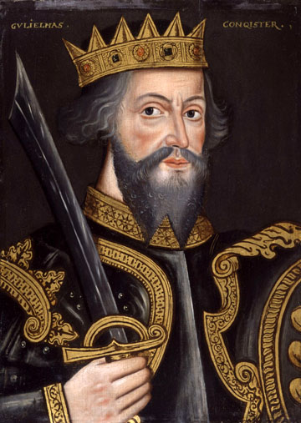
From 1066 to 1485
The Later Middle Ages begins with the invasion of the Normans (from Normandy, France) at the end of the Early Middle Ages.
Their armies were led by a man named William the Conqueror (i.e. William of Normandy, or William the B-word).
William felt he had a right to the throne of England for two reasons:
  The former king told him once, verbally.
  He is the illegitimate son of the cousin of the late king.
    In this context, illegitimate means born outside of marriage, hence the reason for one of his names.

Slide 3
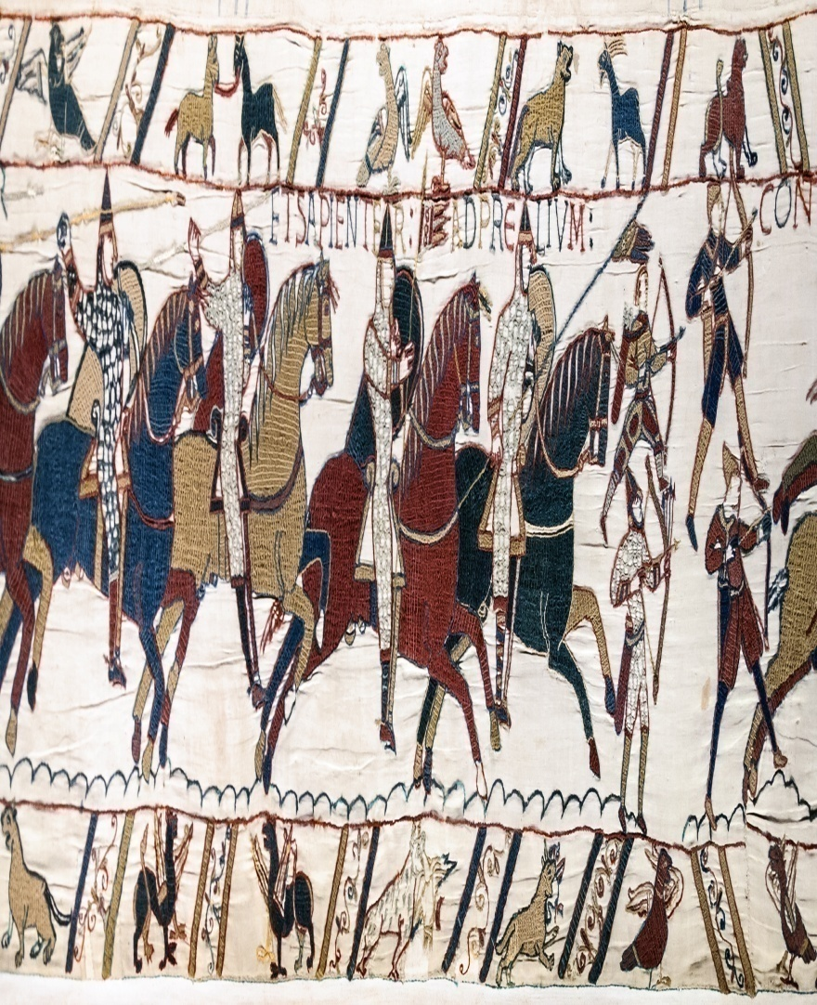
Resistance Is Feudal
When William of Normandy conquered England, he brought several aspects of French culture with him:
  The Feudal System
  The Concepts of Chivalry and Courtly Love
  More King Arthur legends to combine with those England already had.

Slide 4
The Feudal System
Unlike the warrior clans of the Anglo-Saxons, Feudalism is a rigid class system comprised of the king, lords, vassals, and serfs.
The king divides his land up to the lords, who rule in his stead.
The lords do the same with their land, dividing it up amongst their vassals.
In exchange, vassals must give their lords military service (as knights).
At the bottom of the social structure, serfs (or peasants) did most of the manual labor (growing crops, building structures, etc).
King
Lords
powerful
landowners
Vassals
did work or military
service for feudal lords in exchange for land
Serfs
servants to lords and vassals,
bound to their master’s land

Slide 5
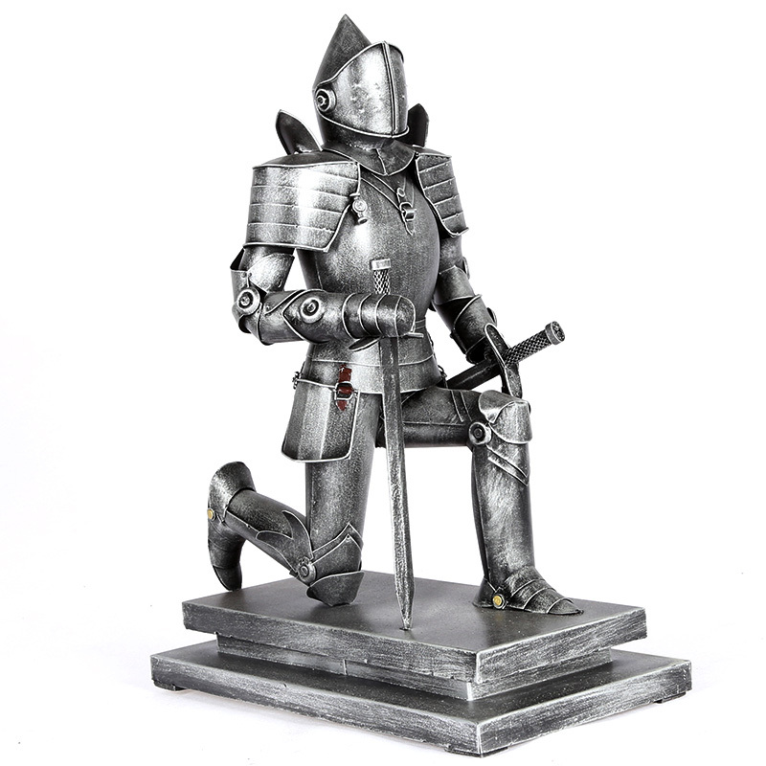
Knights and Armor
  provided military service to lords
  often the sons of nobles
  began training at an early age
  wore very heavy armor into battle (sometimes over 100 pounds of heavy plate metal, weapons, etc).
  followed a code
  of chivalry

Slide 6
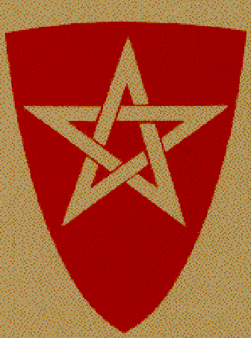
Chivalry
  A code of conduct that covered
  whom to defend—knight’s lord, the king, and the Christian faith
  how to treat a lady—
  courtly love
  how to help others
  how to resist the urge to run away if captured

Slide 7
Courtly Love
Knights also practiced a concept called courtly love.
Therein, knights would admire a noble lady in a completely pure and non-physical / non-romantic way.
  The knight
  adored the lady and was inspired by her
  glorified the lady in words
  The lady
  remained pure and out of reach
  was set above her admirer

Slide 8
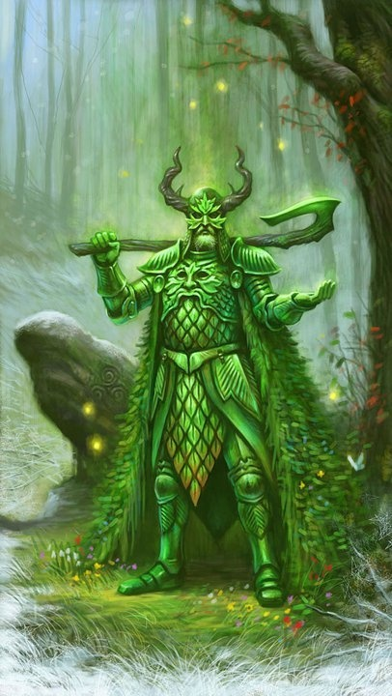
Medieval romance
One very popular genre of literature at this time is the medieval romance.
In a medieval romance, “romance” does not necessarily mean love.
Instead, medieval romances are stories of knights going on adventures, often to rescue a damsel, obtain a magical item, overcome evil, etc.
The romance hero is often born under mysterious circumstances, undergoes a rite of passage in his youth involving a magical weapon, takes advice from a wise old man, goes on a quest to overcome evil, and has both his skill in combat as well as his morals and principles tested.
Though the romance hero occasionally dies at the end of his story, sometimes this is purposefully left vague to suggest that he may return again, someday.
A romance hero must do more than the epic heroes – they must not only have their virtues, but must uphold the code of chivalry and, oftentimes, the guidelines of Christianity. This combination makes for several rules and values the romance hero must live up to.

Slide 9
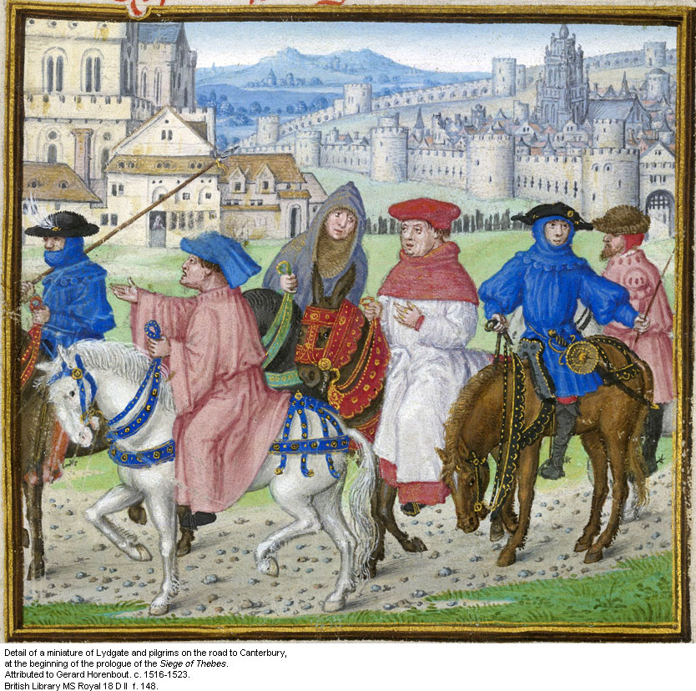
Frame Stories and Vignettes
Aside from medieval romances, another popular literary genre at the time is the frame story.
Frame stories are large stories that contain little stories.
The little stories are called vignettes.
The most famous frame-story writer in Britain, Geoffrey Chaucer, wrote a book called The Canterbury Tales, in which a group of travelers take a holy pilgrimage to Canterbury Cathedral, each telling stories to pass the time on their journey.

Slide 10
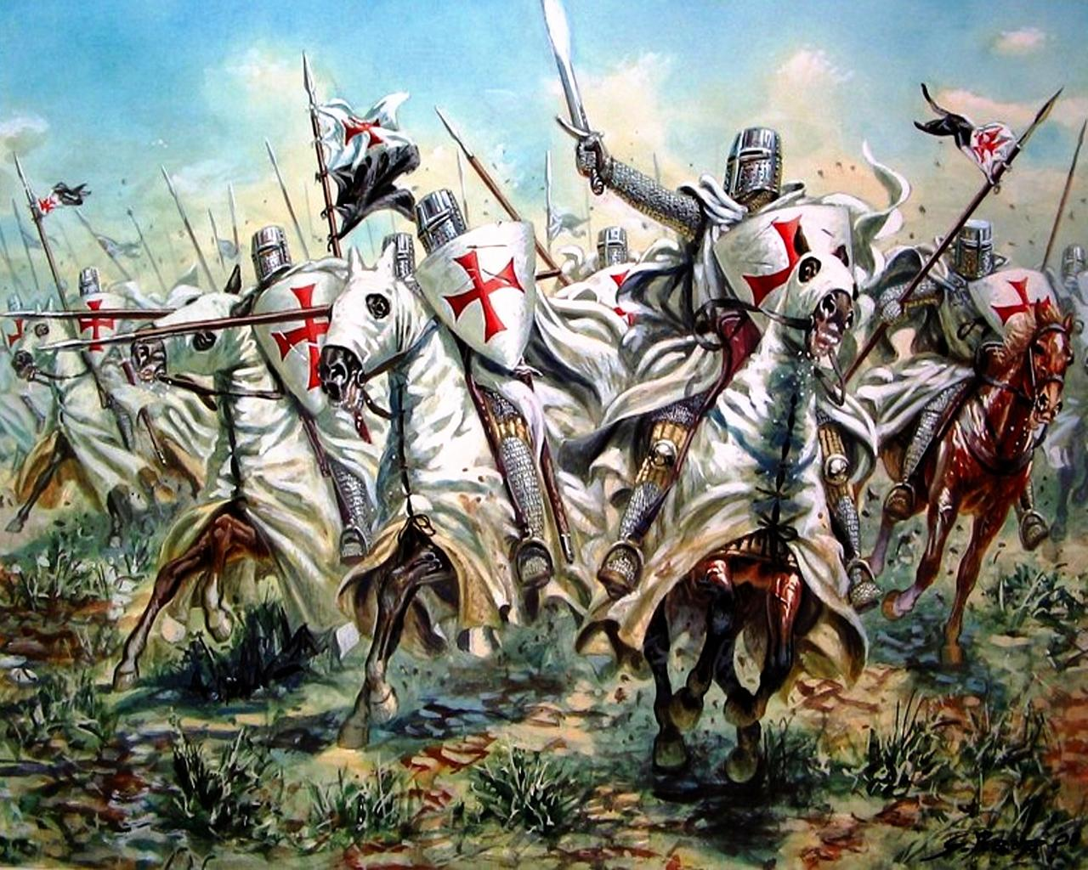
Misc. Important events
A variety of important religious and political events took place in the Later Middle Ages, including the following:
  The Assassination of Archbishop Thomas a Becket
  The Crusades (Christian knights attempting to reclaim the Holy Land)
  The Hundred Years’ War (between England and France)

Slide 11
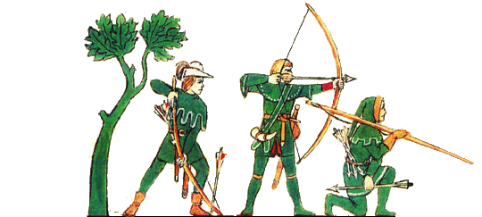
The Decline of Feudalism
Feudalism did not last forever. However, it’s downfall was not the result of one event, but several:
  The smithing of a universal coin system
  The use of long-bows, black-powder weapons, and canons, all of which could pierce knights’ armor.
  And finally, the Black Plague

Slide 12
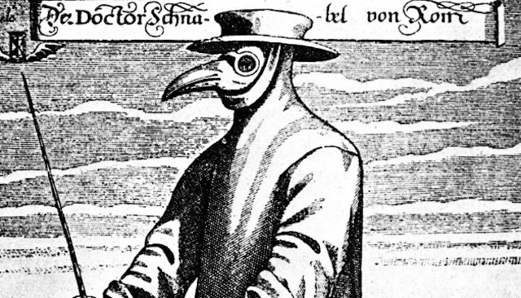
The Black Plague
Also known as the black death or bubonic plague, this disease swept across Europe in the Later Middle Ages, killing 1/3 of Britain.
Dominant theories suggest fleas on migrating rats were responsible for the spread of the disease.
However, a combination of bad hygiene, poor living conditions, and a very limited knowledge of medicine certainly didn’t help.
The following is a music video based on the Black Plague:
https://www.youtube.com/watch?v=rZy6XilXDZQ

Slide 13
Games!
The following link provides a game of knights and jousting:
http://www.tudorbritain.org/joust/index.asp
The following link provides an animated trivia game about the black plague:
http://www.sciencemuseum.org.uk/broughttolife/themes/diseases/black_death.aspx

